Slide 1
Panel 2
Detection and Analysis of Irregularities in Academic Testing
Panelists
Brian Jacob: University of Michigan
Carswell Whitehead: ETS
David Foster: Caveon Test Security
Melissa Fincher: Georgia Department of Education

Slide 2
Detection and Analysis of Irregularities in Academic Testing
Brian A. Jacob:
Walter H. Annenberg Professor of Education Policy & Professor of Economics
University of Michigan

Slide 3
My Focus
As an academic, I have limited familiarity with the practices and policies currently used by SEAs and LEAs
The lessons I will share come from “theory” and from experience working with several large urban districts
My remarks will focus on:
  Teacher and/or administrator cheating as opposed to student cheating, or other illicit testing activities
  Statistical analyses that one can use to detect such manipulation

Slide 4
The Role of Statistical Analysis in Detecting Testing Irregularity
Benefits of statistical analysis
  Relatively low cost
  Covers the entire population
  Provides a measure of the “extent” of the irregularity – e.g., likelihood it would have occurred by chance
  Can identify systemic patterns as well as individual cases of concern
Limits of statistical analysis
  Like preliminary screens for rare diseases, statistical analyses to detect cheating can have a high rate of false positives and false negatives
    Critical to complement statistical analyses with other methods
  Can never identify the individual responsible for the manipulation

Slide 5
Statistical Approaches to Detecting Testing Irregularities
Erasure Analysis
  Common metric is the average number of wrong-to-right erasures in a classroom
Item-Response Analysis
  Looking for unusually common response patterns across students in the same class
Test Score Analysis
  Looking for unusually large gains in one year (often followed by relative declines in the subsequent year)
  Unexpected jumps in the distribution of test scores

Slide 6
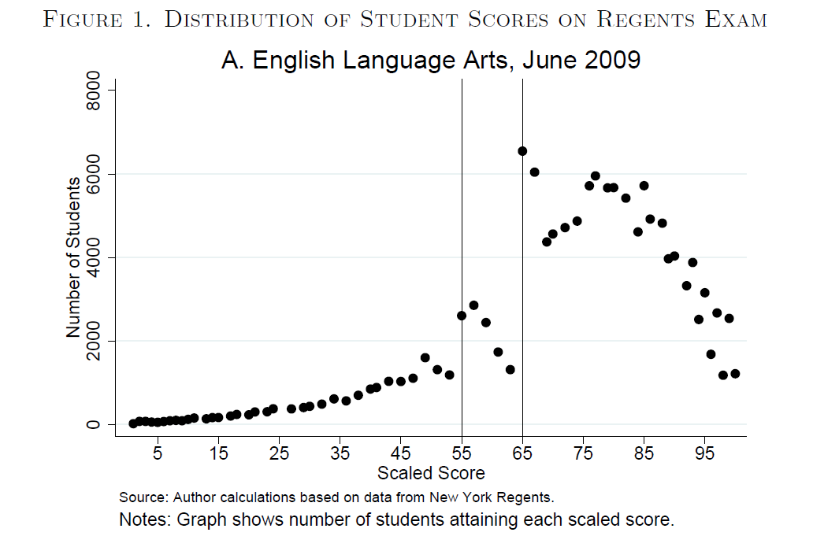
Identifying Irregularities at the Population Level
Source: Dee, Jacob and McCrary (2010)

Slide 7
Using item-response and test-score patterns to identify irregularities
Source: Jacob and Levitt (2003)

Slide 8
Using item-response and test-score patterns to identify irregularities
Source: Jacob and Levitt (2003)

Slide 9
Using item-response and test-score patterns to identify irregularities
Source: Jacob and Levitt (2003)

Slide 10
Distinguishing Testing Irregularities from Illegal Manipulation
A Testing Irregularity Does NOT Necessarily Imply Cheating
  Frequent erasures may be more common among certain students than others, and some teachers may have taught their children legitimate test-taking strategies that result in frequent WTR erasures.
  Commonality of item-response patterns across students within the same class might be due to the curricular or instructional focus of the teacher.
  Large test score gains could result from extremely effective teaching, which would be the last thing one would want to discourage.
Statistical analyses will almost always result in at least some false positives and some false negatives
  Critical to complement statistical analyses with other methods of detection and analysis

Slide 11
Best Practices for Statistical Analysis
Account for student and/or school characteristics that may be associated with erasures or unusual test score patterns
  If cheating is widespread, it may be difficult to identify a comparison group
Use metrics that are robust to outliers, such as the median
  Test the sensitivity of results to the exclusion of one or two students from the classroom
Utilize multiple approaches when possible
Conduct selective retest audit
  Retest students in suspected classrooms along with a sample of randomly chosen classrooms
Conduct in-depth “qualitative” investigation of suspected individuals

Slide 12
Practical Challenges of
Statistical Analysis
State/district capacity
  Analyzing data in real time to permit quick response (e.g., audit)
Data sharing between test vendors, state agencies and local districts
  Costs, FERPA
Statistical fluency of intended audience
  Translation to common parlance is essential

Slide 13
Thank You

Slide 14
Detection and Analysis of Irregularities in Academic Testing
Carswell Whitehead:
Director, Office of Testing Integrity
Educational Testing Service

Slide 15

The Detection Process
All high stakes tests are subject to test takers and professionals who will seek to gain or provide an unfair advantage.
To protect against test compromise, processes must be built into the testing plan to detect irregularities.
The detection plan should include procedures to detect irregularities that occur prior to the test, during the test and after the test.

Slide 16
Pre-administration-Test Material Security
Early detection of test security breaches is essential to the containment of widespread test compromise.
A good test security plan should include an audit process to detect test tampering by students and professionals before the test is administered.
The audit should occur before the test day or on the morning of the test.
All test materials should be individually inventoried to inspect for missing test books or signs of test reproduction.
School officials should be notified immediately of any detected irregularity.
An unannounced audit is usually the most effective method to detect test material irregularities.

Slide 17
Test Administration: Proctoring
Active proctoring is the key to detecting test day irregularities.
The proctor should:
Check identification
Monitor the room for wandering eyes
Ensure students are working on the correct section of the test
Check for unauthorized aids
Document any unauthorized test material access or unusual behavior by school personnel
Inspect the answer sheet to check for impersonation or switching of answer sheets

Slide 18
Post-administration: Scoring Process
The security plan should include post analytics to check for irregularities, such as
Unusual erasures
Handwriting or gridding similarities
Essay similarities
Unusual answer patterns
Inconsistent performance
Test completion timing irregularity (computer-based testing)
Large score difference or spike in the mean test score

Slide 19
Interpretation of Data
The test security plan should have established guidelines to assist with the decision making process
Use detected irregularities as flags
Tips for analyzing the data

Slide 20
Conclusion
Do these detection practices work? Yes!
Proven to be effective at:
Containing test compromise
Providing evidence to cancel invalid test scores
Mitigating further risk
Helping to refine procedures

Slide 21
Thank You

Slide 22
Detecting Security Breaches for High-Stakes Educational Testing
David F. Foster:
Kryterion, Inc.
Caveon Test Security

Slide 23
What Are We Looking For?
Actual breach or potential breach (threat)
The good news: There are only two types
  Cheating: inappropriate attempts to increase scores
  Theft: stealing test content for gain
The bad news: There are hundreds of ways to cheat and steal

Slide 24
Typical Security Threats in Education
Cheating
  Teacher tampering with answer sheets
  Teacher “helping” students during the test
  Teacher “prepping” students before the test
  Teacher having certain students remain at home during test days
  Student cheating on tests using pre-knowledge, assistance, cheat sheets or other methods
Theft
  Teacher or student stealing booklets
  Teacher or student recording questions

Slide 25
Seven Detection Principles
Focus…concentrate on high-risk threats first
Adapt…match detection methods to the threat
Backup…use layers of detection methods
Predict…watch out for new threats
Filter…rule out other explanations
Evaluate…use detection to evaluate security
Plan…set up to succeed

Slide 26

Focus… concentrate on high-risk threats first
Risk of a threat is determined by a combination of factors
  likelihood
  immediacy
  amount of potential damage
  hard to prevent
  hard to detect and mitigate
  vulnerabilities
Example: One teacher cheating brings greater risk than one student cheating

Slide 27


Adapt… match detection methods to the threat
Threats vary depending on circumstances
  Grade levels
  Content area
  Delivery mode
  Testing history
  Motivation
Example: Threats at 3rd grade and threats at 11th grade require different detection methods
We often use the wrong tool for the job

Slide 28

Backup… use layers of detection methods
Use several layers of detection methods
  Forensic statistical analysis
  Continuous observation
  Tip line
  Web monitoring
Example: A teacher cheating can be detected by all of these methods

Slide 29




Predict… watch out for new threats
New threats come along every day
  Changing stakes: New motivations to cheat or steal
  New technologies make cheating and theft less detectable
  Creativity of cheaters and thieves is always high
Example: Undetectable “spy” cameras are here
Lens

Slide 30
Filter… rule out other explanations
Fairness. Detection methods do not always eliminate alternative explanations.
Efficiency. It’s important not to spend resources in the wrong direction.
Example: An apparent statistical detection of cheating may simply be several students answering C to every multiple choice question.
Testing Irregularities
Actual Cheating

Slide 31
Evaluate… use detection to evaluate security
Detection methods allow evaluation of security methods
Example: Effectiveness of a state’s new security methods seen in forensic analysis
Notes:
Mississippi invalidated questionable test scores.

Slide 32
Plan… set up to succeed
Set up to detect specific threats
Improve sensitivity and capability of detection methods
Example: Inserting Trojan Horse items into exams detects students who use stolen test questions and answer key
Trojan Horse items are purposefully mis-keyed items inserted into an exam

Slide 33
Detection: Grade 3 Exam
High Risk: Teacher tampering with answer sheets after the test
  Direct: Physically observe teacher from gathering the answer sheets until handing them off
  Indirect: Statistical forensics
    Unusually high rate of wrong-to-right erasures
    Unexpected score gains
  Indirect: Begin a tip line

Slide 34
Detection: Grade 11 Exam
High Risk: Student cheating by copying from another
  Direct: Trained proctor/teacher vigilantly observes student during the exam
  Indirect: Statistical forensics
    Similarity and collusion analyses
    Aberrant responding analysis
  Indirect: Begin a tip line

Slide 35
Thank You

Slide 36
Detection of Testing Irregularities: Use of Forensic Analyses
Melissa Fincher:
Georgia Department of Education

Slide 37
Georgia: Broad Commitment
Multiple agencies involved:
  Georgia Department of Education
    Development, administration, scoring & reporting of state tests – including security protocols and procedures
  Office of Student Achievement
    Statutorily charged with audit function
  Governor’s Office
    Appointed special investigators
  Professional Standards Commission
    Educator ethics division and standards
    Educator licensing agency

Slide 38
Up-front Considerations
Understand the types of analyses available and what information they contribute
  Ensure assessment data structures can support the analyses needed/desired
    Assessment design
    Test examiner captured?
  No single analysis or combination of analyses is definitive
    Additional investigation will be required

Slide 39
Up-front Considerations
Understand the types of analyses available and what they can contribute, continued…
  Have a clear rationale for flagging criteria
    At what level will flagging occur?
    Be clear about what you’re flagging: data anomalies
    Flagging criteria can be helpful with interpretation
  Ensure contractor has sufficient quality control mechanisms
  Plan for independent replication/verification of analyses
    Expect to be challenged

Slide 40
Planning is Key
To the extent possible, keep things simple, straightforward, and consistent
  Districts and schools will need support in understanding and interpreting data
  Open and comprehensive communication is essential
  Expect things to “ramp-up” very quickly
  Be very clear about what data will be shared and what data cannot be shared

Slide 41
Planning is Key
Have a clear plan for next steps
  Most likely follow-up investigations will be needed
    Who will conduct?
    If districts, support will be needed
      Chain of custody is critical but should not be sole focus
  Assessment policies should address records retention as this will help with follow-up investigations
    Who administered?
    Who proctored?
    Who had possession of secure materials and for how long?
    Who else had access?
    Etc…

Slide 42
Planning is Key
  What changes in test procedures, if any, will take place in next administration?
    Georgia required rotation of teachers
    State monitors placed in schools
      Observed test environment
      Secured answer documents at conclusion of testing each day
      Note: Selection and training of monitors is essential
  If inappropriate behavior is found,
    What support will be provided to students who received inaccurate scores?
    How will accountability determinations be adjusted?
    What other programs/decisions are impacted?

Slide 43
Planning is Key
  Consider capacity at all levels
    School • District
    State • Contractor
  Consider the timing of the reports and investigations
    Most likely scores will have been reported
    Consider domino effect – who will need to be notified of substantiated data inaccuracies
  Keep detailed records of all steps followed
Think and plan as comprehensively as you can

Slide 44
This is a process…
Use the results of the investigation to review test administration policies and procedures
  Adjust as warranted
Be prepared to support further investigations as legal authorities and credentialing agencies follow-up on findings

