Slide 1
Service and Emotional Support Animals in the Workplace
Linda Carter Batiste, J.D., Principal Consultant
Melanie Whetzel, M.A., CBIS, Lead Consultant, Cognitive/Neurological Team

Slide 2
Service Animals
Service and Emotional Support Animals under the ADA:
Title I: Employment
No mention or definition
Title II: State and local government
Specific definition of service animal, excludes emotional support animals
Title III: Public accommodations
Specific definition of service animal, excludes emotional support animals

Slide 3
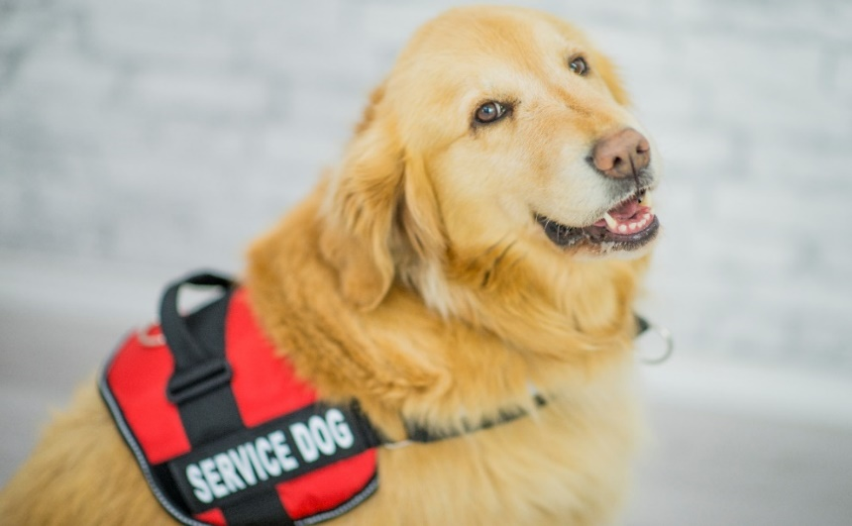
Service Animals
Service and Emotional Support Animals under Title I of the ADA:
Process as a request for a reasonable accommodation
Consider modifying a no-animals policy
Check state law

Slide 4
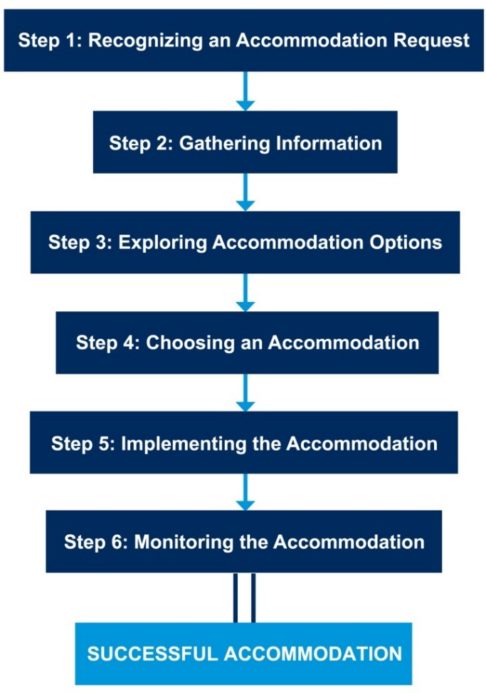
Service Animals
Service Animals and the ADA Process:

Slide 5
Service Animals
Step 1: Recognizing a Request

Slide 6
Service Animals
Step 1: Recognizing a Request
Situation:
An applicant shows up with her service animal for a job interview. The employer refuses to conduct the interview because the applicant did not notify them ahead of time.
Is this a good approach?

Slide 7
Service Animals
ADA
Employers do not have to automatically allow service animals in the workplace and can go through the accommodation process before considering.
Best Practice
Consider going ahead with the interview.

Slide 8
Service Animals
Step 1: Recognizing a Request
Situation:
An employee mentions to her supervisor that it might help her with her anxiety if she could bring her dog to work. The supervisor says there is a no-animal policy and that a coworker has animal allergies and doesn’t discuss it further.
Is this a good approach?

Slide 9
Service Animals
ADA
When an employee mentions that something is needed because of a medical condition, treat it as an accommodation request.
Best Practice
Go through the process, try to accommodate both employees.

Slide 10
Service Animals
Step 2: Gathering Information

Slide 11
Service Animals
Step 2: Gathering Information
Situation:
An employee asks to bring his seizure alert dog to work. The employer asks for the dog’s certification, vet records, and proof of insurance.
Is this a good approach?

Slide 12
Service Animals
ADA
It’s not clear what information employers can ask for related to a service animal.
Best Practice
Consider why you need the information and only ask for what is necessary.

Slide 13
Service Animals
Step 2: Gathering Information
Situation:
After an employee with depression requests to bring an emotional support dog to work, the employer asks for medical documentation to support the request.
Is this a good approach?

Slide 14
Service Animals
ADA
Employers can request medical documentation to prove disability and need for accommodation when not obvious.
Best Practice
Related to the animal itself, consider:
Non-medical documentation
A demonstration

Slide 15
Service Animals
Step 3: Exploring Accommodations

Slide 16
Service Animals
Step 3: Exploring Accommodations
Situation:
An employee who is deaf asks to bring his service animal to work to help alert him to sounds in his environment. The employer wants to know if there is technology available that would work instead.
Is this a good approach?

Slide 17
Service Animals
ADA
Employers get to explore whether other accommodations might be effective.
Best Practice
Remember that service animals often meet non-work-related, personal needs.

Slide 18
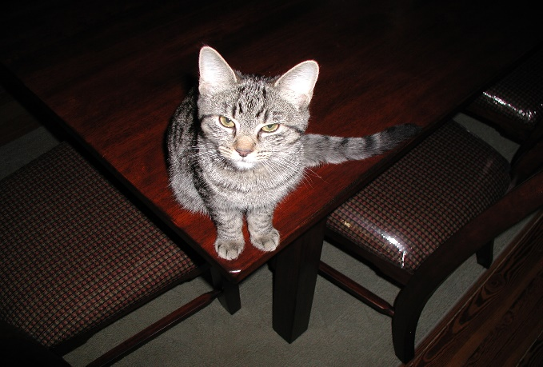
Service Animals
Step 3: Exploring Accommodations
Situation:
An employee asks to bring an emotional support animal to work. When the employer tries to discuss whether there might be other options, the employee refuses to discuss other options. The employer denies the request.
Is this a good approach?

Slide 19
Service Animals
ADA
Employees have a duty to cooperate in the interactive process.
Best Practice
Try to find out why the employee doesn’t want to discuss options.

Slide 20
Service Animals
Step 4: Choosing an Accommodation

Slide 21
Service Animals
Step 4: Choosing an Accommodation
Situation:
An employee with diabetes asks to bring his service animal to work to notify him when his blood sugar drops. The employer decides that the employee should use a glucose monitor instead.
Is this a good approach?

Slide 22
Service Animals
ADA
Employers get to choose among effective accommodations, but do not get to choose medical treatment.
Best Practice
It’s generally best not to even suggest alternative medical treatment.

Slide 23
Service Animals
Step 4: Choosing an Accommodation
Situation:
An employee has been having emotional outbursts at work and asks to bring an emotional support animal to work. The employer is not able to determine whether this will be an effective accommodation, can’t come up with alternatives, so stops there.
Is this a good approach?

Slide 24
Service Animals
ADA
Employers do not have to consider ineffective accommodations.
Best Practice
Consider a trial period when not certain.

Slide 25
Service Animals
Step 5: Implementing the Accommodation

Slide 26
Service Animals
Step 5: Implementing the Accommodation
Situation:
An employer approves an employee’s request to bring a seeing eye dog to work and lets the employee know that a notice will be sent to other employees, so they’ll know not to interfere with dog’s work.
Is this a good approach?

Slide 27
Service Animals
ADA
Employers must keep all medical information confidential including the fact that an employee is receiving an accommodation.
Best Practice
Talk with the employee about voluntarily educating coworkers.

Slide 28
Service Animals
Step 5: Implementing the Accommodation
Situation:
An employee with bipolar disorder is allowed to bring her emotional support animal to work, then requests to modify her break schedule so she can take the dog out for breaks. The employer denies the request because it’s for the dog, not the employee.
Is this a good approach?

Slide 29
Service Animals
ADA
Employees are responsible for caring for their service or emotional support animals, but employers may need to provide accommodations to enable them to do so.
Best Practice
During the interactive process, ask the employee if any accommodations are needed related to caring for the animal while at work.

Slide 30
Service Animals
Step 6: Maintaining the Accommodation

Slide 31
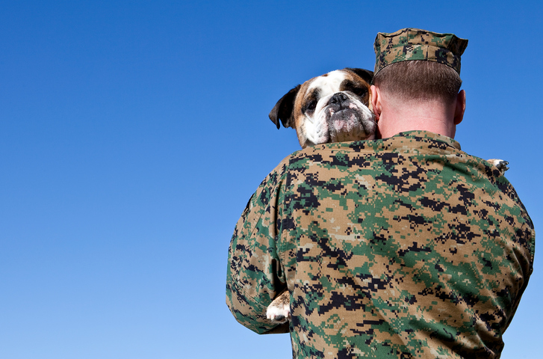
Service Animals
Step 6: Maintaining the Accommodation
Situation:
An employee asks for leave because his service animal is sick. The employer denies the request because the employee isn’t sick.
Is this a good approach?

Slide 32
Service Animals
ADA
Employers only have to provide accommodations that are needed because of an employee’s disability.
Best Practice
Consider whether the leave might be covered under existing policies.
Consider that the employee may not be able to work without the service animal.

Slide 33
Service Animals
Step 6: Maintaining the Accommodation
Situation:
An employee with PTSD has used a service animal at work for several months when a coworker reports that the animal growled at him. The employer asks the employee to remove the service animal and not bring it back into the workplace.
Is this a good approach?

Slide 34
Service Animals
ADA
Employers do not have to allow a service animal that is aggressive or out of control.
Best Practice
Talk with the employee first before deciding what to do.

Slide 35
Service Animals
Other Issues:
Service Animals in Training
Restricted Areas
Breed Exclusions
On the Job Travel
JAN’s Service Animals Page: https://AskJAN.org/topics/servanim.cfm

Slide 36
Service Animals
Service Animals in Training
Situation:
An employee is in the final stages of getting a trained service animal. As part of the final steps, the employee needs to bring the service animal into the workplace for orientation and training. The employer denies the request because the service animal isn’t fully trained.
Is this a good approach?

Slide 37
Service Animals
ADA
The ADA does not address service animals in the workplace so does not address whether employers must consider allowing a service animal in training.
Best Practice
Consider allowing the service animal if it is not disruptive.

Slide 38
Service Animals
Restricted Areas
Situation:
A dish washer in a restaurant asks to be allowed to have his emotional support animal lay near him while he works. The employer denies the request because animals are not allowed in food prep areas and the food prep area is close by.
Is this a good approach?

Slide 39
Service Animals
ADA
Employers do not have to violate other federal laws when providing accommodations under the ADA.
Best Practice
Try to determine whether you can comply with both laws. FDA Food Code states that service animals may be permitted in areas not
used for food preparation.

Slide 40
Service Animals
Breed Exclusions
Situation:
An employee wants to bring a small emotional support dog to work. The employer denies the request, stating that small dogs tend to bark and nip a lot.
Is this a good approach?

Slide 41
Service Animals
ADA
Employers can deny an accommodation that is disruptive or otherwise creates an undue hardship.
Best Practice
Approach on a case-by-case basis. Don’t make assumptions. Service Dog Breed Exclusions and the ADA at https://AskJAN.org/articles/Service-Dog-Breed-Exclusions-and-the-ADA.cfm

Slide 42
Service Animals
On the Job Travel
Situation:
An employee who uses a service dog must fly to a business meeting and asks the employer to pay any added costs. The employer refuses, stating that the employee is responsible.
Is this a good approach?

Slide 43
Service Animals
ADA
While employees are responsible for caring for their service animals, employers are responsible for any added costs resulting from on-the-job travel.
Best Practice
Pay for added travel costs related to taking a service animal on a business trip
unless undue hardship.

Slide 44
Contact
(800)526-7234 (V) & (877)781-9403 (TTY)
AskJAN.org & jan@AskJAN.org
https://AskJAN.org/topics/servanim.cfm

