Slide 1

Department of Defense
Military Family Readiness Council
An Independent Federal Advisory Council
Sponsored by USD(P&R). Supported by ASD(M&RA).
March 6, 2018 Meeting

Slide 2
Table of Contents, Slide 1 of 6
Agenda pg.7
Welcome and Introductions pg.8
Opening Remarks pg.9
Meeting Guidance pg.10
Roles and Mission pg.11
How to Contact the Military Family Readiness Council pg.12
Summary of Public Submissions pg.13
FY17 Recommendations: Status Updates pg.14
Panel Introductions pg.15-17
Interstate Compact for Educational Opportunity for Military Children pg.18
  Military Interstate Children’s Compact pg.19
  How and When the Military Interstate Children’s Compact Can Help pg. 20
  Military Interstate Children’s Compact Implementation and Oversight pg. 21
  DoD Role in Military Interstate Children’s Compact pg. 22
  Challenges and Successes pg.23-25

Slide 3
Table of Contents, Slide 2 of 6
  Contact Information pg.26
  Relevant Resources pg.27
MC&FP Office of Special Needs and Child and Youth Programs pg.28
  About OSN pg.29-30
Blended Retirement System pg.31
  The Military Retirement Benefit pg.32
  Blended Retirement System Basics pg.33
  BRS Resources pg.34
  Social Media Outreach pg.35
  Spouse infographics pg.36
  Questions pg.37
Status Update: Discussion Period pg.38
MFRC Panel: Child and Youth Well-being pg.39
New Parent Support Program pg.40
  About NPSP pg.41-43
  NPSP Goals pg.44

Slide 4
Table of Contents, Slide 3 of 6
  Protective Factors pg.45
  Parental Support pg.46
  NPSP Collaboration pg.47
  Drivers for Collaboration pg.48
Child Development Programs pg.49
  About Child Development Programs (CDPs) (pg.50)
  Improving Access to Care pg.51
  Youth Programs pg.52
JBLM Cares pg.53
  Background pg.54
  Home, School, Medical and Community Collaboration pg.55
  Cares Vision pg.56-57
  Services Offered pg.58
  JBLM Cares Improves Readiness! pg.59
  Your Military Base Cares pg.60

Slide 5
Table of Contents, Slide 4 of 6
Telemedicine & Telemental Health in TRICARE pg.61
  Telemedicine Policy pg.62
  Using Telemedicine in TRICARE pg.63
Boys & Girls Clubs of America (BGCA) – Service to Military
Connected Youth & Families pg.64
  BGCA: Our Mission pg.65
  BGCA: HISTORIC PARTNERSHIP WITH THE ARMED SERVICES (27 Years) pg.66
  Service Delivery Model – Military Youth & Families pg.67
  Partnerships: Background on Partnerships pg.68
  Outreach to Military Connected Families pg.69
  BGCA Contact pg. 70
Project Arête pg.71
  Bottom Line up Front pg.72
  What is Character? pg.73
  How does Character Develop? pg.74-75
  Collaboration with West Point pg.76

Slide 6
Table of Contents, Slide 5 of 6
  Initial Findings pg.77
  4 Key Components of Character pg.78
  Developing Leaders of Character pg.79
  Thank You pg.80
Child and Youth Well-being Discussion Period pg.81
Military Spouse License Portability pg.82
  Study Findings pg.83
  2018 Spouse Licensure Initiatives pg.84
  Recognized Compacts pg.85
Teacher Licensure Portability pg.86-89
Physical Therapy Licensure Compact pg.90
  PT Compact pg.91
  Status of Compact Adoption pg.92
  PT Compact Definitions pg.93-94

Slide 7
Table of Contents, Slide 6 of 6
  Compact Benefits pg.95
  Benefit to Military Families: Choice of Home State pg.96
  Contact pg.97
They Also Serve pg.98
  The Why pg.99
  The How pg.100
  My Strategy pg.101
Spouse Licensure Portability Panel Discussion Period pg.102
Closing Remarks and Plans for Next MFRC Meeting pg.103

Slide 8
Agenda
Meeting Called to Order
Opening Remarks - MFRC Chair
Administrative Remarks & Review of Written Submissions
-- MFRC Overview and Meeting Guidance
-- Executive Summary of Written Public Submissions
Council Business-- Status Updates on Three FY17 Recommendations
-- Focus Area 1: Child and Youth Well-Being
-- Focus Area 2: Spouse Licensure Portability
Two Question & Answer Periods
Closing Remarks
End of Year Meeting - 6 Jun 2018 (Voting: FY18 SECDEF Recommendations)

Slide 9
Welcome and Introductions
MFRC Chair
MFRC Alternate Chair
Council Members
12 Attending Today
5 Representatives
1 Position Vacant
Mr. Robert Wilkes, USD(P&R)
Ms. Stephanie Barna, Acting ASD(M&RA)
MFRC Council Support Team
Dr. Randy Eltringham
Designated Federal Officer (DFO)
Mr. Bill Story
Alternate DFO
Ms. Melody McDonald
Mr. Frank Emery
Mr. Eddy Mentzer

Slide 10
Opening Remarks
MFRC Chair

Slide 11
Meeting Guidance
The MFRC Council is a congressionally mandated, non-discretionary Federal Advisory Committee that provides independent advice and recommendations to the Secretary of Defense.
  MFRC must follow guidelines established by the Federal Advisory Committee Act (FACA) of 1972 and DoDI 5105.04, Department of Defense Federal Advisory Committee Management Program, August 6, 2007.
  The public is invited to provide written statements for review and consideration at any time and prior to
  each meeting.
  MFRC documents are available for review on the MFRC webpage.
Council membership is set by law [10 U.S.C. § 1781a(b), as amended].
MFRC has 18 members. Only members may deliberate and vote.
  A formal motion must be made to bring an issue to a vote.
3. Advisors , representatives of Council members, and others may provide information
or offer views during Council meetings if called upon by the MFRC Chair.
  MFRC meetings are open to the public.
  Meetings are not Town Hall meetings unless specifically announced as such.
4. MFRC FACT Sheet (See MFRC Webpage) -- Please share it widely

Slide 12
Roles and Mission
MFRC Council shall:
Review MFR policies, plans, programs and initiatives
Evaluate designed to meet the needs of Service and
Monitor family members and produce desired
outcomes, including funding and resources
Make Recommendations to SECDEF for his consideration / action
MFRC Members represent specific constituent groups, whose voices they bring to the table as the Council deliberates on topics under review.
MFRC addresses a full range of Military Family Readiness policies, plans, programs and initiatives.
    -- FY17 MFRC Recommendations (7/6): Status Updates
    -- FY18: 4 New Focus Areas
(1) PTSD/TBI
(2) Community Collaboratives/Disaster Preparedness
(3) Child and Youth Well-Being
(4) Spouse Licensure

Slide 13
How to Contact the
Military Family Readiness Council
By eMail:
osd.pentagon.ousd-p-r.mbx.family-readiness-council@mail.mil
By Mail:
Office of Military Family Readiness Policy
Attn: Military Family Readiness Council
4800 Mark Center Drive
Suite 03G15
Alexandria, VA 22350-2300
MFRC Webpage:
http://www.militaryonesource.mil/service-providers/mfrc

Slide 14
Summary of Public Submissions
Letter: EFM Support During Relocation Received from Shannon DeBlock
Pediatric Advocacy Forum Briefing Slides Received from Jeremy Hilton
Character Development Article Received from Dr. Kristina Callina
Child Abuse Research Information Paper Received from Douglas Strane
Personal Finance Webinar Received from Vickie LaFollette
Blended Retirement System Webinar Received from Vickie LaFollette
Income Tax Tips Webinar Received from Vickie LaFollette
Resources for Special Needs Families Received from Dr. Ed Tyner
JBLM CARES (Autism Center) Tri-Fold Received from Dr. Eric Flake
Military Kids Connect Resources & Info Cards Received from Dr. Kelly Blasko
Navy Family Framework (Strategic Plan) Received from Elka Giordano
Presidential Executive Order 13822 “Supporting Received from Michelle Padgett
Our Veterans During Their Transition From
Uniformed Service to Civilian Life”
13. Fact Sheet/Article: Trump Takes Care of Veterans Received from Michelle Padgett
14. Child Abuse Research -- Reporting and Received from Dr. David Rubio
Treatment for Military Families
Military Child Education Coalition 2018 Received from Dr. Mary Keller
Created by Military Children in Germany
TOTAL Submissions: 15

Slide 15
FY17 Recommendations: Status Updates
#1 IA: Interstate Compact on Educational Opportunity for Military Children: Assess current status and parental satisfaction level with the Interstate Compact on Educational Opportunity for Military Children in each state.
#5: Continue Standardization of the Exceptional Family Member Program across all Military Services. Strengthen collaboration between service providers caring for family members with special medical and educational needs.
#5 IA: Continue Support for Families with Special Needs, including Family Support, Health Care and Special Education: Focus on improving the medical care aspects and integration of services between medical, education and family support for families with special needs.
#3-IA: Financial Literacy & the Blended Retirement System:
Monitor implementation of the Blended Retirement System.

Slide 16
Status Update Panel
Ms. Kathleen Facon, Chief Education Partnerships and Resources, Department of Defense Education Activity (DODEA)
Interstate Compact on Educational Opportunity for Military Children
Dr. Ed Tyner, Director, Office of Special Needs and Child and Youth Programs
EFMP Standardization, Collaboration and Integration of Family Support, Health Care and Special Education
Mr. Andrew Corso, Assistant Director, Military Compensation Policy, Retired and Annuitant Pay
Blended Retirement System: Implementation Status
HOLD Questions for Discussion Period
Members May Submit Additional Questions for the Record

Slide 17
Child and Youth Well-Being Panel
Dr. Mary Keller, Military Family Readiness Council Member and Chief Executive Officer, Military Child Education Coalition
Child and Youth Well-Being Overview and Panel Facilitator
Ms. Tib Campise, Senior Program Analys DoD Family Advocacy Program, Office of Military Family Readiness Policy
New Parent Support Program
Ms. Carolyn Stevens, Director, DoD Office of Military Family Readiness Policy
DoD Child Development Programs
Col(S) Eric Flake, USAF, MC, Developmental Pediatrician, Joint Base Lewis-McChord (JBLM), Madigan Army Medical Center
JBLM Cares: Center for Autism Resources, Education and Services
CAPT Ed Simmer, USN, MC, Deputy Director, TRICARE/ Defense Health Agency
Telemedicine and TeleMentalHealth
Ms. Terrill McFarland, National Vice President, Military & Outreach Services, Boys & Girls Clubs of America
Better Together
Dr. Kristina Callina, Research Assistant Professor, Institute for Applied Research in Youth Development Tufts University
PROJECT ARÊTE: A Study of Character and Leadership Development
HOLD Questions for Discussion Period
Members May Submit Additional Questions for the Record

Slide 18
Spouse Licensure Portability Panel
Mr. Marcus Beauregard, Director,
Defense-State Liaison Office
Spouse Licensure Portability Status Update and Panel Facilitator
Ms. Kim Lopez, Facilitator, National Military Family Association Facebook Group for
Military Educators
Advocacy and Progress for Military Spouse Teachers
Ms. Leslie Adrian, Director, Professional Standards Federation of State Boards of
Physical Therapy
Advocacy and Progress for Military Spouse Physical Therapists
Ms. Carol Blood, Nebraska State Senator
Working with State Legislators
On Military Spouse Licensure Portability
HOLD Questions for Discussion Period
Members May Submit Additional Questions for the Record

Slide 19

Interstate Compact for Educational Opportunity for Military Children
Military Family Readiness Council, March 6, 2018
Ms. Kathleen M. Facon
Chief, Education Partnership and Resources DoDEA

Slide 20
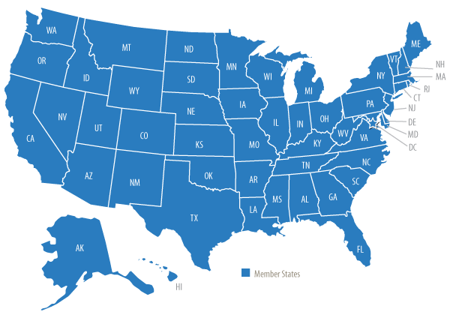
Military Interstate Children’s Compact
The Compact was developed by:
  Council of State Governments
  Department of Defense
  National associations
  Federal and state officials
  School administrators
This Compact a legal agreement with membership including all 50 states, and the District of Columbia
  Department of Defense Education Activity (DoDEA) schools policies and procedures mirror those in the Compact’s guidelines and related rules

Slide 21

How and When the Military Interstate Children’s Compact Can Help
The goal of the Compact is to addresses key education transition issues
encountered by children of military families
Frequently or recurring K-12 education topics for transitioning military students include:
  Kindergarten & First Grade Entrance Age
  Course and Educational Program Placement
  Special Education Services
  Placement Flexibility
  Absence Related to Deployment Activities
  Waiving courses required for graduation if similar course work has been completed
  Flexibility in accepting state exit or end-of-course exams, national achievement tests, or alternative testing in lieu of testing requirements for graduation in the receiving state
  Allowing a student to receive a diploma from the sending school instead
  of the receiving school

Slide 22
Military Interstate Children’s Compact Implementation and Oversight
The Military Interstate Children’s Compact Commission (MIC3) is a national governing body responsible for enacting rules and oversight of the Compact
The commission is comprised of Commissioners from each member state
The commission is funded through an annual assessment of the number of school age military children residing in the member states
Each member state has a State Council that must include at least:
  State superintendent of education
  Superintendent of a school district with a high concentration of military children
  Representative from a military community
  One representative each from the legislative and executive branches of government
  Other offices and stakeholder groups the State Council deems appropriate

Slide 23
DoD Role in Military Interstate
Children’s Compact
The DoD supports the Compact by:
  Designating the ex-officio member to the Military Interstate Children’s Compact Commission (MIC3)
  Designating a military representative, by position, to State Councils
  Implementing policy thorough the Department of Defense Instruction 1342.29 “Interstate Compact on Educational Opportunity for Military Children”
  Ensuring Department of Defense Education Activity (DoDEA) schools comply with the DoD Policy to operationalize the Compact
  Military Services School Liaison Officers serve to support transition issues impacting military connected students and facilitate solutions within the compact rules

Slide 24

Challenges and Successes
The goal of the compact is to support transitioning military students with a comprehensive approach. However, there are limitations on what it covers
  The compact is designed to resolve transition issues and does not impact the quality of education, grade computation, or require a state to waive any of its state education standards or exams
The compact provisions specifically provide flexibility and local discretion in course and program placement, and on-time graduation within the criteria established by the state

Slide 25

Challenges and Successes, Slide 1 of 2
The Compact supports the opportunity to participate in extracurricular activities
Under the compact, schools agree to consistent requirements for students' enrollment, eligibility, placement, and graduation
  For example, prior to the compact, a child might have had to repeat a state history course to graduate, even if she had already taken a similar course in a previous state. Adoption of the compact ensures families can request a waiver for this type of coursework

Slide 26

Challenges and Successes, Slide 2 of 2
What makes the Compact most successful?
  Managing expectations and understanding
  Communication
  Accessing resources
How can DoD help families?
  Understand the importance of educational planning for sequence and mobility
  Provide support to facilitate transition
  Offer resources to support educational continuity

Slide 27

Contact Information
Kathleen M. Facon
Chief, Education Partnership and Resources Department of Defense Education Activity
4800 Mark Center Drive
Alexandria, VA 22350
Office:
Cell:

Slide 28

Relevant Resources
Military Interstate Children's Compact Commission (MIC3) Website:
  http://www.mic3.net/
MIC3 Compact Information One-Pager:
  http://www.mic3.net/assets/one-pager-information.pdf
DoDEA Compact Page:
  https://www.dodea.edu/Partnership/interstateCompact.cfm
Military OneSource - "Helping Your Children Change Schools":
  https://www.militaryonesource.mil/-/helping-your-children-change-schools

Slide 29
Military Community & Family Policy
Office of Special Needs (OSN) and
Child & Youth Programs
Dr. Ed Tyner

Slide 30
Office of Special Needs (OSN), Slide 1 of 2
OSN Vision
Military families with special needs prepared for the challenges
of military life
OSN Mission
Strengthen personal readiness for military families with special needs through policy, resources, research and oversight of programs
Stakeholders
Family members with special needs, service providers and the
Military Departments

Slide 31
Office of Special Needs (OSN), Slide 2 of 2
OSN and the Military Services continue to work on standardizing elements of the Exceptional Family Member Program (EFMP) across the Department of Defense (DoD)
  The Department recently completed several major initiatives including a Family Member Travel Screening Pilot which reduced the required number of forms to be completed from 9 down to 5, implementation of a DoD EFMP Data Repository, Process and Outcome Metrics (POM) Pilot for family support, and a standard EFMP Leadership brief for all installations.
A Department-wide oversight framework geared toward improving and enhancing EFMP and the support it provides was developed in coordination with the Services
OSN is working closely with the Defense Health Agency (DHA) to build stronger collaboration to support families

Slide 32

Blended Retirement System
Military Family Readiness Council
Mr. Andrew Corso
Assistant Director of Military Compensation Policy Office of the Deputy Assistant Secretary of Defense (Military Personnel Policy)
March 6, 2018
UNCLASSIFIED
PERSONNEL AND READINESS

Slide 33


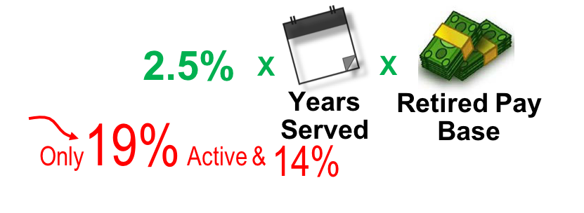
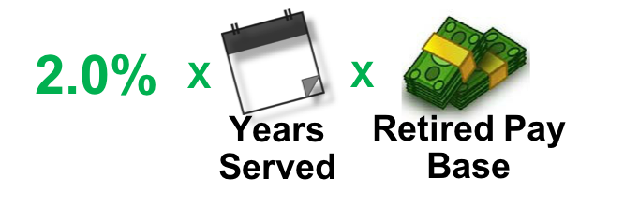

The Military Retirement Benefit
UNCLASSIFIED
The Uniformed Services Blended Retirement System
Legacy Retirement System
– Defined annuity benefit computed as
– Must serve at least 20 years
Blended Retirement System, blends:
– Defined annuity becomes
– Automatic & matching TSP
85%
of all service members will get government-provided retirement benefits
Service members who leave after just 2 years will keep TSP savings + DoD Contributions + Any Earnings

Slide 34
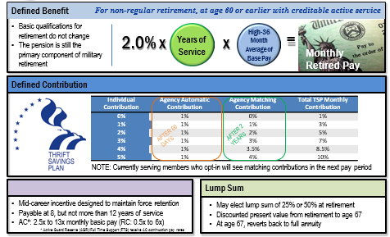
Blended Retirement System Basics
UNCLASSIFIED
The Uniformed Services Blended Retirement System

Slide 35
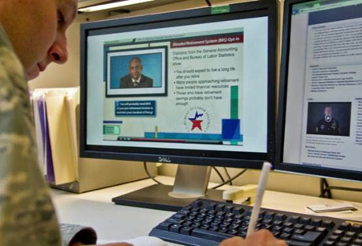
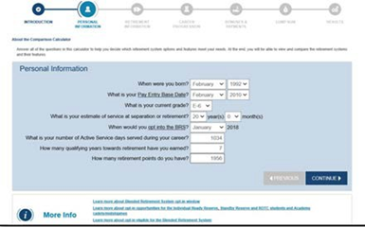
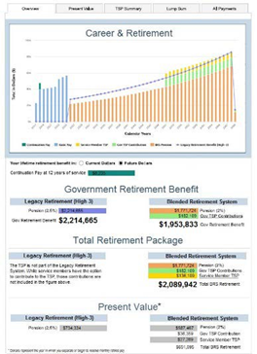
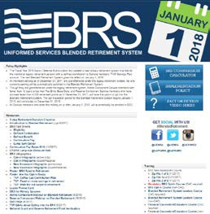
BRS Resources
TRAINING
Four online training courses
Available through Military OneSource
“Opt-In Course” was mandatory for all eligible Service members
1.5M completed opt-in course in 2017
CALCULATOR
Can be used by active, NG and reserve
Compares benefits under both systems
Member can adjust 12 fields to tailor output
No CAC required; publicly available
BRS RESOURCE WEBSITE
  Policy
  Links to training
  Infographics
  Posters
  Videos
  Fact Sheets
  Links to Services’ websites
http://militarypay.defense.gov/blendedretirement
FINANCIAL COUNSELORS
475 Professional Financial Managers provide certified, installation-based education and counseling CONUS and OCONUS
300 contract-accredited Professional Financial Counselors
24/7 Military OneSource financial counseling
Available to Active, NG and reserve Service members and their families

Slide 36






Social Media Outreach
The Uniformed Services Blended Retirement System
Major social media outreach campaign began in August 2017 and ran through end of year to direct Service members to BRS resources
            24 videos released over social media in 2017
            6 million total views
            Reach of 28 million people
            Ongoing campaigns planned for 2018 to direct members to BRS information
Facebook Q&As, Twitter Chats, and Webinars conducted with:
#AskRobyn

Slide 37

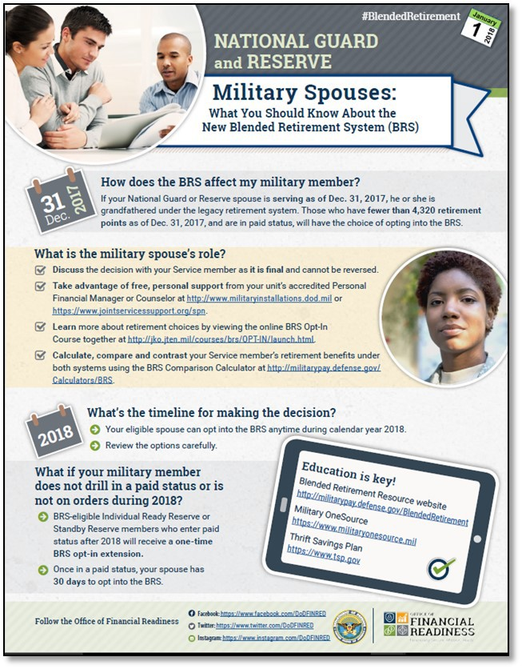
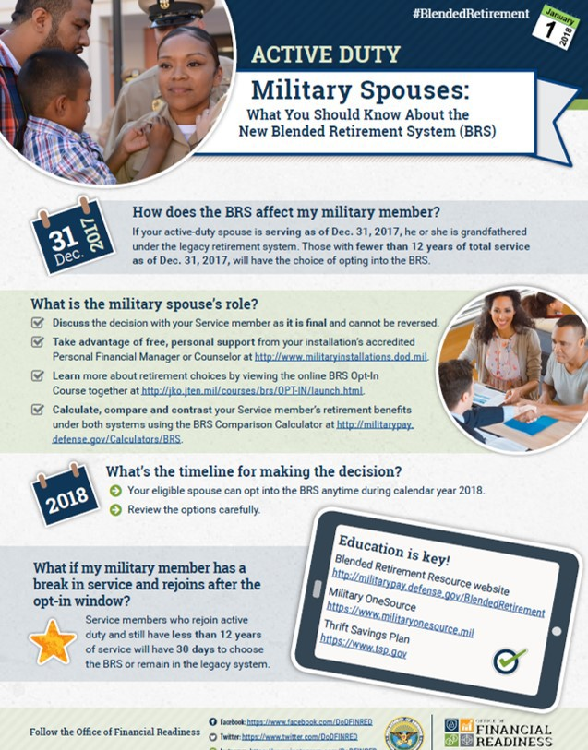
Spouse Infographics
UNCLASSIFIED
The Uniformed Services Blended Retirement System
http://militarypay.defense.gov/blendedretirement

Slide 38





Questions
UNCLASSIFIED
The Uniformed Services Blended Retirement System
http://militarypay.defense.gov/blendedretirement http://www.militaryonesource.com
BRS Videos on Facebook
BRS DVIDS Hub

Slide 39
Status Update
Discussion Period

Slide 40

MFRC Panel: Child and Youth Well-Being March 6, 2018
CHILD & YOUTH WELL-BEING: UNIVERSAL DOMAINS*
Family Economic Well-Being
Positive Social Relationships/Connections
Health
Safety/Behavioral Concerns/Healthy Choices
Emotional Well-Being/Character Development
Community Engagement
Educational Attainment
*Duke Center for Child and Family Policy: National Child and Youth Well-Being Index (CWI-1975-2013):
Evidence-based Composite Measure Trends: 28 Key Indicators of Well-Being/Quality-of-Life/Well-Being Domains (2014)
3/6/18 Photo Attribution: MCEC

Slide 41
New Parent Support Program
Mary E. Campise, LICSW
Family Advocacy Program
Office of the Deputy Assistant Secretary of Defense
Military Community & Family Policy
Office of Military Family Readiness Policy
Notes:
40

Slide 42
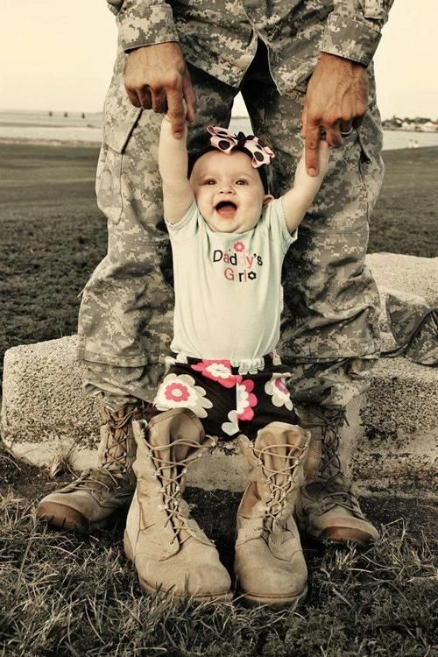
New Parent Support Program
(NPSP)
Getting Families Off to a Strong Start

Slide 43
NPSP, Slide 1 of 2
Standardized secondary prevention program
Targets expectant and new parents of children under the age of 3 whose life circumstances are challenging
Uses intensive voluntary home visitation model primarily using professional staff
Notes:
Challenging life circumstances might include separation from family, friends, natural helping networks, deployment, etc.

Slide 44
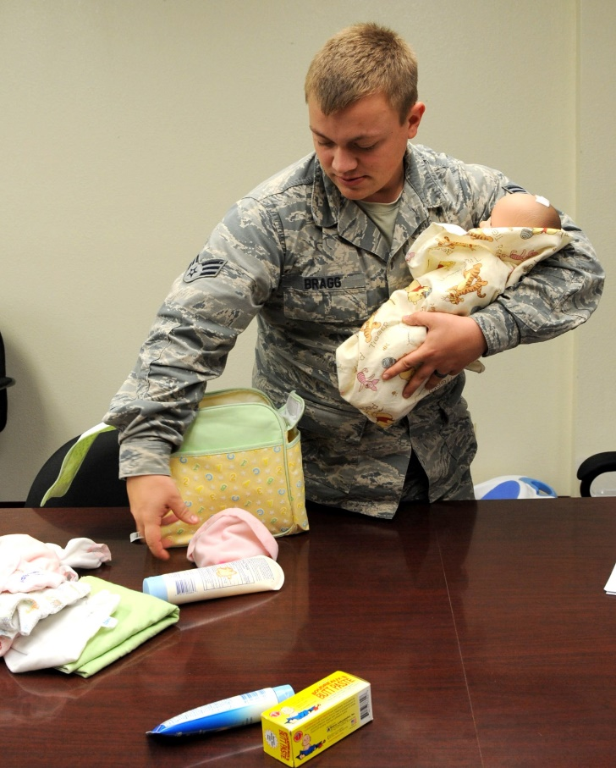
NPSP, Slide 2 of 2
Home visitation services often augmented by:
  Parent Education
  Parent Support Groups
  Play Mornings
  Life Skill Support
  Counseling Support
  Primary Care Support
Notes:
Baby bootcamp
Prenatal support
Infant Massage
Financial/employment/childcare/co-parenting relationship/primary care support
Counseling support includes MOS/MFLC

Slide 45
NPSP Goals
Promote protective factors associated with the optimal development of children and reducing risk factors associated with child abuse and neglect
Promote successful adaptation to parenting
Foster coordination between military and civilian resources to support parents

Slide 46

Protective Factors
Strengths focused – benefits ALL families
Attributes most parents want to strengthen
Approach not a program
Lifts up what’s working
Grounded in research
Notes:
Ensures a consistent experience for all families, no wrong door approach
Strengths focused – Positively framed
Provides a common language and approach across programs and disciplines. Work together and reinforce one another. Unifying approach.
Doesn’t cost a penny!
Provides a common set of outcomes.
Facilitates cross training and collaboration

Slide 47
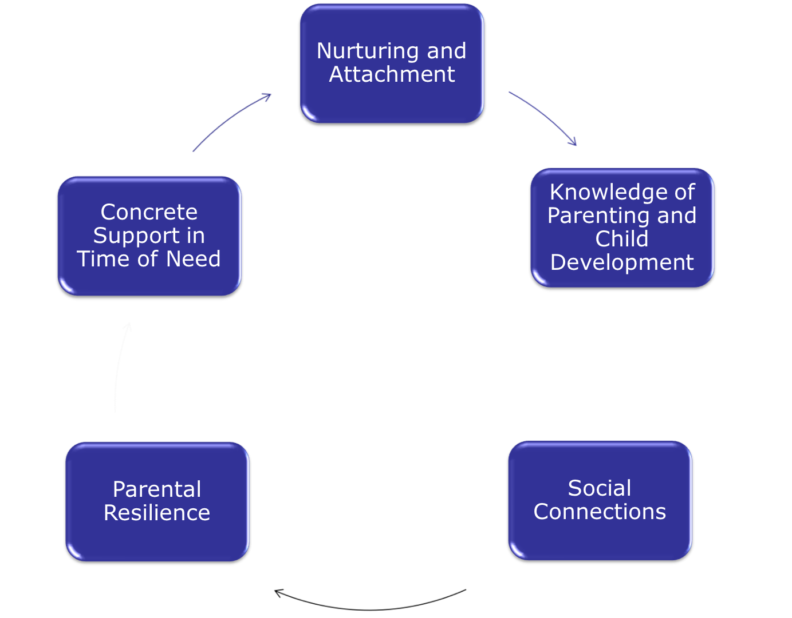

Parental Support
http://www.cssp.org

Slide 48
NPSP Collaboration
USDA Partnerships
  THRIVE - developmentally targeted parenting program
  Family Foundations - co-parenting program
  NPSP Continuous Quality Improvement Project
National Child Traumatic Stress Network
  DoD virtual learning community for all home visitors on a trauma informed Protective Factors Framework-Military
National Center on Shaken Baby Syndrome (NCSBS)
  Period of PURPLE Crying

Slide 49
Drivers for Collaboration
Approximately 70% of AD families live in civilian communities
Approximately 400 home visitors serving over 225 installations
Military members drawn from and return to civilian communities
Identify and close any gaps between military and civilian provided services
Shared effort to coordinated care

Slide 50
Child Development Programs
Carolyn Stevens
Director
Office of Military Family Readiness Policy
Office of the Deputy Assistant Secretary of Defense
Military Community & Family Policy
Notes:
49

Slide 51
Child Development Programs
(CDPs)
Military child development programs support mission and family readiness.
CDPs provide access to affordable, quality programs and services for children, from birth through 12 years of age utilizing approximately 740 child development program facilities and 1,800 Family Child Care homes.
  Over 55 percent of the installation-based capacity is dedicated to the care of children under three years of age.
Child Development and School Age Programs meet standards of operation necessary for accreditation by a DoD approved national early childhood programs accrediting body.
Notes:
Challenging life circumstances might include separation from family, friends, natural helping networks, deployment, etc.

Slide 52
Improving Access to Care
Implemented MilitaryChildCare.com Department-wide.
  A child care wait list management system that makes it easier for families to find available child care from anywhere in the world.
Providing fee assistance as a way to defray the cost of care for families who are unable to access child care on the installation utilizing approved community-based child care programs that meet health, safety, and quality standards.
Currently reviewing state child care licensing requirements and Quality Rating and Improvement Systems (QRIS) as a possible avenue to expand the availability of community child care for military families eligible for fee assistance.

Slide 53
Youth Programs
The military Services operate approximately 275 Youth and Teen Centers serving more than 1,000,000 military youths each year through a variety of educational and recreational programs.
The military Services collaboration with nationally-recognized youth development organizations, such as the Boys & Girls Clubs of America, 4-H Youth Development, and YMCA.
Programs and initiatives offered through these relationships support installation-based efforts to promote positive youth development.

Slide 54


JBLM
C•A•R•E•S
CENTER FOR AUTISM RESOURCES, EDUCATION AND SERVICES
We support military families impacted by Autism through timely access to resources, education and services which contribute to readiness and family resiliency.
53

Slide 55
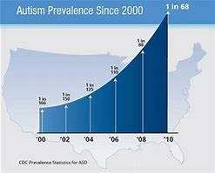
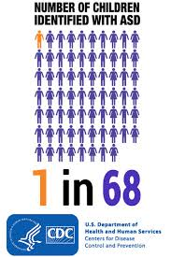
Background
  Autism is a disorder in social and language development.
  Affects 1 in 68 US children,
  Evidence Based Therapy includes OT, ST, PT, and Applied Behavior Analysis (ABA).
  Intensive and Early therapy is the most effective treatment for children with autism.
  Therapy for children is expensive, has long wait list and impacts soldier readiness
  The lifetime societal cost for one child with autism is $1.4 to $2.4 million
54
Notes:
The Problem: The lifetime societal cost for one child with autism is $1.4 to $2.4 million
A recent editorial in the Journal of Pediatrics titled “Zebras in the living room” provides a mental model of the unmistakable but not totally explainable increased prevalence of autism.
WHY??
Broader diagnostic criteria appear to have contributed in part to the increased prevalence.
2. more people are recognizing it ….. Though referral bias and single site of ascertainment is a problem—in the prevalence study from JAMA in 2003, many poor children are not identified until school age, so if only 2 or 3 year old prevalence rates are sought, they may be lower….
3. Increased prevalence may also be attributed to clinicians looking for autism even in the face of another diagnosis . For example, a 43% comorbidity between autism and TS has been found (Gutierrez, 1998). 8% of children with phenotype of autism have a Fragile X genotype.
In the 90’s, as the dx of ASD’s went up, the dx of MR went down….
Finally, there MAY be a true increase in incidence, with increased environmental influences early in gestation.
at the end of the talk I will come back to the summary of MMR and/or immunization preservatives, and I will touch on Dr Lopreiato’s recent publication in Lancet….on this topic
Prevalence does not totally substantiate incidence questions……see http//www.cdc.gov/ncbddd/dd/aic/states/
1 out of 4 career Military Families are enrolled in EFMP
23% of Military Children have a Chronic Medical Condition
5% with complex chronic care account for > 40% of child healthcare dollars
Approximately 40,000 military children have been diagnosed with an Autism Spectrum Disorder (ASD)

Slide 56






Home, School, Medical and Community Collaboration
55
Notes:
1 out of 4 career Military Families are enrolled in EFMP
23% of Military Children have a Chronic Medical Condition
5% with complex chronic care account for > 40% of child healthcare dollars
Approximately 40,000 military children have been diagnosed with an Autism Spectrum Disorder (ASD)

Slide 57




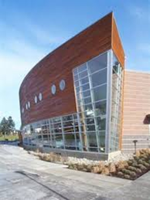
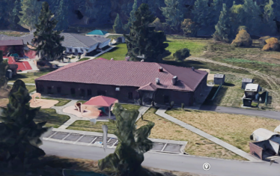
CARES Vision
Neurodevelopmental Center
On Joint Base Lewis McChord
Family with new diagnosis or PCS to JBLM
Direct therapy for 100-150 children
Eliminate referral wait time
Recapture some cost
Reduce EFMP denials
Increase readiness
Physician and Therapist oversight of CARES center
100% oversight of community Autism care for military beneficiaries
Training and research
40% remain in CARES for long term therapy
60% Case load turnover every
3-9 months to community partners
or PCS/ETS

Slide 58
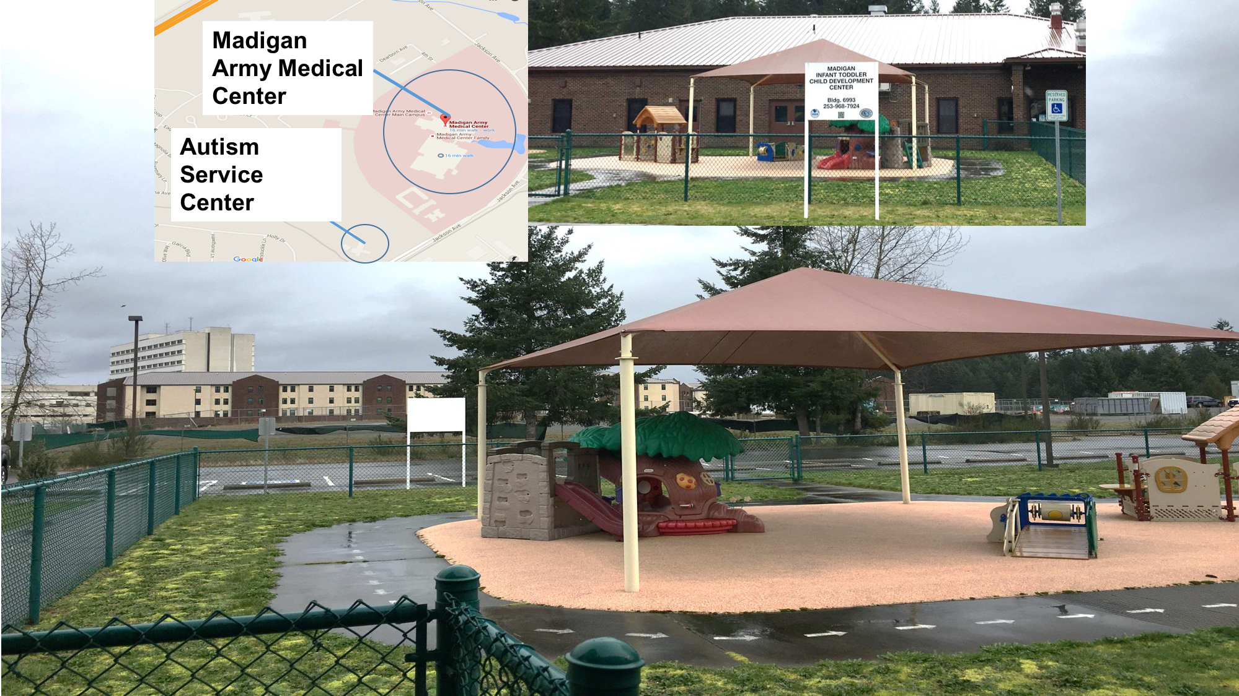
Medical Centers
57

Slide 59

Services Offered
Speech Therapy
Occupational Therapy
Physical Therapy
ABA Therapy
Social skills classes
Social skills classes
Social skills classes
Feeding Groups
Life skills training
Parent impact/support groups
Educational resources
System Navigation
Notes:
Fragmented services vs consolidated services- If we can get this model right we’ll be taking care of these families better than we ever have before.

Slide 60
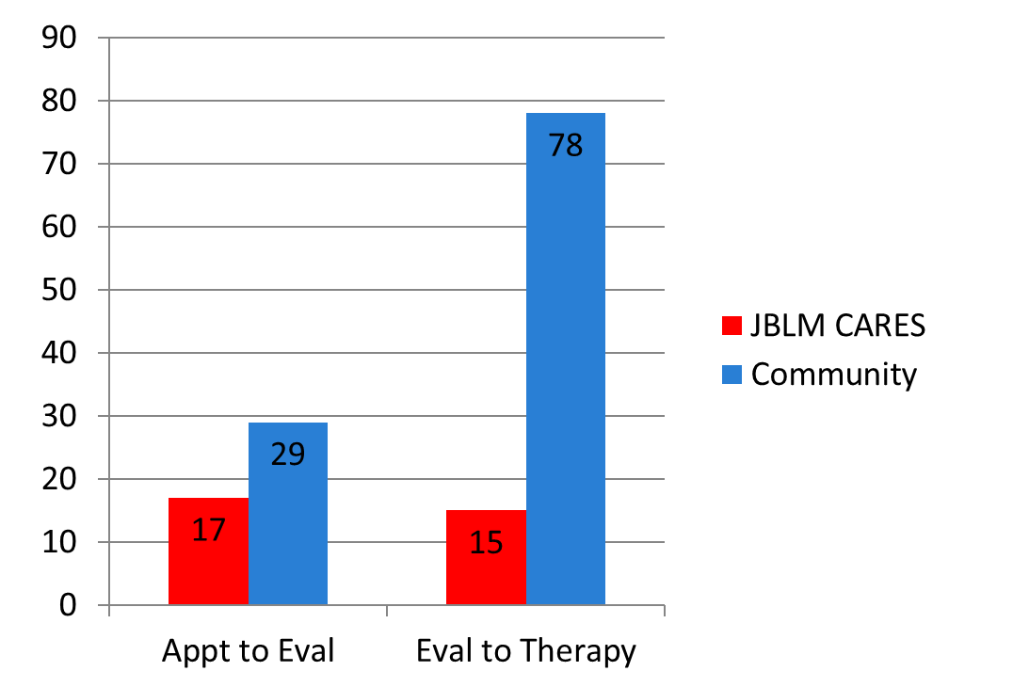
JBLM CARES IMPROVES READINESS!
  Zero EFMP denials
  Evaluation and Therapy within 2 weeks
  Bridges Home, Community, Ed. & Medical
Average number of days to services
JBLM CARES PROVIDES HOPE!
“tears came to my eyes immediately, because as a parent, this represents hope”.
Maj Racin – mother of child with Autism

Slide 61

YOUR MILITARY
BASE
C•A•R•E•S
Center for Autism Resources, Education and Services
JBLM CARES STRATEGIC PILLARS
  Pillar 1. Link children and families to existing RESOURCES.
  Pillar 2. Provide comprehensive EDUCATION throughout the lifespan.
  Pillar 3. Identify and facilitate appropriate SERVICES.
  Pillar 4. Collect ongoing data to determine optimal therapeutic outcomes.

Slide 62
Telemedicine & Telemental Health in TRICARE:
CAPT Edward Simmer, MC, USN
Chief Clinical Officer,
TRICARE Health Plan
Improving access and convenience
for our beneficiaries
“Medically Ready Force…Ready Medical Force”

Slide 63
Telemedicine Policy
Telemedicine, when used appropriately, is a method that can improve access, convenience, and experience of care
Telemedicine is a covered benefit in TRICARE, and its use is encouraged
From the TRICARE Policy Manual (Ch. 5, Sec. 1, 1.3):
  “telehealth modalities are covered services to the same extent as if provided in person”
  “to the extent practical, the contractor shall offer telemedicine to all Tricare beneficiaries, regardless of location”
“Medically Ready Force…Ready Medical Force”

Slide 64
Using Telemedicine in TRICARE
Any authorized provider can use telehealth; reimbursement is the same as if care was provided in the office
Care must be appropriate for telehealth
Communication via secure, encrypted portal (not Skype®, etc.)
Must be video and audio (not just audio only)
Can be synchronous (real time with patient) or asynchronous (radiology readings, for example)
Patient can be at home or in a provider office
Provider must be licensed at both locations
Contingency plan in place for emergencies
“Medically Ready Force…Ready Medical Force”

Slide 65

Boys & Girls Clubs of America (BGCA) – Service to Military
Connected Youth & Families
March 6, 2018
Military Family Readiness Council Meeting
Mrs. Terrill McFarland
National Vice President, Military & Outreach Service

Slide 66
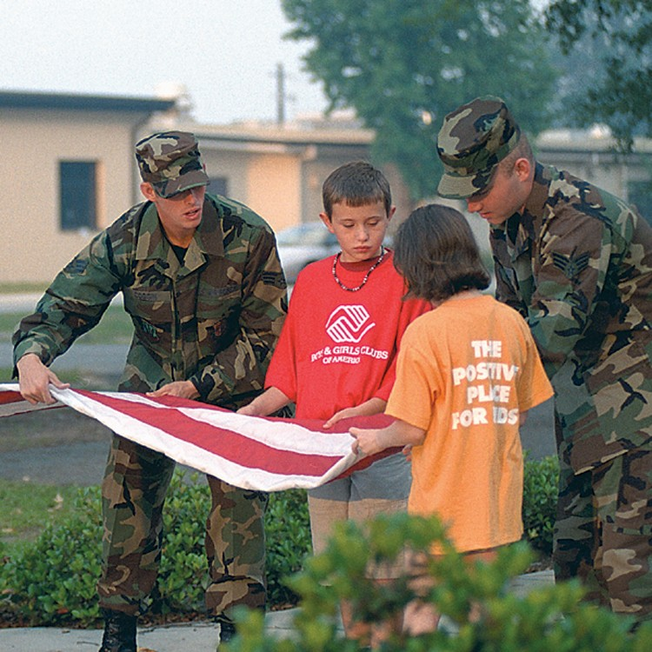

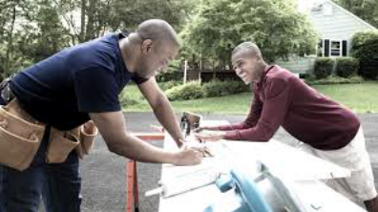

BGCA: Our Mission
To enable all young people, especially those who need us most, to reach their full potential as productive, caring, responsible citizens.
Notes:
Fun
Recognition
Positive Adult Relationships
Opportunities and Expectations
Safe, Supportive Environment
Workforce Readiness
Resiliency Building

Slide 67

BGCA: HISTORIC PARTNERSHIP WITH
THE ARMED SERVICES (27 Years)
4.5M Youth Served Annually
458,000 Military-Connected Youth
50,000 Trained Professionals
4,300 Clubs
(15 Counties, Native Lands & Military Installations; US)
Partnerships: Resiliency, Workforce Readiness, Sports
& Fitness, STEM, Leadership, Academics
Notes:
Boys & Girls Clubs of America’s partnership with the military began during the Persian Gulf war crisis. As parents in the Reserve and National Guard were deployed overseas, local Clubs provided memberships to some 17,000 military youth.
Through collaborative efforts with the Department of Defense, BGCA went on to develop a formal partnership with each branch of the Armed Forces.
Today, we serve more than 458,000 military-connected youth on installations in the U.S. and in 15 countries abroad.

Slide 68

Service Delivery Model – Military Youth & Families
Program & Services
Advocacy & Thought Leadership
Military Youth of the Year
Mission Youth Outreach
No Cost Memberships to military-connected youth
BGCA-Affiliated Youth Programs
Annual Scholarship $40,000
Character and Leadership
Education and Career
Health and Life
The Arts
Sports,
Fitness and Recreation
Workforce Readiness & Resiliency Building
National Military Leadership Council
Military Public Private Partnership
$3.5 M Annual Support to Youth Programs
Notes:
Provided one-year, no-cost memberships to children of the approximately 78% of families who live outside military installations
Served 22,000 military-connected youth annually by the 1,437 non- military Clubs.

Slide 69

PARTNERSHIPS:
Background on Partnerships
The PEAR Institute: Partnerships in Education and Resilience is a
translational center located in McLean Hospital and Harvard Medical
School that bridges research to practice.
Founded by Gil Noam, Ed.D., Ph.D. (Habil), PEAR takes a developmental approach to help youth thrive in society and meet their potential.
PEAR and BGCA partnership includes:
STEM
Social Emotional Development Programming
Training and assessment
Notes:
Founded in 1999
University based translational center located at Mclean Hospital- place that facilitates easy movement between practice, policy and research.
We work with programs, schools, school districts and youth-serving organizations across the country providing transformational training in our youth development model, Clover as well as our assessment and observational tools
There is a clear need for students to learn 21st century skills and SEL skills in order to succeed in life.
Much of what we do at PEAR represents out integrated approach to student learning that connects academic achievement with socio emotional learning in a way that benefits student’s mental health and development.
In addition to our work in the field of SEL, PEAR is involved in promoting quality STEM programming in OST.
Case for focus on both SEL and STEM
Afterschool programs have track record of promoting resilience
Quality STEM education addresses youth development needs
Participating in quality content-focused programs both in and out of school builds resiliency in kids
PEAR connects innovations in SEL and STEM between afterschool and in-school

Slide 70

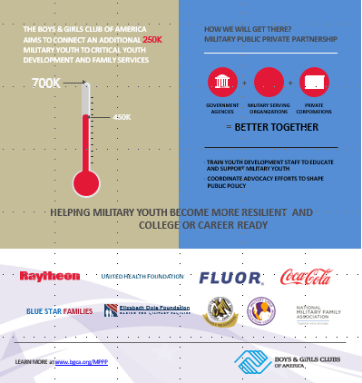
Outreach to Military Connected Families
Notes:
We have a five year goal to serve an additional 250,000 youth (Operation 250K) through connections----we don’t expect all those youth to fill Boys & Girls Clubs, but by providing assistance and training around outreach we want to connect military youth to programs whether that’s membership or special events.

Slide 71

For More Information Contact:
Terrill McFarland, National Vice President Military & Outreach Services (BGCA)
Boys & Girls Clubs of America
1275 Peachtree St. NE
Atlanta, GA 30309-3506
(404) 487-5700
BGCA.org
© 2018 Boys & Girls Clubs of America • 18-MKTG-010370

Slide 72
Project Arête
A Study of Character and Leadership Development among Cadets at the United States Military Academy
Kristina Schmid Callina
Military Family Readiness Council
Marc 6, 2018

Slide 73

Bottom Line Up Front:
Project Arete is first-of-its kind assessment of character and leadership development
Focus on unique character strengths
Focus on the entire developmental system
There is no “right amount” of character
Journal of Character Education, Vol. 13(1), 2017

Slide 74
What is Character?
Character reflects a person’s positive relationship with the world around them
The attributes that make up character must vary across time and place,
in order to meet situational demands
Individuals have unique constellations of character attributes – success in life may be linked to different aspects of character

Slide 75
How does Character Develop? Slide 1 of 2
“Mutually beneficial person ⬄ context relations”
  Alignment of youth strengths and strengths of the setting
Youth have agency to develop their own character
  Intentional self-regulation skills, executive functioning important
Successful character development programs leverage relationships, empower youth agency, take a holistic and developmental approach
  PRIMED model

Slide 76

How does Character Develop? Slide 2 of 2
Parents, educators, and practitioners often ask: What is the “right amount” of character?
Better Questions: What are this young person’s strengths? What are the resources available in our family, community, school, installation, to help optimize their strengths?
Notes:
We hear from parents, educators, and practitioners who want to know, what is the right amount of character? What are the ideal scores for my child or teen to have on attributes like grit, gratitude, or integrity?
But new theory and research about what character is and how it develops are helping us understand that these are the wrong sorts of questions to be asking.

Slide 77
Collaboration with West Point
Project Arete builds on a decade of existing research
  Grit (Duckworth, Matthews, Kelly, et al.)
  Hardiness (Bartone, Matthews, Kelly, et al.)
  Values-in-Action (Matthews, Kelly, et al.)
Study is first of its kind: longitudinal, multi-rater, multi-method, linking different data sources
This new study will address the multi-part “what” question to describe how character develops for more targeted feedback and intervention
Notes:
We seek to understand:
what cadets,
with what background characteristics,
develop what character strengths,
in what contexts,
with what outcomes for performance
and leadership?

Slide 78
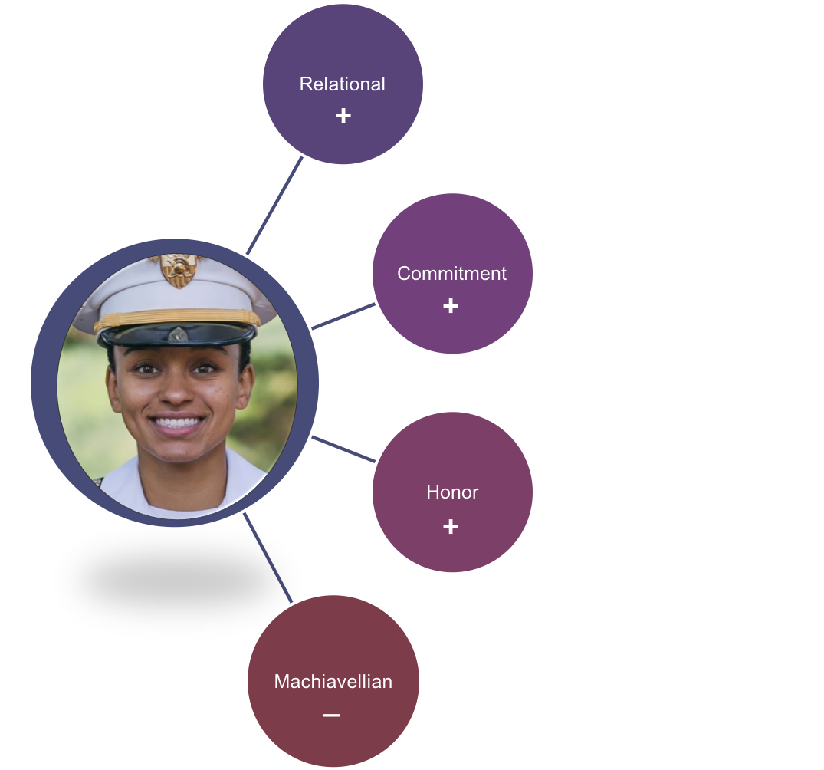
Initial Findings
4 Key Components of Character
Notes:
Picture in the center happens to be of Simone Askew, who is the first black woman to become first captain at USMA (highest position in cadet chain of command).

Slide 79
4 Key Components of Character
Relational
  Leadership, Intellectual Openness, Relational Humility, Social Intelligence, Empathy, Teamwork
Commitment
  Hardiness-Commitment, Optimism, Hardiness-Control, Purpose, Grit
Honor
  Honesty, Integrity, Bravery
Machiavellian
  Control, Status, Distrust, Manipulation, Intellectual Arrogance

Slide 80
Developing Leaders of Character
Project Arete will investigate:
What is the relationship between character and leadership?
How are character and mastery related in cadets’ professional development at USMA?
How can these findings be applied to other youth-serving organizations, OST activities, service academies, the larger Army?

Slide 81
Thank you!
Project Arete is funded by a grant from the Templeton Religion Trust
For more information:

Slide 82
Child and Youth Well-Being
Discussion Period

Slide 83
Military Spouse License Portability
  37% of working mil spouses need licenses (~ 130K)
  Defense – State Liaison Office (DSLO) worked with all 50 states on improving endorsement, temporary licensing and expedited applications
    Endorsement: allow an applicant to use a license in good standing to obtain a license in the new state
    Temporary licensing: allow an applicant to obtain employment while fulfilling state requirements
    Expedited processes: identify the military spouse and apply special procedures to speed up the process
  University of Minnesota evaluation of implementation of policy changes
    https://reachmilitaryfamilies.umn.edu/research/document/13865

Slide 84
Study Findings
University of Minnesota validated:
  42 states provide temporary licensing for
  spouses who cannot qualify for endorsement
  39 states make endorsement of existing
  licenses available and attainable
  31 states expedite the process of getting a
  license
Other findings:
  Endorsement, temporary and expedited did not relieve the underlying burden of licensing – only made the process faster
    Military spouse must still provide transcripts, course descriptions, and test scores to prove current license in good standing meets the new state’s equivalency requirements.
    Temporary licensing requires an application for permanent license
  Boards did not uniformly implement state laws – only 40 percent of states had information posted on websites, board staff were often not knowledgeable and not all applications to expedite processes included military affiliation

Slide 85
2018 Spouse Licensure Initiatives
  Follow-up on University of Minnesota Study
    Request follow-up by legislatures/Governors on actions taken by boards
    Requesting coverage of both spouse and transitioning Service member provisions
  Military spouse teacher certification
    Largely not impacted by previous license portability initiative
    State status: 23 states existing/enacted policy
  License Compacts recognizing military spouses
    Interstate solution to an interstate problem
    Redefines the core issues driving licensing burdens for military spouses: state specific competency standards and competency evaluations
    Compact is written into state law, creating a consistent approach across states

Slide 86
Recognized Compacts
  Physical Therapy License Compact:
    Approved in 15 states; active legislation in 6
    Privilege to practice provision allows military spouse to work in any member state with an unencumbered license in the home state
  Enhanced Nurse Licensure Compact:
    Approved in 28 states; active legislation in 8
    Privilege to practice provision
    Flexibility through Military Spouse Residence Relief Act
  REPLICA – Emergency Medical Services Compact
    Approved in 11 states; active legislation in 8
    Establishes consistent licensing requirements
    Special provisions for military
  PSYPACT – Psychological Interjurisdictional Compact
    Approved in 3 states; active legislation in 3
    Supports tele-practice – important for access to care
    Assists military spouse psychologists maintain clients

Slide 87
Teacher Licensure Portability, Slide 1 of 4
Kim Lopez
Educator and Military Spouse

Slide 88
Teacher Licensure Portability, Slide 2 of 4
Purpose:
To allow military spouses to seamlessly transfer their teaching credentials from one state to another without any state obstacles.

Slide 89
Teacher Licensure Portability, Slide 3 of 4
Progress Toward Goal:
Meeting with Utah decision- makers to work for out- of- state licensing changes:
  Organized State of Utah listening session
  Supporting Utah Senator Weiler to advocate for changes in legislation for military spouse teachers.
Met with Federal decision/policy makers to work for streamlined reciprocity for teacher licensing:
  White House listening session led by Ivanka Trump and Kellyanne Conway
  Fireside Chat with Chairman of the Federal Trade Commission
Podcasts/Articles/Blogs to educate the public and other military spouses of the issues.
Partnered with NMFA to launch a National Military Spouse Professional Teaching Network
(currently a moderator of site with approximately 1,300 members).

Slide 90
Teacher Licensure Portability, Slide 4 of 4
Challenges/Obstacles:
How to get states to coordinate and discuss common standards (buy- in needed).
Agreement on minimum standards (some states fear standards will be too low).
State willingness to adopt these standards (without conditions) and approve reciprocity for military spouses.
Notes:
Every state that a teacher goes to has a different set of standards teachers must meet.
We need to find a way to create a set of agreed upon standards (among all fifty states and DODEA) in order to alleviate expensive, time-consuming, and often redundant requirements and national testing for military spouse who move every 2-4 years.
Example: For me to transfer my my VA and CA license with twenty years of experience, I still have to retake three National Praxis Exams (approximately $700) and retake some course work to obtain a Utah license. Ironically, Utah states that it is reciprocal with both VA and CA. How is this process reciprocal?

Slide 91
Physical Therapy Licensure Compact

Slide 92

PT Compact
Facilitate interstate practice of physical therapy with the goal of improving public access to physical therapy services
Model: Mutual recognition of authorization to practice with notification to the jurisdiction of intention to practice

Slide 93
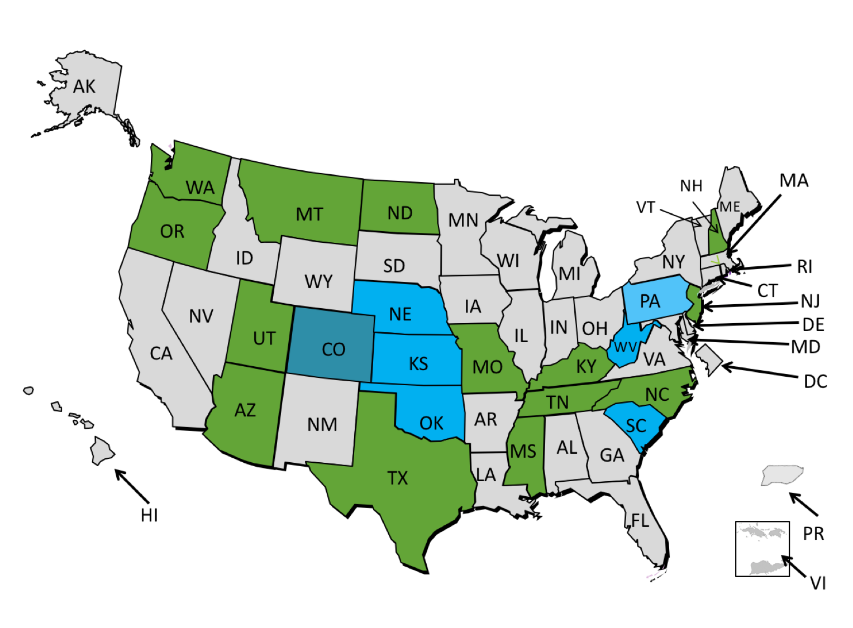
Status of compact adoption
February 5, 2018
Compact Legislation Enacted (15)
Compact Legislation Awaiting Governor Signature (0)
Compact Legislation Passed One Chamber (0)
Compact Legislation Introduced (6)
Session Closed without passage (0)
Suspended Status (1)

Slide 94
PT Compact Definitions, Slide 1 of 2
Home State
Licensee’s primary state of residence
Military/spouses can select Home State
Remote State
Member state where licensee holds a Compact Privilege
Compact Privilege
Authorization granted to practice physical therapy in the remote state

Slide 95
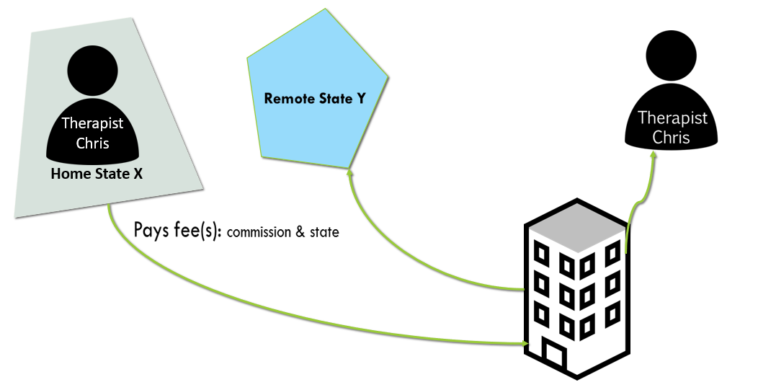
PT Compact Definitions, Slide 2 of 2
Chris receives Compact Privilege & begins working in remote state Y
Compact Commission
Assures Chris’ eligibility
Remits any fees to state Y
Notifies state Y Chris is coming
Chris must have
  License in home state
  Primary residence in home state
  No encumbered licenses of any type
  No disciplinary action within the last 2 years
  Met any jurisprudence requirement of state Y

Slide 96
Compact Benefits
Improves access to physical therapy providers
Improves mobility of licensees
Preserves the current state-based licensure system
Improved public protection
    Requires criminal background checks for applicants for initial licensure
    Allows sharing of investigatory information
    Requires reporting of licensure & disciplinary information to be shared with all member states
Eye to the future- new health care delivery models
*Improve portability for military spouses

Slide 97
Benefit to Military Families: Choice of Home State
SECTION 5. ACTIVE DUTY MILITARY PERSONNEL OR THEIR SPOUSES
A licensee who is active duty military or is the spouse of an individual who is active duty military may designate one of the following as the home state:
A. Home of record;
B. Permanent Change of Station (PCS);
C. State of current residence if it is different than the PCS state or home of record.
Fees
State may have $0 or reduced Compact Fee for military or spouses if state law requires
Commission will charge full Compact Fee

Slide 98
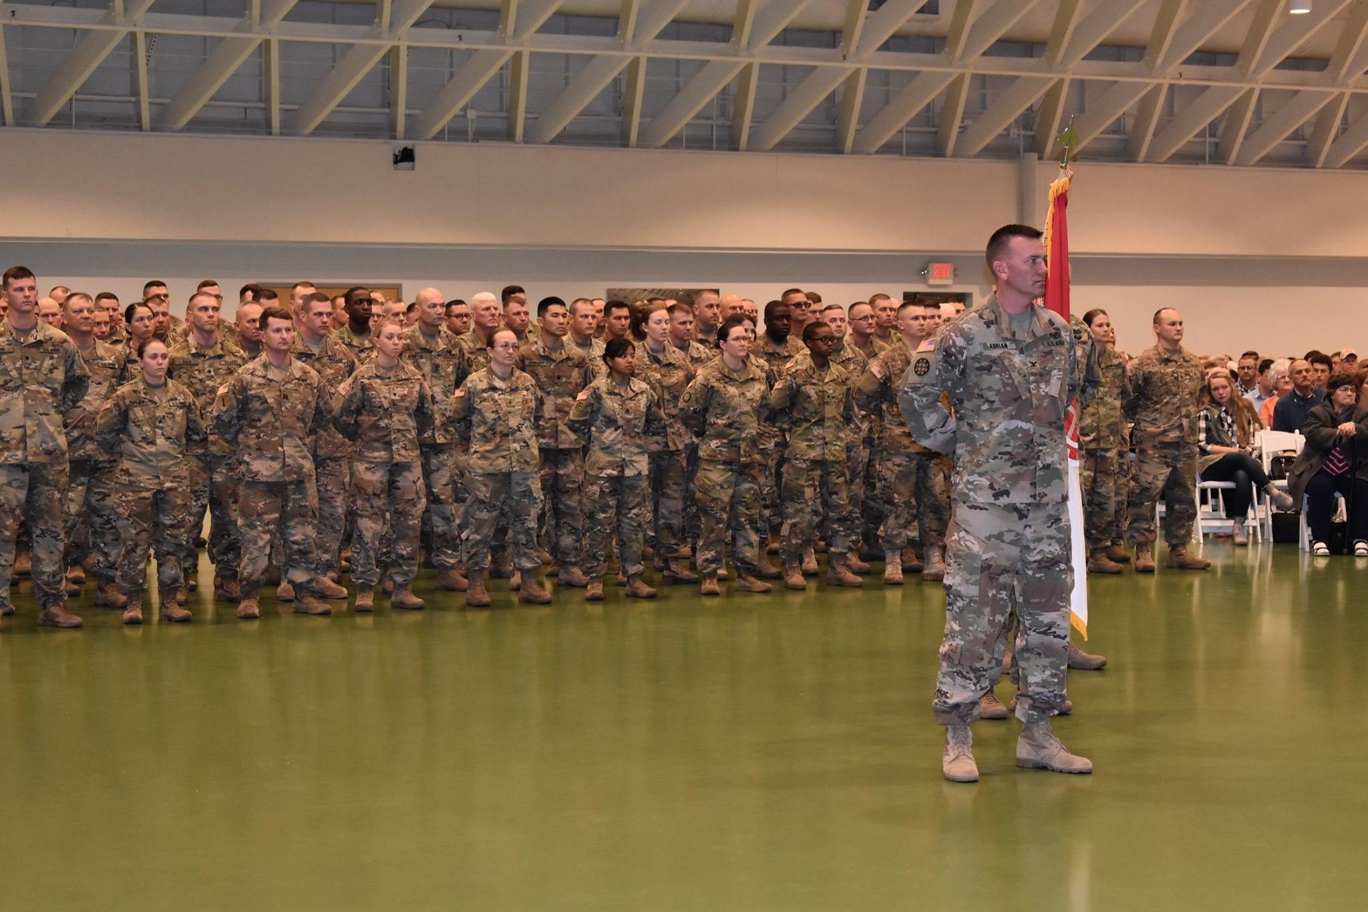


Contact
Leslie Adrian, PT, DPT, MPA
Proud Military Spouse
Director of Professional Standards
Federation of State Boards of Physical Therapy
124 S West St, 3rd floor
Alexandria, VA 22314

Slide 99
They Also Serve
Why Legislators Must Step Up To The Plate

Slide 100
The Why
More than 1.3 million active service members are working to keep America safe
Only 55% of Americans have a friend or relative serving
As Legislators, we are tasked with educating the public
Part of that education must be the message that “they also serve”

Slide 101
The How
Few states can deny the military’s impact on local economies
The DOD contributes billions of dollars each year to state economies through the operation of military installations
In Nebraska that impact is estimated to be 1.7 billion on the local economies of the surrounding communities
We want/need to keep Offutt AFB open. We MUST support those who serve and our families, because it is the right thing to do

Slide 102
My Strategy
Low Hanging Fruit
Expedited licenses, temporary licenses, licenses by endorsement and interstate compacts
Licensure issues are not always about legislation
Licensure issues benefit not only the military, but others looking to work in our state or wanting to work in a participating state
Easy to push. No brainer. Need to not address scope of practice, whenever possible

Slide 103
Spouse Licensure Portability Panel – Questions?
Discussion Period

Slide 104

Closing Remarks and Plans for Next MFRC Meeting
End of Year Meeting
June 6, 2018 1:00 PM – 3:00 PM PLCC Room B6
Development of FY 2018 Recommendations for SECDEF and Selection of FY 2019 Focus Areas

