Slide 1
Department of Defense (DoD)
Military Family Readiness Council (MFRC)
A Federal Advisory Council – Providing Independent Advice to SecDef
Sponsored by USD(P&R) and Supported by ASD(M&RA)
June 17, 2024
Council Meeting
Please feel free to visit the MFRC webpage on Military OneSource (https://www.militaryonesource.mil)

Slide 2
Agenda
Department of Defense (DoD)
Military Family Readiness Council (MFRC)
A Federal Advisory Council – Providing Independent Advice to SecDef
Sponsored by USD(P&R) and Supported by ASD(M&RA)
Military Family Readiness Council Meeting
June 17, 2024 (1300-1530 Eastern Time Zone)
1300 | Opening Remarks
1315 | The Military Health System
 | Stabilizing and Improving Specific Mitigation Network Provider Shortages Increasing Reimbursement Rotator Model Discussion
1400 | Break
1515 | Closing Remarks – Chair/DFO
1530 | Public Meeting is Officially Closed

Slide 3
Military Family Readiness Council: Focus on Medical
Office of the Assistant Secretary of Defense for Health Affairs

Slide 4
Framing Today’s Discussion
Review the organizational construct and key data points of the Military Health System
Summarize recent and on-going reforms to the Military Health System
Explain short term mitigation to constrained access to care for military families

Slide 5
The Military Health System

Slide 6
What is the Military Health System?
As summarized by the Congressional Research Service
DOD administers a statutory health entitlement through the Military Health System (MHS).
The MHS offers health care benefits and services through its TRICARE program to approximately 9.5 million beneficiaries composed of servicemembers, military retirees, and family members.
Health care services are available through DOD-operated hospitals and clinics, referred to collectively as military medical treatment facilities (MTFs), or through civilian health care providers participating in the TRICARE program.

Slide 7
Key Data Points
Summarized from the Fiscal Year 2023 TRICARE Annual Evaluation
Total Beneficiaries | 9.5 million worldwide^{b}
MILITARY FACILITIES––DIRECT CARE SYSTEM^{c}
Inpatient Hospitals and Medical Centers | 45 (31 in U.S.)
Ambulatory Care and Occupational Health Clinics^{d} | 566 (466 in U.S.)
Dental Clinics | 117 (94 in U.S.)
Military Health System (MHS) Defense Health Program Personnel | 127,511
Military Civilian (including Foreign National) | 70,116 26,404 Officers 44,914 Enlisted 57,395
CIVILIAN RESOURCES––PRIVATE SECTOR CARE SYSTEMe
Network Primary Care, Behavioral Health (BH), and Specialty Care Providers (i.e., individual, not institutional, providers) | 1,163,560
Network BH Providers (shown separately, but included in above) | 164,245
TRICARE Network Acute Care Hospitals | 4,880
BH Facilities | 2,295
Contracted (Network) Retail Pharmacies | 42,500
Contracted Worldwide Pharmacy Home Delivery Vendor | 1
TRICARE Dental Program (TDP) (for Active Duty families, Reserve members and their families) | Over 1.79 million covered lives in 756,000 contracts
TDP Network Dentists | Over 80,300 total dentists, including: 62,144 general dentists and 18,191 specialty dentists
Total Requested FY 2023 Unified Medical Program (UMP) (Including Projected Trust Fund Receipts) | $58.38 billion^{f}
Projected Receipts from Medicare-Eligible Retiree Health Care Fund (MERHCF) Trust Fund | $9.74 billion
ª Unless specified otherwise, this report presents budgetary, utilization, and cost data for the Defense Health Program (DHP)/UMP only, not those related to deployment or funded by the “Line” of the Services.
^{b} Department of Defense (DoD) health care beneficiary population projected for the end of FY 2022 is 9,489,182, rounded to 9.5 million. This projection is based on the DoD Comptroller’s Budget End Strength, the DoD Actuary’s forecast of the retiree population, and the family members per sponsor from the Defense Manpower Data Center Defense Enrollment Eligibility Reporting System (DEERS) as of January 2023.
^{c} Military medical treatment facility (MTF) clinic count includes occupational health, community-based, embedded behavioral health, Active Duty troop, centers of excellence, and joint DoD-Department of Veterans Affairs (VA) clinics, and excludes leased/contracted facilities and Aid Stations. Military facility counts are that of the number of facilities based on the Defense Medical Information System Identifiers ID, not clinical functions Source: Defense Health Agency (DHA)/Resources & Management (J-1/J-8)/Budget and Execution and Programming Divisions, 1/26/2023.
^{d} The projected increase in ambulatory clinics for FY 2023 is largely administrative in nature to ensure system alignment with MHS GENESIS Patient Care locations. The policy reinforcement has come from two different directions: (1) Defense Medical Information System Identifiers (DMIS IDs) table alignment with MHS GENESIS to resolve issues in clerk/patient appointing and (2) aligning overhead costs to a building or function to better reflect the cost of care (delineating buildings on the DMIS table that don’t fall under a campus concept).
^{e} As reported by the managed care support contractors (MCSCs) for contracted network provider and hospital data, 12/19/2022; and TRICARE Dental Program Section, Health Plan Execution and Operations for dental provider data, 3/1/2023.
^{f} UMP presented here includes direct and private sector care funding, military personnel, military construction, and the MERHCF (“Accrual Fund”). Budget and expense data from DHA/Resources & Management Directorate (J-8)/Budget & Execution Division, as of FY 2023 Request.

Slide 8
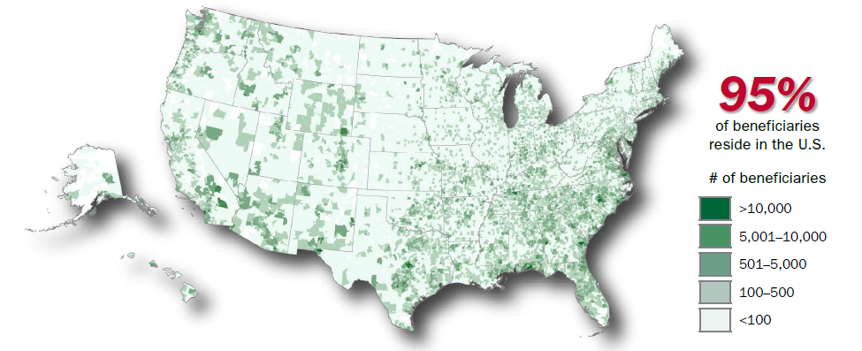
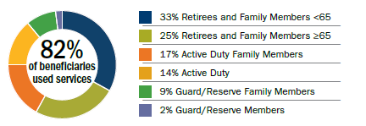
Key Data Points (cont.)
Summarized from the Fiscal Year 2023 TRICARE Annual Evaluation

Slide 9
Stabilizing and Improving

Slide 10
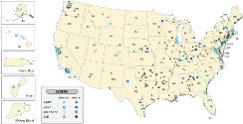
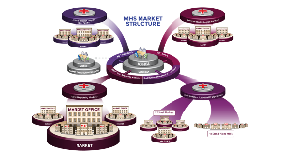
Timeline of Major Reforms
Twenty-five years of change in the MHS from 1998-2023
TRICARE Management Activity established as a field activity (1998)
Joint Task Force National Capital Region (2007)
Secretary of Defense directs the MHS Review (2014)
DoD begins deploying a new electronic health record
(2018)
1998
2023
5th Base Realignment and Closure (BRAC) consolidated Water Reed Army Medical Center and National Naval Medical Center Bethesda
(2005)
DHA replaces TRICARE Management Activity and Joint Task Force Capital Medicine
(2011-2013)
DHA authorities expand to manage MTFs and DTFs, research and development, public health, and education and training
(2017-Present)

Slide 11
Directives for 2024
From the Deputy Secretary memo “Stabilizing and Improving the Military Health System”
Requirements Determination (i.e., mission analysis)
Comprehensive review of all medical manpower and staffing.
Add medical force generation to the Defense Readiness Reporting System (DRRS).
Update DoD policy to reflect these directives.
Military Manpower
Primarily prioritize assignment of uniformed medical and dental personnel to MTF/DTFs.
Business rules to more holistically adjudicate risk to MTFs, DTFs, and operational medical readiness.
MTFs and DTFs become the primary choice of assignment absent specific, validated operational and training requirements identified by the Service Secretary of exigent circumstance.
Civilian Manpower
Prioritize implementation of chapter 74 of title 38, U.S. Code, authorities to improve recruitment and retention of health care personnel.

Slide 12
Specific Mitigation

Slide 13
Network Provider Shortages
TRICARE, like Medicare and other health plans, is opt-in for providers and health care organizations.
The current Managed Care Support Contractors are meeting all contractual requirements for network adequacy
Medical provider shortages in the local communities have been linked to high medical liability insurance, driving them to practice in neighboring states (e.g., TX, CO, and AZ).
In the next TRICARE Managed Care Support Contract (T-5), enrolled beneficiaries will have broader access to telehealth to mitigate local shortages.
Improving reimbursement rates and opening the aperture on value-based care arrangements will also increase access to care in the longer term.

Slide 14
Increasing Reimbursement
The next generation TRICARE Managed Care Support Contacts (T-5) changes to cap on reimbursements to incentivize providers and health delivery systems to stay in or even join the TRICARE network.
T-5 introduces Alternate Payment Models (APMs), which reward health care providers for delivering high quality and coordinated care. APMs can apply at the population level or by specific health condition
Pay for Reporting
Pay-for-Performance
Supplement fee-for-service (FFS) payments with shared savings and/or downside risk
Replace some or all FFS payments with capitation or a similar population-based, two-sided risk arrangement
Locality–Based Waivers carry-over from T-2017
If it is determined that access to specific health care services is severely impaired, higher payment rates could be applied to all similar services performed in a locality

Slide 15
Rotator Model
A circuit rider for manning assists
The Defense Health Agency is leveraging its reorganization into Defense Health Networks to prioritize rotator/circuit rider opportunities to maximize available capacity across the military medical treatment facilities (MTFs).
Impending OSD-level policy will streamline rotator/circuit rider requests.
Requests Assistance
Manages Request
Backstops Request
Defense Health Network A
Directs resources within its network
Coordinates across networks
Defense Health Network B

Slide 16
Discussion

Slide 17
Discussion Items
Discussants
Principal Deputy Assistant Secretary of Defense for Health Affairs
Chief of Staff, Office of the Assistant Secretary of Defense for Health Affairs
Topics for Consideration
Relationship between military family readiness and routine health service delivery
Tradeoff and integration between operational medical readiness and health service delivery
Impact of national health care personnel shortages on military family readiness

