Slide 1

Department of Defense (DoD)
Military Family Readiness Council (MFRC)
A Federal Advisory Council – Providing Independent Advice to SecDef Sponsored by USD(P&R) and Supported by ASD(M&RA)
March 27, 2024
Council Meeting
Please feel free to visit the MFRC webpage on Military OneSource (https://www.militaryonesource.mil)

Slide 2
Agenda
Military Family Readiness Council Meeting
March 27, 2024 (1300-1530 Eastern Time Zone)
Department of Defense (DoD)
Military Family Readiness Council (MFRC)
1300 – Remarks
1315 – Council Chair Opening Remarks
1325 – Roll Call
1330 – Food Security
1345 – Break
1405 – Childcare Update
1425 – Break
1430 – Spouse Employment Update
1440 – Break
1445 – Compensation and Financial Readiness
1455 – Break
1500 – Military Service Panel
1525 – Closing Remarks

Slide 3
Focus Areas FY24
Department of Defense (DoD)
Military Family Readiness Council (MFRC)
Bucket 1 – Economic Security
Food/Economic Insecurity
Bucket 2 – Medical/Health
Changes in Dependent Healthcare Systems and Implications for Military Family Readiness
  Health Care for Military, Family and Civilians both OCONUS and CONUS
  Medicaid Waiver Portability for Military Families
  Medical care challenges just inside the reimbursable range authorized by the JTR (100 miles), placing a financial and time burden on families requiring specialty medical care. A waiver and/or permanent change to the JTR to allow for reimbursement for travel based on frequency of miles per month
  Medical provider shortages in the local communities have been linked (in news sources) to high medical liability insurance driving them to practice in neighboring states (for example TX, CO, and AZ). This has led to reduced access-to-care locally. Accessing telehealth across state lines would help curb this negative trend.
  Manning assist (specialists assigned TDY on a rotational basis) and creating localized reimbursements (like Alaska, North Dakota, NM) to increase the rates at isolated MTFs where patients must drive long distances to access care.
CV19 (Pandemic) - Capture Lessons Learned - Successes/Failures/Recommendations

Slide 4
Focus Areas FY24 (Cont’d)
Department of Defense (DoD)
Military Family Readiness Council (MFRC)
Bucket 3 – Employment
Employment of childcare professionals, especially in overseas locations.
Military Spouse Employment
Childcare on drill weekends is very challenging, and affordable childcare for service members is a challenge. Ability to offer subsidies for service members on drill weekends (could be incentive for local day care providers).
Expand Military Spouse Employment Preference (MSP) to be used in conjunction with the transition process leading to retirement (see attached).
Accurate Military Spouse Unemployment tracking through the BLS (tied to Unemployment Insurance/Financial Security)
Civilian Hiring
Child and Youth Services staff expressed interest in increasing the grade of APF billets to increase salary and incentivize applications for APF vs NAF. Currently, NAF employees make more than APF employees, so some GS employees opt to transition to NAF positions, causing a strain on MWR fund.
Bucket 4 – Technology
Leveraging technology to meet needs of modern military families
Investigate the feasibility of establishing a department-wide, e-tool to collect real-time statistics regarding service/family member knowledge/awareness of services and their satisfaction rates after receiving services.
Overseas WIC is currently administered using paper drafts/checks vice EBT to redeem for items at the commissary. Modernize the process so EBT can be used at the point of sale at a commissary. The stigma of using paper vouchers or checks, vice a more discrete system through EBT, has been cited by Service members as one reason WIC isn't as widely used as it could be.
Bucket 5 – Support Services
Personal and Family Life Education

Slide 5
Department of Defense (DoD)
Military Family Readiness Council (MFRC) (2)
A Federal Advisory Council – Providing Independent Advice to SecDef Sponsored by USD(P&R) and Supported by ASD(M&RA)
March 27, 2024
Council Meeting
Please feel free to visit the MFRC webpage on Military OneSource (https://www.militaryonesource.mil)

Slide 6

Strengthening Food Security in the Force:
An Update on Departmental Actions
27 March 2024
Program Analyst, OSD MC&FP

Slide 7
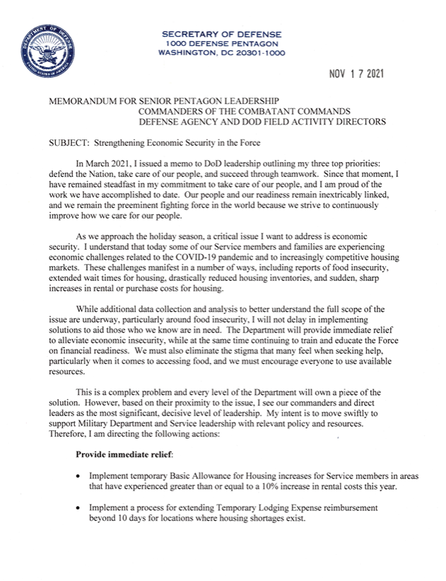

Strengthening Food Security in the Force: A Brief History
Secretary of Defense Memorandum, Strengthening Economic Security in the Force (November 2021)
  Announced official release of the Military Leaders Economic Security Toolkit
  Required Under Secretary of Defense for Personnel and Readiness to provide a strategy on food security
Office of the Under Secretary of Defense for Personnel and Readiness, Strengthening Food Security in the Force: Strategy and Roadmap (July 2022)

Slide 8

Strengthening Food Security in the Force: Building on Our Progress (1)
Published to Military OneSource on 20 December 2023: https://download.militaryonesource.mil/12038/MOS/Economic-Security/strengthening-food-security-in-the-force-strategy-and-roadmap-2023.pdf
Follow-on to the original, Strengthening Food Security
in the Force: Strategy and Roadmap (July 2022)
6 Lines of Effort (LOEs):
  Increase access to healthy food
  Enhance spouse employment opportunities
  Review service member pay and benefits
  Reinforce financial resources and awareness
  Encourage service members and families to seek available resources and services
  Expand data collection and reporting

Slide 9
Strengthening Food Security in the Force: Building on Our Progress (2)
Examples of actions taken between July 2022 and December 2023:
Implemented the Basic Needs Allowance, and increased the Basic Allowance for Housing and the Basic Allowance for Subsistence
Increased savings for Service members shopping at commissaries
Expanded childcare options and announced a new childcare fee schedule that will significantly reduce fees for many military families
Implemented a 4.6% basic pay raise in January 2023
Introduced a Military Spouse Career Accelerator Pilot
Initiated a qualitative study, to better understand the causes of food insecurity among junior enlisted Service members

Slide 10
Strengthening Food Security in the Force: Building on Our Progress (3)
Examples of new actions outlined in the report:
(1) Actions focusing on junior unaccompanied Service members living on installations include:​
Expanding campus-style dining (Air Force)​
Providing access to 24/7 minimarts (Navy/NEXCOM)​
(2) Actions focusing on enlisted, single-earner families with children include:​
Reinforcing the availability of federal nutrition assistance programs to those who may be eligible to receive benefits (All Services)​
The Defense Health Agency is expanding food security screening capabilities within the military’s electronic health record (DHA)​
Piloting online WIC payments at commissaries in Nevada (DeCA)​
Encouraging spouses and other dependents of enlisted personnel to patronize dining facilities at the discount rate (Army)

Slide 11



Featured Food Security Tools for Leaders and Providers
Military OneSource: Military Leaders Economic Security Toolkit (November 2021)
OneOp Food Security in Focus Series (September 2022)
Defense Organizational Climate Pulse (DOCP) Survey (February 2024)

Slide 12
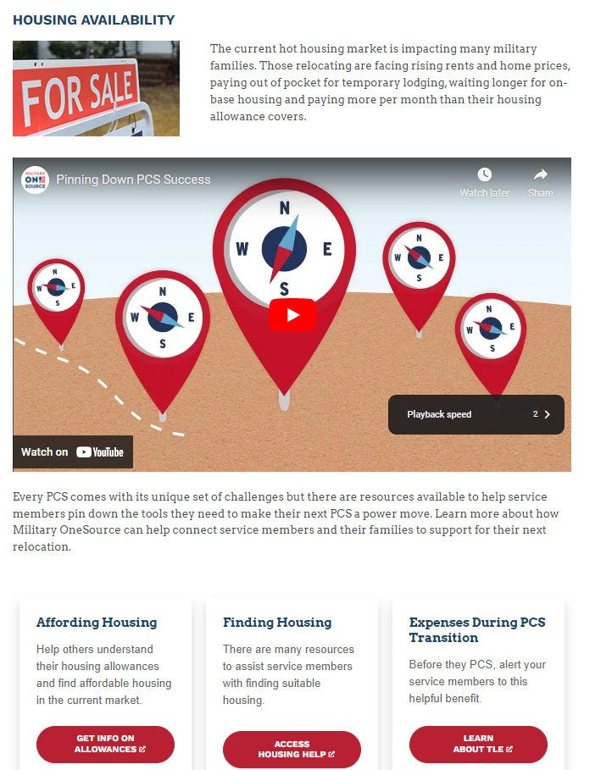
Military Leaders
Economic Security Toolkit (1)

Slide 13
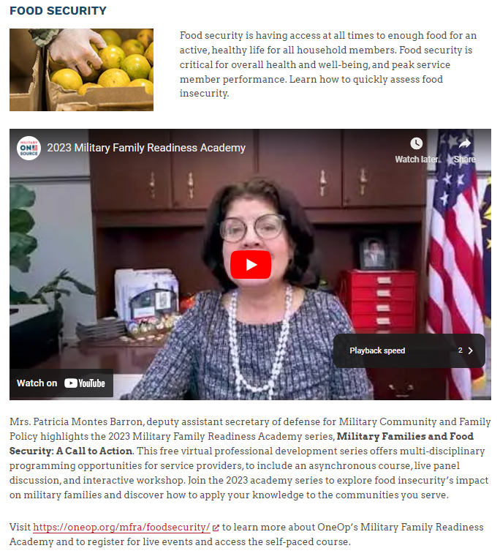
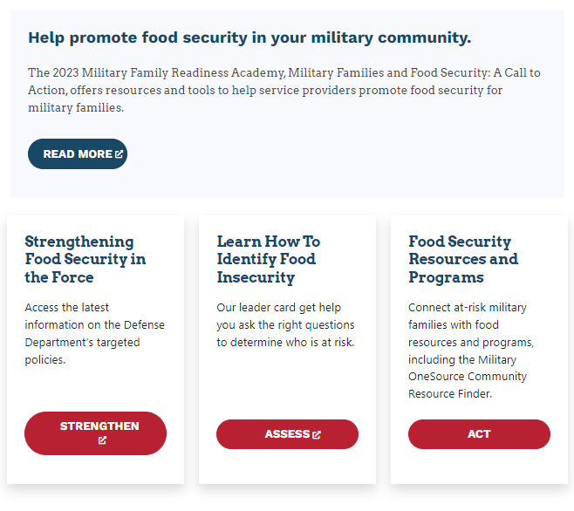
Military Leaders
Economic Security Toolkit (2)

Slide 14
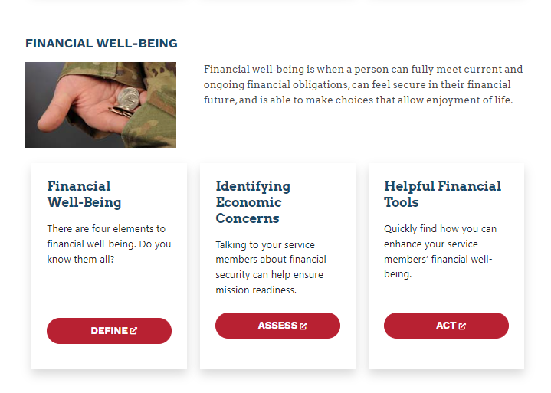
Military Community & Family Policy

Slide 15
Thank you!
Program Analyst, OSD MC&FP

Slide 16
Child Development Program Update (1)
March 2024

Slide 17
Child Development Program Fee Policy SY 23/24
The Department is required to annually review and issue a childcare fee policy based on total family income (TFI) for use by programs in the DoD child development system of care.
Childcare fees were restructured to make them more equitable and more affordable for families with the greatest economic need by reducing the percentage of income that families with TFI in the lower income/fee categories devote to their childcare needs.
  Under the SY 23/24 fee policy, families should expect their childcare fees to be approximately 7% of their annual income for one child in full-time care.
Most families with TFI at or below $120,000 per year are expected to see a decrease as compared to SY 22/23 fees.
Installation commanders have the authority to grant case-by-case exceptions to individual fees if financial hardship warrants.
The SY 23/24 Fee Policy also increased the community-based fee assistance provider rate cap from $1700 to $1800/month/child increasing the amount of fee assistance for which families may quality.

Slide 18
Military Child Care In Your Neighborhood - PLUS
Military Child Care in Your Neighborhood (MCCYN) is the Department’s childcare fee assistance program for military families using civilian providers in the local community.
  Civilian providers must obtain a state license with annual licensing agency inspections, conduct employee background checks, and achieve national accreditation.
MCCYN-PLUS is an MCCYN initiative to expand eligibility to providers participating in state quality rating and improvement systems (QRIS).
  Achieving a designated QRIS level is an indicator of provider quality in lieu of the requirement for national accreditation.
Participating states include Arkansas, Colorado, Kentucky, Maryland, Michigan, Minnesota, Nebraska, Nevada, New York, North Carolina, Oklahoma, Texas, Virginia, Washington, and Miami-Dade Co, FL.
MCCYN-PLUS served 6,816 children through 2,032 providers (4 Mar 24).
MC&FP is currently engaged with 18 additional states to join MCCYN-PLUS and continues outreach efforts across the country.

Slide 19
Child Development Program Workforce Initiatives (1)
Recruitment, Retention, and Compensation Task Force
  Established to conduct a foundational review of the current 30-year-old Child Development Program (CDP) compensation and staffing model framework.
  Comprised of a multi-disciplinary team of subject matter experts in the fields of CDP, Human Resources, Policy, and Resourcing from OSD, Military Departments, Service Headquarters, and Installations.
  After identifying challenges and recommendations, developed a comprehensive five-year plan to phase-in modernization of the CDP compensation and staffing model.
  Initial phasing of recommendations for year-one included in FY25 budget:
    Redesign compensation to support increases for mid to senior level direct care staff- update current duties and responsibilities to accurately reflect current performance and expectations.
    Redesign compensation to support increases for management staff- update current duties and responsibilities to accurately reflect current performance and expectations.
    Implement new position of Lead Educators to improve classroom environment/climate with added supervision, coaching, and expertise to the classroom.
    Continuation of Special Needs Inclusion Coordinator Pilot.

Slide 20
Child Development Program Workforce Initiatives (2)
Child Care Discounts for Direct-Care Staff
  The Secretary’s “Taking Care of Our Service members and Families” September 2022 memorandum directed a 50 percent employee childcare discount for the fist child of direct-care workers.
  Nearly 28 percent of direct-care staff receiving discount as of Q1 FY24.
  Incomplete Q1 FY24 data shows a minimum of $2.8M in fee discounts to military spouses.
  The average weekly discount per employee is approximately $90, for a total annual cost savings of over $4,500.
  Since implementation, the total number of direct-care staff increased by 14.6 percent.
  The Military Services have authority to offer up to 100 percent discount.
The Military services are implementing additional workforce initiatives such as: advanced training opportunities, improved work center facilities, recruitment bonuses in hard to fill locations, and increased subsidies to incentivize and retain Family Child Care providers.

Slide 21
Child Development Program Update (2)
March 2024

Slide 22
Spouse Education & Career Opportunities
Military Family Readiness Council
Military Spouse Career Accelerator Pilot (MSCAP)
27 March 2024
Notes:
Hello and welcome to today’s Military Spouse Employment Partnership Potential Partner Overview
I cannot emphasize how appreciative we are that you are not only taking the time out of your schedules to join us today, but that your organization is considering joining more than 600 employer partners that have committed to recruiting, hiring, retaining, and promoting military spouses
As mentioned, my name is Eddy Mentzer and I serve within the Office of the Deputy Assistant Secretary of Defense for Military Community and Family Policy as an Associate Director
In my role, I oversee the Department of Defense’s spouse employment portfolio
I also happen to be a military spouse myself of 2e years and counting and have experienced many of the same challenges that military spouses around the world face in achieving and maintaining meaningful careers
Throughout the presentation, you will see a lot of acronyms because that is how we speak in the DoD…keep me honest and if I do not explain an acronym or spell it out, use the chat pod to let me know
And do not hesitate to put any questions you might have in the3 chat pod. Today’s presentation is about giving you additional background as you move through the vetting process and if you have a question, I guarantee others probably are thinking the same thing.
We also have a great team in the background that will be answering your questions in the chat, but we will also save some time at the end for additional questions.

Slide 23





Spouse Education & Career Opportunities (1)
Leveraging authority provided in the 2022 National Defense Authorization Act, Secretary of Defense Austin directed the development of a military spouse fellowship with industry as part of the “Taking Care of People” priority
MSCAP was launched in December of 2022 with the first military spouse fellows being placed in January of 2023
While engaged in the fellowship, military spouses are compensated through funding provided by the Defense Department
The fellowship was initially designed to support career ready military spouses; those spouses that have the education and/or experience to move into the workforce rapidly
Eligible spouses include those whose Service member is currently serving in the active, national Guard, or reserve component
MSCAP only supports CONUS fellowships
There are 278 MSCP “Host companies”
Notes:
Our newest initiative is MSCAP, or the Military Spouse Career Accelerator Pilot
This one might be of particular interest to you as employers.
MSCAP is a competitive, 12-week, paid fellowship where employer hosts can select from an amazing talent pool of military spouses
We currently have more than 600 spouses fully registered in MSCAP and being pushed to employer hosts each month
Let me tell you about the participating spouses
These are career ready military spouses …of the more than 170 that have been placed into fellowships since January of this year, more than 90% have a 4 year degree and more than 30% have advanced degrees.
This is a great opportunity to bring in a potential candidate and have the Department of Defense pay them for 12 weeks.
The goal of the initiative is to have spouses converted from fellow to employed at the conclusion of the fellowship
We are looking for employer hosts who have employment opportunities and want to host MSCAP fellows
The team has dropped information on becoming an MSCAP host in the chat.
MSCAP is a separate initiative from MSEP, but many of our MSEP partners are hosting fellows or becoming employer hosts

Slide 24
Spouse Education & Career Opportunities (2)
Year 1: December 22 through December 23
Total Fellowships Placed: 347
  Traditional Fellowships: 288
  Salesforce Fellowships: 28
  Career Forward Fellowships: 18
  Skills-based Fellowships: 13
Total Direct hires: 111
  Traditional direct-hire: 110
  Career Forward direct-hire: 1
Overall Successful Employment Opportunities: 357
  Fellowships Completed*: 309
  Employment Opportunities*: 246
  Direct-hires: 111
  Job-offer rate: 85%
  Average Salary Offer: ~$65k
*Employment opportunities are reported as of 3/19/2024. Employment opportunities are tracked 90 following fellowship completion
Notes:
Our newest initiative is MSCAP, or the Military Spouse Career Accelerator Pilot
This one might be of particular interest to you as employers.
MSCAP is a competitive, 12-week, paid fellowship where employer hosts can select from an amazing talent pool of military spouses
We currently have more than 600 spouses fully registered in MSCAP and being pushed to employer hosts each month
Let me tell you about the participating spouses
These are career ready military spouses …of the more than 170 that have been placed into fellowships since January of this year, more than 90% have a 4 year degree and more than 30% have advanced degrees.
This is a great opportunity to bring in a potential candidate and have the Department of Defense pay them for 12 weeks.
The goal of the initiative is to have spouses converted from fellow to employed at the conclusion of the fellowship
We are looking for employer hosts who have employment opportunities and want to host MSCAP fellows
The team has dropped information on becoming an MSCAP host in the chat.
MSCAP is a separate initiative from MSEP, but many of our MSEP partners are hosting fellows or becoming employer hosts

Slide 25


Spouse Education & Career Opportunities (3)
In year two, we are focusing on expanding MSCAP into two new sectors
Creation of Skills Based Fellowships
Supports spouses that may not have the needed experience or education but want to enter the workforce
Over the 12-week fellowship, spouses will receive the necessary training to move into an employed role
We have 20 spouses currently participating in these new fellowships
  Expansion into the public sector
  We recognize that federal employment is a great opportunity for military spouses
  We are working across federal agencies to overcome some of the differences between the private and public sector; mainly access to facilities and moving into an employed status at the end of the fellowship
Notes:
Our newest initiative is MSCAP, or the Military Spouse Career Accelerator Pilot
This one might be of particular interest to you as employers.
MSCAP is a competitive, 12-week, paid fellowship where employer hosts can select from an amazing talent pool of military spouses
We currently have more than 600 spouses fully registered in MSCAP and being pushed to employer hosts each month
Let me tell you about the participating spouses
These are career ready military spouses …of the more than 170 that have been placed into fellowships since January of this year, more than 90% have a 4 year degree and more than 30% have advanced degrees.
This is a great opportunity to bring in a potential candidate and have the Department of Defense pay them for 12 weeks.
The goal of the initiative is to have spouses converted from fellow to employed at the conclusion of the fellowship
We are looking for employer hosts who have employment opportunities and want to host MSCAP fellows
The team has dropped information on becoming an MSCAP host in the chat.
MSCAP is a separate initiative from MSEP, but many of our MSEP partners are hosting fellows or becoming employer hosts

Slide 26

Spouse Education & Career Opportunities 4)
Office of Military Family Readiness Policy
Office of the Deputy Assistant Secretary of Defense
(Military Community and Family Policy)
Notes:
Our newest initiative is MSCAP, or the Military Spouse Career Accelerator Pilot
This one might be of particular interest to you as employers.
MSCAP is a competitive, 12-week, paid fellowship where employer hosts can select from an amazing talent pool of military spouses
We currently have more than 600 spouses fully registered in MSCAP and being pushed to employer hosts each month
Let me tell you about the participating spouses
These are career ready military spouses …of the more than 170 that have been placed into fellowships since January of this year, more than 90% have a 4 year degree and more than 30% have advanced degrees.
This is a great opportunity to bring in a potential candidate and have the Department of Defense pay them for 12 weeks.
The goal of the initiative is to have spouses converted from fellow to employed at the conclusion of the fellowship
We are looking for employer hosts who have employment opportunities and want to host MSCAP fellows
The team has dropped information on becoming an MSCAP host in the chat.
MSCAP is a separate initiative from MSEP, but many of our MSEP partners are hosting fellows or becoming employer hosts

Slide 27
Spouse Education & Career Opportunities &
Military Family Readiness Council
Military Spouse Career Accelerator Pilot (MSCAP)
27 March 2024
Notes:
Hello and welcome to today’s Military Spouse Employment Partnership Potential Partner Overview
I cannot emphasize how appreciative we are that you are not only taking the time out of your schedules to join us today, but that your organization is considering joining more than 600 employer partners that have committed to recruiting, hiring, retaining, and promoting military spouses
As mentioned, my name is Eddy Mentzer and I serve within the Office of the Deputy Assistant Secretary of Defense for Military Community and Family Policy as an Associate Director
In my role, I oversee the Department of Defense’s spouse employment portfolio
I also happen to be a military spouse myself of 2e years and counting and have experienced many of the same challenges that military spouses around the world face in achieving and maintaining meaningful careers
Throughout the presentation, you will see a lot of acronyms because that is how we speak in the DoD…keep me honest and if I do not explain an acronym or spell it out, use the chat pod to let me know
And do not hesitate to put any questions you might have in the3 chat pod. Today’s presentation is about giving you additional background as you move through the vetting process and if you have a question, I guarantee others probably are thinking the same thing.
We also have a great team in the background that will be answering your questions in the chat, but we will also save some time at the end for additional questions.

Slide 28
Financial Well-Being and Education – Key Findings
2022 Status of Forces Survey
A majority of Service members reported a comfortable financial condition, but the percentage declined markedly compared to past years. Findings consistent with other national surveys administered at time.
More Service members reported financial challenges, but very few reported a serious financial challenge, such as a bankruptcy or adverse personnel action.
Only a small proportion reported they spent more than their income, substantially lower than the percentage of U.S. adults who reported spending more than their income in national surveys.
Service members exhibited higher levels of financial literacy and reported establishing positive financial goals and using credit responsibly. Better financial management was a top reason cited for those who reported a positive change in their financial condition.
Full report available at: https://finred.usalearning.gov/assets/downloads/FINRED-2023-FinancialLiteracy-R.pdf.pdf
Notes:
Financial Condition
Current financial condition, financial situation compared to 12 months ago, and reasons situation was better/worse than 12 months ago
Financial Management Activities
Activities used routinely to manage finances
Saving or Investment Habits and Routine Expenses
Saving or investment habits, financial goals, payment of credit card debt, emergency savings fund, financial problems in past 12 months, and financial products/services used to cover routine expenses in past 12 months
Consumer Financial Protection Bureau (CFPB) Financial Well-Being Scale
Research-based tool developed by CFPB to measure an individual’s level of financial wellbeing. 5 questions are used to generate a score from 1 to 100.
Financial Literacy Quiz
10-item financial literacy declarative knowledge quiz that has been administered on surveys of the civilian population.

Slide 29
Financial Readiness Update: Training and Education
Sen$e Updates
  Enhanced user interface and navigation successfully launched
  Focus is on content review and alignment with enhancements
Learning Resources Library
  Single repository for DoD Financial Readiness Resources
  Expansion to complete Phase II underway
Homebuying Basics video series
  Final edits in-progress
  Release April 2024
Multiple curricula in development and review
  Million Dollar Service Member
  Financial Planning for Transition
  Yellow Ribbon Reintegration
Curriculum Evaluation Form
  https://finred.usalearning.gov/assets/downloads/FINRED-CurriculumEval-TK.pdf
29

Slide 30

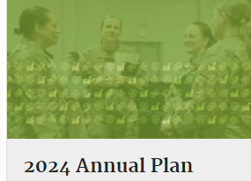
Financial Readiness Update: Outreach and Comms
LinkedIn Launch
  DoD expanded its financial readiness community outreach efforts https://www.linkedin.com/company/dodfinred
Financial Considerations of PCS Podcast
  Planned for April recording
April Financial Capability Month (FINCAP)
  Media kit at https://community.apan.org/wg/finred-lrl/w/wiki_sr/39569/financial-capability-month/
July Military Consumer Month
  Annual campaign in coordination with CFPB and FTC, plus interested stakeholders
Website Usability Studies
  Card Sorting Study to determine taxonomy and updates
  Reimagining content based on previous study results
30

Slide 31
Military Compensation Update: Pay Increases
Today’s military compensation package is robust and competitive. In 2024:
  A new member (E-1 <4 months) earns more than $20/hour.
  By the end of the 1st year as an E-2, this same member earns more than $25/hour.
  By the end of year 3 the member is an E-4 and earning more than the median income of all U.S. workers.
  By the end of year 4, when promoting to E-5, this member earns about the equivalent of U.S. median household income.
Military Basic Pay
  Service Members received a 4.6% pay raise in 2023 and a 5.2% raise in 2024.
    This equates to a 10 percent increase in basic pay since 2023.
    With the 4.5% percent raise in 2025, members will have received a 15% increase since 2023.
Basic Allowance for Housing and for Subsistence
  In 2023, members received an average 12.1% increase in BAH and another 5.4% increase in 2024. That’s more than an 18.1% increase in BAH rates in 2 years.
  It’s been a similar story for BAS. In 2023 BAS went up by 11.2% and in 2024 by 1.7%. That’s a combined increase of over 13% the past 2 years.
31

Slide 32
Military Compensation Update
Basic Needs Allowance
Basics
  A monthly taxable allowance for active-duty members with dependents. Implemented in January 2023.
  Gross household income (GHI) must fall below 150% of federal poverty guidelines (FPG) for the household size and geographical area.
  Members must apply and reapply at least annually.
Usage
  Relatively few members qualify because majority of members receive military pay and allowances alone that place them well above 150% of FPG and eligibility is based upon household income.
  Primarily benefits junior enlisted members with large families.
 | Average Enlisted Grade | Average Household Size | Average Number of Months in Receipt | Average Monthly Payment
CY 2023 | E-4 | 8 | 4.25 | $1,511
Way Ahead
  DoD working to exclude Supplemental Nutrition Assistance Program (SNAP) benefits from GHI calculation.
32

Slide 33

33

Slide 34
Financial Well-Being
Military Family Readiness Council
27 March 2024
ORGANIZATION: Deputy Chief of Staff, G-9
ORGANIZATION: Deputy Chief of Staff, G-9

Slide 35
Financial Well-Being Agenda
Purpose: Army’s Best Economic Security Practices/Policies
Financial readiness within Integrated Primary Prevention
Economic security as a holistic approach (Army Response)
Conclusion and Recommendations

Slide 36

Financial Readiness Within Integrated Primary Prevention
PREVENTION
TREATMENT (INTERVENTION/RESPONSE)
Primary Prevention
BEFORE
Secondary Prevention
IMMEDIATELY AFTER
(prevent negative outcomes)
Tertiary Prevention
LONGER-TERM RESPONSE
Intervention & response is the current focus, not primary (upstream) prevention
Spiritual readiness
Suicide prevention
Financial readiness
Quality childcare
Warrior Adventure Quest
Soldier Family Readiness Groups
Master Resilience Training
Climate/culture activities
Law Enforcement
Family Advocacy Prevention (e.g., New Parent Support)
Strong Bonds
Quality Housing
SHARP Prevention
ASAP Prevention
ACS
Address social determinants of health
Sports
Postvention (suicide)
Financial Intervention
Law Enforcement
First Responders
SHARP
ASAP
SUICIDE
Family Advocacy
Healthcare
Behavioral Health
SHARP
ASAP
Family Advocacy
Legal
GOAL:
Reduce/ eliminate harmful behaviors
Child Abuse
Domestic Abuse
Harassment
Suicide
Sexual Assault
Retaliation
Incident
Social determinants of health (SDOH) are the conditions in the environments where people are born, live, learn, work, play, worship, and age that affect a wide range of health, functioning, and quality-of-life outcomes and risks.
*limited evaluation of impacts on harmful behaviors across Army programs
Universal & Targeted Prevention
Indicated Prevention
Primary (Upstream) Prevention
Stopping Harmful Behaviors Before They Occur
Strategies that create healthy relationships and environments reduce risks and create buffers
Secondary Prevention
Immediate Responses to Harmful Behaviors
Services like emergency and medical care address short-term consequences
Tertiary Prevention
Long-term Responses to Harmful Behaviors
Approaches address trauma or disability resulting from experiences of harmful behaviors; helps survivors recover physically and emotionally
Universal prevention – intended for everyone
Targeted prevention – intended for select group because of identified risk
Indicated prevention – intended for those already exposed to harmful behaviors

Slide 37


Economic Security as a Holistic Approach (Army Response) Overview
OSD Efforts
Military OneSource Military Leader's Economic Toolkit
Strategy and Roadmap
Financial Well-Being Assessment Tool
Spouse Economic Opportunities
Enhance employment opportunities to bolster the economic well-being of military families to include increased childcare options
Healthy Food
To nutritionally adequate and affordable food is a readiness issue
OSD Efforts
Pay and Benefits
Help secure affordable basic needs
Basic Needs Allowance
Review 2023 BAH tables
Fully fund commissaries
4.6% pay increase
Increase dislocation allowance
Spouse Economic Opportunities
Healthy Food
Reinforce Financial
Resources and Awareness
Enhance and drive awareness of available financial education and counseling resources
Reinforce Financial
Resources and Awareness
Economic Security
Pay and Benefits
Expand data collection and reporting
Data and analysis is necessary to fully understand the scope and contributing factors of the issue in order to calibrate solutions
Expand data collection and reporting
Seek available resources and services
Seek available resources and services
Encourage help-seeking behavior, increase awareness of resources, train professionals, and give leaders trusted tools
DATE: 15MAR24

Slide 38
Economic Security as a Holistic Approach (Army Response)
Spouse Economic Opportunities
Navigating Civilian Employment Army Reference Guide
Occupational license reimbursement
Civilian Employee Assistance Tool (CEAT) Tool
Investment in Child Development Centers
Expansion of the non-competitive military spouse hiring authority
Healthy Food
Improved Go For Green menus
Alternate healthy meal options
Army Food Program established governance boards
Meal prep program pilot
“Meals in Minutes” classes for Soldiers and Families
OSD Efforts
Pay and Benefits
Basic Needs Allowance resources on http://www.financialfrontline.org
Implemented $17.39/hour for entry CYPA with Presidio of Monterey and Hunter Liggett at $17.89/hour
Assignment Incentive Pay (Fort Irwin)
Increased subsidy program to increase recruitment and retention efforts
Dependent Care Flexible Spending Account (DCFSA)
TLE increased to 14 days for CONUS and up to 60 days for certain cases; Dislocation Allowance advance authorized for those with Government Travel Card
5.2% base pay rate increase (2024), Basic Allowance for Subsistence 11.2% increase (2023), and BAH increases
Pet reimbursements up to $550 CONUS and up to $2000 OCONUS
Spouse Economic Opportunities
Healthy Food
Reinforce Financial
Resources and Awareness
Financial Well-Being Assessment
Pre-Accession financial readiness training for all recruits
American Forces Network videos on Financial Readiness Common Military Training Requirements and Economic Security
http://www.financialfrontline.org
Financial Readiness Toolkit
Media Kit for Community and Leaders
Reinforce Financial
Resources and Awareness
Economic Security
Pay and Benefits
Expand data collection and reporting
Seek available resources and services
Expand data collection and reporting
Vantage Financial Readiness Tracker and Commander’s Risk Reduction Toolkit
Army Spouse Panel 2.0 Survey Results
Status of Forces Survey
Seek available resources and services
Digital Technology
Financial Readiness Common Military Training Requirements
Financial Readiness added to QOL campaign
Army Emergency Relief assistance; “Financial Literacy Initiative”
Financial education in all levels of enlisted Professional Military Education
and Company Commander First Sergeant Pre-Command Course
DATE: 15MAR24

Slide 39
Financial Well-Being (2)
Military Family Readiness Council
27 March 2024
ORGANIZATION: Deputy Chief of Staff, G-9

Slide 40
Military Family Readiness
Tom Yavorski
Council Brief
Released by Family Readiness Program

Slide 41
Military Family Readiness
Pay & Benefits
Access to Healthy Foods
Basic Needs Allowance screening and notification
Dependent Care Flexible Spending Accounts
Unaccompanied Quarters cooking appliances policy
Unaccompanied Quarters cookbook
Ashore Galley Grab & Go
Navy Exchange Micro Markets shore & afloat
Fleatery Food Truck and Outpost
Navy Exchange Student Meal Program
Navy Standard Core Menu Expansion
MWR & Navy Exchange installation initiatives
Spouse Economic Security & Childcare
ACCESS
TO HEALTHY FOODS
PAY &
BENEFITS
Family Employment Readiness Program
Spouse Licensure Reimbursement
Spouse Engagement Sessions
Child & Youth Program Employee Child Care Discount
Expanding Child Care Enrollment Options Off-base
Navy Exchange Military Family Member Continuity Program
Navy Exchange Veteran Employment – Skillbridge
SPOUSE
ECONOMIC SECURITY & CHILDCARE
Seeking Resources
ECONOMIC
SECURITY
SEEKING RESOURCES
Fleet & Family Support Center Food Bank Directory
MyNavy Financial Literacy App
MyNavy Family App
Personal Financial Manager
Fleet & Family Support Center Economic Security Screening
DATA COLLECTION & REPORTING
FINANCIAL RESOURCES & AWARENESS
Data Collection & Reporting
Financial Resources & Awareness
Fleet & Family Support Center Economic Security Screening
Naval Post-graduate Study of Food Security
Navy Financial Readiness Program
Debt Destroyer Workshop
Million Dollar Sailor Course
Financial Readiness Touchpoint Training
Personal Financial Managers & Command Financial Specialists
Complex problem which requires integrated solutions

Slide 42
Military Family Readiness
Council Brief
Released by Family Readiness Program

Slide 43
DAF Food 2.0 Program
Overview
Performance Foods
Food 2.0 Concept
  Transforms Dining Facility (DFAC) servery area to university style feeding stations
  Centrally managed Mission Essential Feeding Fund (MEFF) and contracts supported by Aramark & Sodexo
  Expands access to DFAC to the entire installation
Increased access to healthy food
  Operating hrs average 84 hrs/week (vs 42 hrs/week Legacy)
  Campus Dining System (CDS) extends Essential Station Messing (ESM) entitlement to participating Nonappropriated Fund (NAF) Food & Beverage (F&B) outlets
  Podsand Kiosks strategically located on or near flight line
Implemented at 28 installations/transitioning 5 bases in FY24/25
  Holloman/Shaw/Offutt/Eielson/Luke
Scratch Cooking
  Featured in both 2.0 and legacy operations
  High nutrient dense foods and less processed
Station Menu Variety
  Feature 5-7 feeding stations
  Facilitates introduction of new menus such as plant-based & chef inspired offerings
Contract Updates
  Strengthening contract language to enhance Go for Green compliance
  Highlighting nutrient vs. calorie dense foods

Slide 44
Military Family
Readiness Council
Personal and Professional Readiness
Marine and Family Programs (MF)
Manpower and Reserve Affairs (M&RA)

Slide 45
ECONOMIC SECURITY - MAJOR AREAS OF FOCUS
Integrated Prevention Efforts
  Incorporated financial assessments in Behavioral Programs (NPSP, FAP, SAP, CCP) to identify financial challenges
  OPT with command and installation personnel to develop an Integrated Prevention and Response framework
    Fosters cross collaboration across the enterprise
    Shares data to better inform commanders of trends and opportunities for a more proactive approach to support
Spouse Employment
  Initiated CDC Spouse Transfer program (180 spouses transferred)
  Released MARADMIN 259-23 Hiring Authorities for Military Spouses….for Marine Corps NAF Positions
  Working to add capability in HR system for spouse working in MCCS to identify new duty station prior to PCS
Training
  Utilize MOL for notifications to Marines of required Financial Education Action Point (FEAP) training
  Refreshed FEAP curricula and other training materials to meet new requirements in DoDI 1322.34
  Updating the Personal Readiness Seminar to include scenario-based learning about finances and resources
  Collaborating with other programs to incorporate financial training/information where appropriate
Communication/Messaging
  Partnering with M&RA Divisions to ensure timely dissemination of information (e.g. BNA, Dependent Care Flexible Spending Accounts, access to healthy food)
  Incorporated monthly financial information in the MF Strategic Communication Plan which includes a quarterly Prevention in Action newsletter
  Partnering with Food and Hospitality to disseminate financial information in facilities (i.e. lodging)

Slide 46
Military Family
Readiness Council (2)
Personal and Professional Readiness
Marine and Family Programs (MF)
Manpower and Reserve Affairs (M&RA)

Slide 47
Department of Defense (DoD)
Military Family Readiness Council (MFRC) (3)
A Federal Advisory Council – Providing Independent Advice to SecDef Sponsored by USD(P&R) and Supported by ASD(M&RA)
March 27, 2024
Council Meeting
Please feel free to visit the MFRC webpage on Military OneSource (https://www.militaryonesource.mil)

