Slide 1
Chapter 8 | Coastal Effects

Slide 2
Ch. 8 | Coastal Effects
8
Key Message #1
Coastal Economies and Property Are Already at Risk
America’s trillion-dollar coastal property market and public infrastructure are threatened by the ongoing increase in the frequency, depth, and extent of tidal flooding due to sea level rise, with cascading impacts to the larger economy. Higher storm surges due to sea level rise and the increased probability of heavy precipitation events exacerbate the risk. Under a higher scenario (RCP8.5), many coastal communities will be transformed by the latter part of this century, and even under lower scenarios (RCP4.5 or RCP2.6), many individuals and communities will suffer financial impacts as chronic high tide flooding leads to higher costs and lower property values. Actions to plan for and adapt to more frequent, widespread, and severe coastal flooding would decrease direct losses and cascading economic impacts.

Slide 3
Ch. 8 | Coastal Effects
8
Key Message #2
Coastal Environments Are Already at Risk
Fisheries, tourism, human health, and public safety depend on healthy coastal ecosystems that are being transformed, degraded, or lost due in part to climate change impacts, particularly sea level rise and higher numbers of extreme weather events. Restoring and conserving coastal ecosystems and adopting natural and nature-based infrastructure solutions can enhance community and ecosystem resilience to climate change, help to ensure their health and vitality, and decrease both direct and indirect impacts of climate change.

Slide 4
Ch. 8 | Coastal Effects
8
Key Message #3
Social Challenges Intensified
As the pace and extent of coastal flooding and erosion accelerate, climate change impacts along our coasts are exacerbating preexisting social inequities, as communities face difficult questions about determining who will pay for current impacts and future adaptation and mitigation strategies and if, how, or when to relocate. In response to actual or projected climate change losses and damages, coastal communities will be among the first in the Nation to test existing climate-relevant legal frameworks and policies against these impacts and, thus, will establish precedents that will affect both coastal and non-coastal regions.

Slide 5
Table 8.1: Economic Importance of U.S. Coastal Areas
Ch. 8 | Coastal Effects
Region | Employment |  | GDP |  | Population |  | % Land Area
 | Millions | % of US | $Trillions | % of US | Millions | % of US
United States | 134.0 |  | $16.7 |  | 316.5
All Coastal States | 109.2 | 81.5% | $13.9 | 83.7% | 257.9 | 81.5% | 57.0%
Coastal Zone Counties | 56.2 | 42.0% | $8.0 | 48.0% | 133.2 | 42.1% | 19.6%
Shore-Adjacent Counties | 50.2 | 37.5% | $7.2 | 43.2% | 118.4 | 37.4% | 18.1%
The coast is a critical component of the U.S. economy. This table shows U.S. employment, GDP, population, and land area compared to coastal areas as of 2013. “Coastal zone counties” comprise shore-adjacent counties plus non-shore-adjacent counties. For more complete definitions, see: http://www.oceaneconomics.org/Market/coastal/coastal_geographies.aspx. Source: Kildow et al.¹
Notes:
1: Kildow, J.T., C.S. Colgan, P. Johnston, J.D. Scorse, and M.G. Farnum, 2016: State of the U.S. Ocean and Coastal Economies: 2016 Update. National Ocean Economics Program, Monterey, CA, 31 pp. http://midatlanticocean.org/wp-content/uploads/2016/03/NOEP_National_Report_2016.pdf

Slide 6
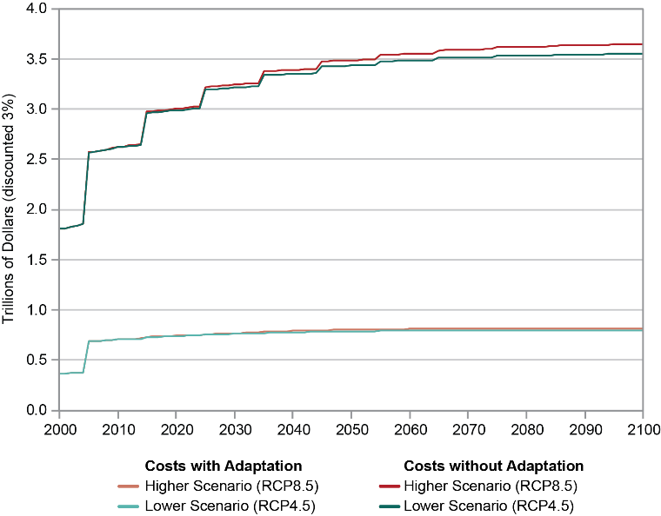
Fig. 8.1: Cumulative Costs of Sea Level Rise and Storm Surge to Coastal Property
Ch. 8 | Coastal Effects
This figure shows that cumulative damages (in 2015 dollars) to coastal property across the contiguous United States would be significantly reduced if protective adaptation measures were implemented, compared to a scenario where no adaptation occurs. Without adaptation, cumulative damages under the higher scenario (RCP8.5) are estimated at $3.6 trillion through 2100 (discounted at 3%), compared to $820 billion in the scenario where cost‐effective adaptation measures are implemented. Under the lower scenario (RCP4.5), costs without adaptation are reduced by $92 billion relative to RCP8.5 and are $800 billion with adaptation. Note: The stepwise nature of the graph is due to the fact that the analysis evaluates storm surge risks every 10 years, beginning in 2005. Source: adapted from EPA 2017.³⁵
Notes:
35: EPA, 2017: Multi-model Framework for Quantitative Sectoral Impacts Analysis: A Technical Report for the Fourth National Climate Assessment. EPA 430‐R‐17‐001. U.S. Environmental Protection Agency (EPA), Washington, D.C., 271 pp. https://cfpub.epa.gov/si/si_public_record_Report.cfm?dirEntryId=335095

Slide 7
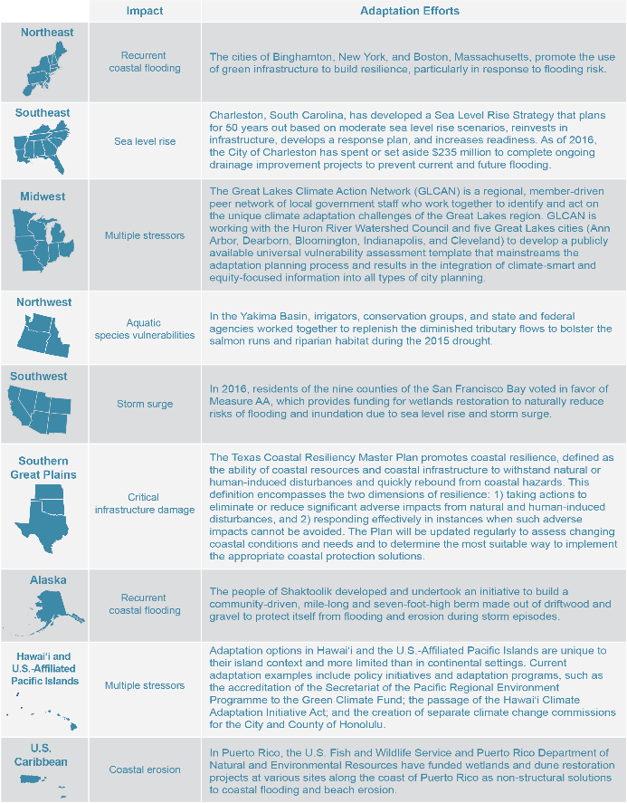
Fig. 8.2: Regional Coastal Impacts and Adaptation Efforts
Ch. 8 | Coastal Effects
The figure shows selected coastal effects of climate change in several coastal regions of the United States. See the online version of this figure at http://nca2018.globalchange.gov/chapter/8#fig-8-2 for additional examples. Source: NCA4 Regional Chapters.

Slide 8
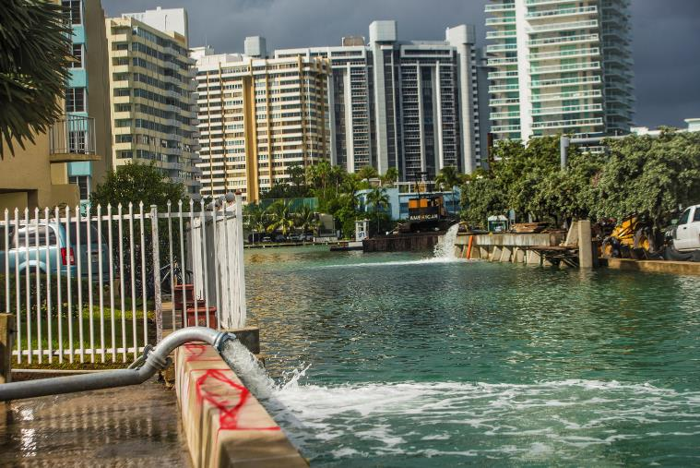
Fig. 8.3: Flooding Impacts in Miami Beach
Ch. 8 | Coastal Effects
Tidewater is pumped back into a canal near the Venetian Causeway entrance from Purdy Avenue, where the seawall is also being raised, during a seasonal king tide in Miami Beach, Florida, in 2016. Source: Max Reed/The New York Times/Redux

Slide 9
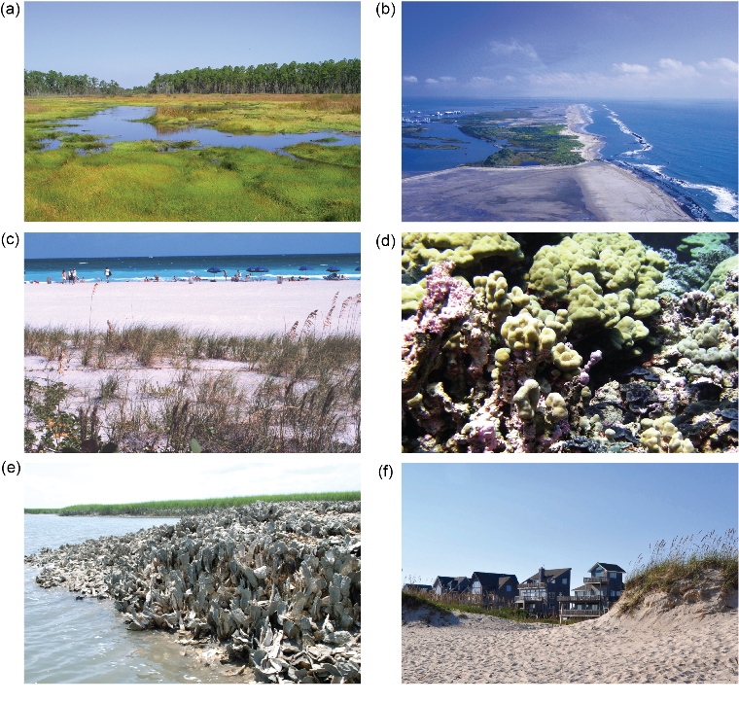
Fig. 8.4: Natural and Nature-Based Infrastructure Habitats
Ch. 8 | Coastal Effects
Natural and nature-based infrastructure habitats include seagrass meadows (not shown), (a) coastal wetlands, (b) barrier islands, (c) beaches, (d) corals, (e) oyster reefs, and (f) dunes. Each of these habitats provides storm and erosion risk reduction by causing waves to break or slow as they roll over the ecosystem. Waves slow down, for example, as they flow across the rough surfaces and crests of reef ecosystems; likewise, water decelerates as it pushes through the vegetation of wetland ecosystems. This slowing decreases wave height and energy as the wave proceeds through or across each ecosystem, reducing the amount of erosion that the wave would otherwise cause. Photo credits: (a) Gretchen L. Grammer, NOAA National Ocean Service; (b) Erik Zobrist, NOAA Restoration Center; (c) NOAA; (d) LCDR Eric Johnson, NOAA Corps.; (e) Jonathan Wilker, Purdue University; (f) Ann Tihansky, USGS.

Slide 10
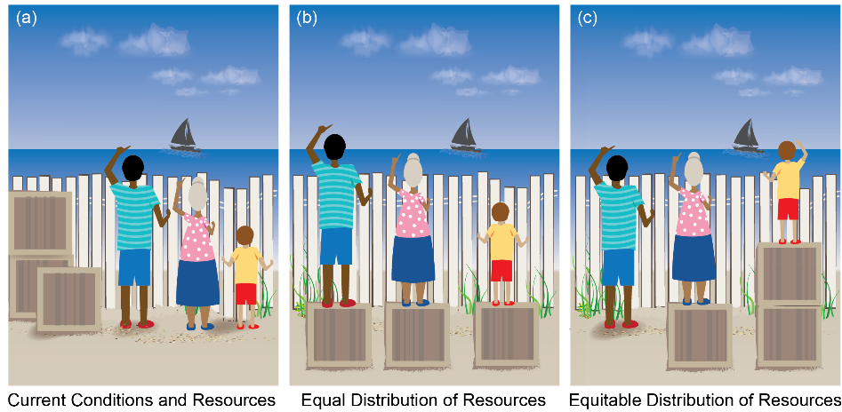
Fig. 8.5: Societal Options for Resource Allocation in a Changing Climate
Ch. 8 | Coastal Effects
Society has limited resources to help individuals and communities adapt to climate change. Panel (a) illustrates that there are finite resources available and that individuals and communities are starting from different levels of readiness to adapt. Panel (b) illustrates the option for society to choose an equal allocation of resources where everyone gets the same amount of help, or as illustrated in Panel (c), society can choose to distribute resources equitably to give people what they need to reach the same level of adaptation. Source: adapted with permission from Craig Froehle.

Slide 11
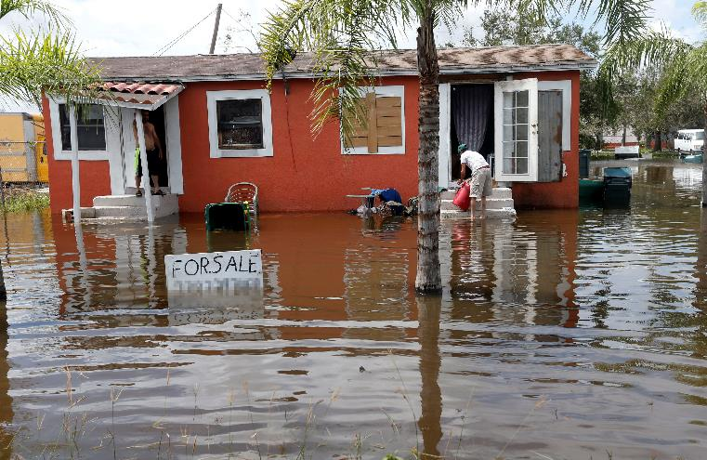
Fig. 8.6: Impacts of the 2017 Hurricane Season
Ch. 8 | Coastal Effects
Quintana Perez dumps water from a cooler into floodwaters in the aftermath of Hurricane Irma in Immokalee, Florida. Photo credit: AP Photo/Gerald Herbert.

Slide 12
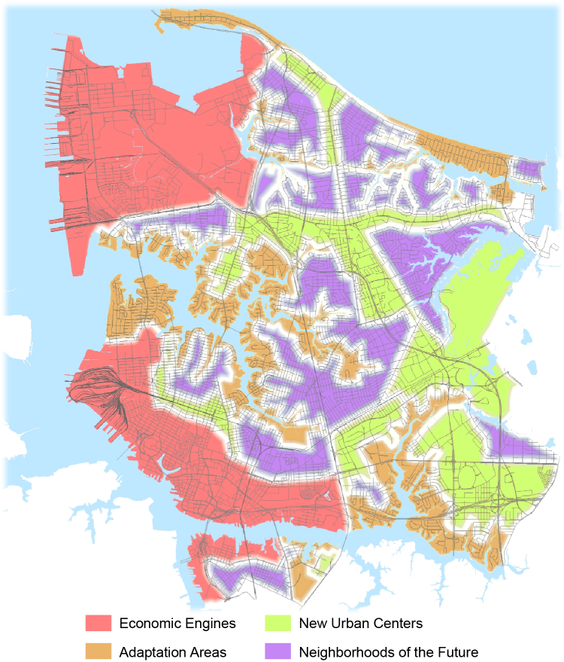
Fig. 8.7: Vision 2100: Designing the Coastal Community of the Future
Ch. 8 | Coastal Effects
The City of Norfolk is building a long-term strategy to address the flooding challenges due to sea level rise. Green areas are at low risk of coastal flooding and have great potential for high-density, mixed-use, and mixed-income development. Red areas are home to key economic assets that are essential to the city’s future. Brown areas are established neighborhoods that experience more frequent flooding. Purple areas are established neighborhoods at less risk of coastal flooding. (Descriptions in the legend are from the original City of Norfolk publication.) Source: City of Norfolk 2016.¹²⁰
Notes:
120: City of Norfolk, 2016: Norfolk Vision 2100. Norfolk, VA, 50 pp. https://www.norfolk.gov/DocumentCenter/View/27768

Slide 13
Ch. 8 | Coastal Effects
8
Chapter Author Team
Federal Coordinating Lead Authors
Jeffery Payne, National Oceanic and Atmospheric Administration
William V. Sweet, National Oceanic and Atmospheric Administration
Chapter Lead
Elizabeth Fleming, U.S. Army Corps of Engineers
Chapter Authors
Michael Craghan, U.S. Environmental Protection Agency
John Haines, U.S. Geological Survey
Juliette Finzi Hart, U.S. Geological Survey
Heidi Stiller, National Oceanic and Atmospheric Administration
Ariana Sutton-Grier, National Oceanic and Atmospheric Administration
Review Editor
Michael Kruk, ERT, Inc.

Slide 14
Ch. 8 | Coastal Effects
8
Acknowledgments
USGCRP Coordinators
Matthew Dzaugis, Program Coordinator
Christopher W. Avery, Senior Manager
Allyza Lustig, Program Coordinator
Fredric Lipschultz, Senior Scientist and Regional Coordinator

Slide 15
Fleming, E., J. Payne, W. Sweet, M. Craghan, J. Haines, J.F. Hart, H. Stiller, and A. Sutton-Grier, 2018: Coastal Effects. In Impacts, Risks, and Adaptation in the United States: Fourth National Climate Assessment, Volume II [Reidmiller, D.R., C.W. Avery, D.R. Easterling, K.E. Kunkel, K.L.M. Lewis, T.K. Maycock, and B.C. Stewart (eds.)]. U.S. Global Change Research Program, Washington, DC, USA. doi: 10.7930/NCA4.2018.CH8
https://nca2018.globalchange.gov/chapter/coastal

