Slide 1
Chapter 13 | Air Quality

Slide 2
Ch. 13 | Air Quality
13
Key Message #1
Increasing Risks from Air Pollution
More than 100 million people in the United States live in communities where air pollution exceeds health-based air quality standards. Unless counteracting efforts to improve air quality are implemented, climate change will worsen existing air pollution levels. This worsened air pollution would increase the incidence of adverse respiratory and cardiovascular health effects, including premature death. Increased air pollution would also have other environmental consequences, including reduced visibility and damage to agricultural crops and forests.

Slide 3
Ch. 13 | Air Quality
13
Key Message #2
Increasing Impacts of Wildfires
Wildfire smoke degrades air quality, increasing the health risks to tens of millions of people in the United States. More frequent and severe wildfires due to climate change would further diminish air quality, increase incidences of respiratory illness from exposure to wildfire smoke, impair visibility, and disrupt outdoor recreational activities.

Slide 4
Ch. 13 | Air Quality
13
Key Message #3
Increases in Airborne Allergen Exposure
The frequency and severity of allergic illnesses, including asthma and hay fever, are likely to increase as a result of a changing climate. Earlier spring arrival, warmer temperatures, changes in precipitation, and higher carbon dioxide concentrations can increase exposure to airborne pollen allergens.

Slide 5
Ch. 13 | Air Quality
13
Key Message #4
Co-Benefits of Greenhouse Gas Mitigation
Many emission sources of greenhouse gases also emit air pollutants that harm human health. Controlling these common emission sources would both mitigate climate change and have immediate benefits for air quality and human health. Because methane is both a greenhouse gas and an ozone precursor, reductions of methane emissions have the potential to simultaneously mitigate climate change and improve air quality.

Slide 6
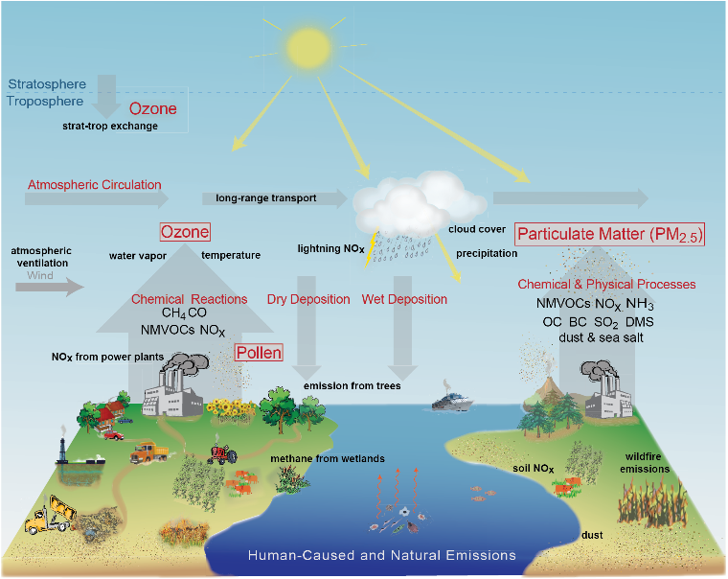
Fig. 13.1: Pathways by Which Climate Change Will Influence Air Pollution
Ch. 13 | Air Quality
Climate change will alter (black bold text) chemical and physical interactions that create, remove, and transport air pollution (red text and gray arrows). Human activities and natural processes release precursors for ground-level ozone (O₃) and particulate matter with a diameter less than 2.5 micrometers (PM_{2.5}), including methane (CH₄), carbon monoxide (CO), nitrogen oxides (NO_{x}), non-methane volatile organic compounds (NMVOCs), sulfur dioxide (SO₂), ammonia (NH₃), organic carbon (OC), black carbon (BC), and dimethyl sulfide (DMS); and direct atmospheric pollutants, including mineral dust, sea salt, pollen, spores, and food particles. Source: adapted from Fiore et al. 2015.⁴ Reprinted by permission of the publisher (Taylor & Francis Ltd., http://www.tandfonline.com).
Notes:
4: Fiore, A.M., V. Naik, and E.M. Leibensperger, 2015: Air quality and climate connections. Journal of the Air & Waste Management Association, 65 (6), 645-685. http://dx.doi.org/10.1080/10962247.2015.1040526

Slide 7
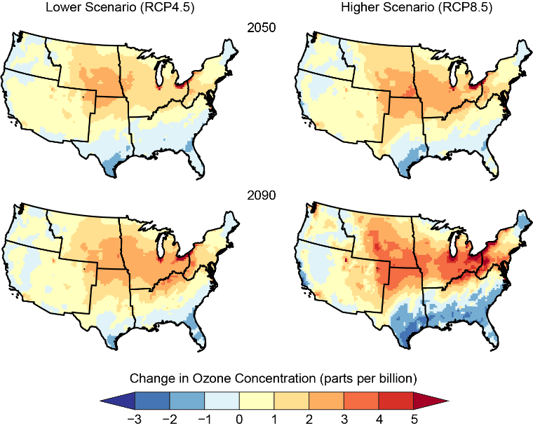
Fig. 13.2: Projected Changes in Summer Season Ozone
Ch. 13 | Air Quality
The maps show the change in summer averages of the maximum daily 8-hour ozone concentration (as compared to the 1995–2005 average). Summertime ozone is projected to change non-uniformly across the United States based on multiyear simulations from the Community Multiscale Air Quality (CMAQ) modeling system. Those changes are amplified under the higher scenario (RCP8.5) compared with the lower scenario (RCP4.5), as well as at 2090 compared with 2050. Data are not available for Alaska, Hawai‘i, U.S.-Affiliated Pacific Islands, and the U.S. Caribbean. Source: adapted from EPA 2017.¹
Notes:
1: EPA, 2017: Multi-model Framework for Quantitative Sectoral Impacts Analysis: A Technical Report for the Fourth National Climate Assessment. EPA 430‐R‐17‐001. U.S. Environmental Protection Agency (EPA), Washington, D.C. https://cfpub.epa.gov/si/si_public_record_Report.cfm?dirEntryId=335095

Slide 8
Ch. 13 | Air Quality
13
Chapter Author Team
Federal Coordinating Lead Author
Christopher G. Nolte, U.S. Environmental Protection Agency
Chapter Lead
Christopher G. Nolte, U.S. Environmental Protection Agency
Chapter Authors
Patrick D. Dolwick, U.S. Environmental Protection Agency
Neal Fann, U.S. Environmental Protection Agency
Larry W. Horowitz, National Oceanic and Atmospheric Administration
Vaishali Naik, National Oceanic and Atmospheric Administration
Robert W. Pinder, U.S. Environmental Protection Agency
Tanya L. Spero, U.S. Environmental Protection Agency
Darrell A. Winner, U.S. Environmental Protection Agency
Lewis H. Ziska, U.S. Department of Agriculture
Review Editor
David D’Onofrio, Atlanta Regional Commission

Slide 9
Ch. 13 | Air Quality
13
Acknowledgments
USGCRP Coordinators
Ashley Bieniek-Tobasco, Health Program Coordinator
Sarah Zerbonne, Adaptation and Decision Science Coordinator
Christopher W. Avery, Senior Manager

Slide 10
Nolte, C.G., P.D. Dolwick, N. Fann, L.W. Horowitz, V. Naik, R.W. Pinder, T.L. Spero, D.A. Winner, and L.H. Ziska, 2018: Air Quality. In Impacts, Risks, and Adaptation in the United States: Fourth National Climate Assessment, Volume II [Reidmiller, D.R., C.W. Avery, D.R. Easterling, K.E. Kunkel, K.L.M. Lewis, T.K. Maycock, and B.C. Stewart (eds.)]. U.S. Global Change Research Program, Washington, DC, USA. doi: 10.7930/NCA4.2018.CH13
https://nca2018.globalchange.gov/chapter/air-quality

