Slide 1
Chapter 14 | Human Health

Slide 2
Ch. 14 | Human Health
14
Key Message #1
Climate Change Affects the Health of All Americans
The health and well-being of Americans are already affected by climate change, with the adverse health consequences projected to worsen with additional climate change. Climate change affects human health by altering exposures to heat waves, floods, droughts, and other extreme events; vector-, food- and waterborne infectious diseases; changes in the quality and safety of air, food, and water; and stresses to mental health and well-being.

Slide 3
Ch. 14 | Human Health
14
Key Message #2
Exposure and Resilience Vary Across Populations and Communities
People and communities are differentially exposed to hazards and disproportionately affected by climate-related health risks. Populations experiencing greater health risks include children, older adults, low-income communities, and some communities of color.

Slide 4
Ch. 14 | Human Health
14
Key Message #3
Adaptation Reduces Risks and Improves Health
Proactive adaptation policies and programs reduce the risks and impacts from climate-sensitive health outcomes and from disruptions in healthcare services. Additional benefits to health arise from explicitly accounting for climate change risks in infrastructure planning and urban design.

Slide 5
Ch. 14 | Human Health
14
Key Message #4
Reducing Greenhouse Gas Emissions Results in Health and Economic Benefits
Reducing greenhouse gas emissions would benefit the health of Americans in the near and long term. By the end of this century, thousands of American lives could be saved and hundreds of billions of dollars in health-related economic benefits gained each year under a pathway of lower greenhouse gas emissions.

Slide 6
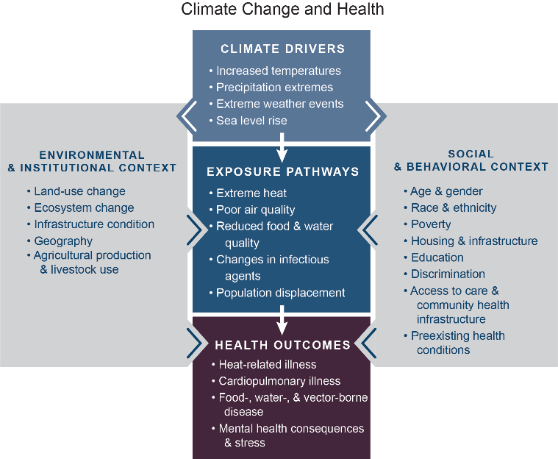
Fig. 14.1: Climate Change and Health
Ch. 14 | Human Health
This conceptual diagram illustrates the exposure pathways by which climate change could affect human health. Exposure pathways exist within the context of other factors that positively or negatively influence health outcomes (gray side boxes). Key factors that influence vulnerability for individuals are shown in the right box and include social determinants of health and behavioral choices. Key factors that influence vulnerability at larger scales, such as natural and built environments, governance and management, and institutions, are shown in the left box. The extent to which climate change could alter the burden of disease in any location at any point in time will depend not just on the magnitude of local climate change but also on individual and population vulnerability, exposure to changing weather patterns, and capacity to manage risks, which may also be affected by climate change. Source: Balbus et al. 2016.²
Notes:
2: Balbus, J., A. Crimmins, J.L. Gamble, D.R. Easterling, K.E. Kunkel, S. Saha, and M.C. Sarofim, 2016: Ch. 1: Introduction: Climate change and human health. The Impacts of Climate Change on Human Health in the United States: A Scientific Assessment. U.S. Global Change Research Program, Washington, DC, 25–42. http://dx.doi.org/10.7930/J0VX0DFW

Slide 7
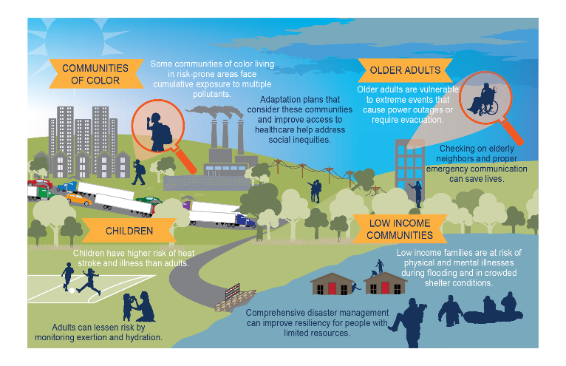
Fig. 14.2: Vulnerable Populations
Ch. 14 | Human Health
Examples of populations at higher risk of exposure to adverse climate-related health threats are shown along with adaptation measures that can help address disproportionate impacts. When considering the full range of threats from climate change as well as other environmental exposures, these groups are among the most exposed, most sensitive, and have the least individual and community resources to prepare for and respond to health threats. White text indicates the risks faced by those communities, while dark text indicates actions that can be taken to reduce those risks. Source: EPA.

Slide 8
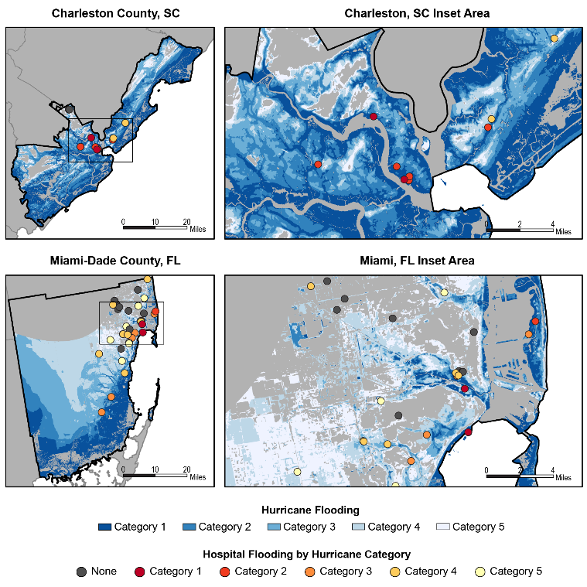
Fig. 14.3: Hospitals at Risk from Storm Surge by Hurricanes
Ch. 14 | Human Health
These maps show the locations of hospitals in (top) Charleston County, South Carolina, and (bottom) Miami-Dade County, Florida, with respect to storm surge inundation for different categories of hurricanes making landfall at high tide. Colors indicate the lowest category hurricane affecting a given location, with darker blue shading indicating areas with the greatest susceptibility to flooding and darker red dots indicating the most vulnerable hospitals. Four of the 38 (11%) hospitals in Miami-Dade County face possible storm surge inundation following a Category 2 hurricane; this could increase to 26 (68%) following a Category 5 hurricane. Charleston hospitals are more exposed to inundation risks. Seven of the 11 (64%) hospitals in Charleston County face possible storm surge inundation following a Category 2; this could increase to 9 (82%) following a Category 4. The impacts of a storm surge will depend on the effectiveness of resilience measures, such as flood walls, deployed by the facilities. Data from National Hurricane Center 2018¹⁵² and the Department of Homeland Security 2018.¹⁵³
Notes:
152: National Hurricane Center, 2018: National Storm Surge Hazard Maps—Version 2. NOAA National Weather Service, Miami, FL. https://www.nhc.noaa.gov/nationalsurge/
153: DHS, 2018: Homeland Infrastructure Foundation-Level Data (HIFLD) [web tool]. U.S. Department of Homeland Security (DHS), Washington, DC. https://hifld-geoplatform.opendata.arcgis.com/

Slide 9
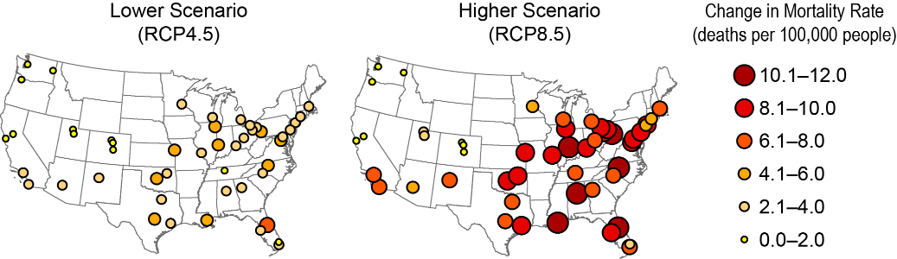
Fig. 14.4: Projected Change in Annual Extreme Temperature Mortality
Ch. 14 | Human Health
The maps show estimated changes in annual net mortality due to extremely hot and cold days in 49 U.S. cities for 2080–2099 as compared to 1989–2000. Across these cities, the change in mortality is projected to be an additional 9,300 deaths each year under a higher scenario (RCP8.5) and 3,900 deaths each year under a lower scenario (RCP4.5). Assuming a future in which the human health response to extreme temperatures in all 49 cities was equal to that of Dallas today (for example, as a result of availability of air conditioning or physiological adaptation) results in an approximate 50% reduction in these mortality estimates. For example, in Atlanta, an additional 349 people are projected to die from extreme temperatures each year by the end of century under RCP8.5. Assuming residents of Atlanta in 2090 have the adaptive capacity of Dallas residents today, this number is reduced to 128 additional deaths per year. Cities without circles should not be interpreted as having no extreme temperature impact. Data not available for the U.S. Caribbean, Alaska, or Hawai‘i & U.S.-Affiliated Pacific Islands regions. Source: adapted from EPA 2017.¹⁵⁷
Notes:
157: EPA, 2017: Multi-model Framework for Quantitative Sectoral Impacts Analysis: A Technical Report for the Fourth National Climate Assessment. EPA 430‐R‐17‐001. U.S. Environmental Protection Agency (EPA), Washington, DC, 271 pp. https://cfpub.epa.gov/si/si_public_record_Report.cfm?dirEntryId=335095

Slide 10
Ch. 14 | Human Health
14
Chapter Author Team
Federal Coordinating Lead Authors
John M. Balbus, National Institute of Environmental Health Sciences
George Luber, Centers for Disease Control and Prevention
Chapter Lead
Kristie L. Ebi, University of Washington
Chapter Authors
Aparna Bole, University Hospitals Rainbow Babies & Children’s Hospital, Ohio
Allison Crimmins, U.S. Environmental Protection Agency
Gregory Glass, University of Florida
Shubhayu Saha, Centers for Disease Control and Prevention
Mark M. Shimamoto, American Geophysical Union
Juli Trtanj, National Oceanic and Atmospheric Administration
Jalonne L. White-Newsome, The Kresge Foundation
Review Editor
David D’Onofrio, Atlanta Regional Commission

Slide 11
Ch. 14 | Human Health
14
Acknowledgments
Technical Contributor
Stasia Widerynski, Centers for Disease Control and Prevention
USGCRP Coordinators
Ashley Bieniek-Tobasco, Health Program Coordinator
Sarah Zerbonne, Adaptation and Decision Science Coordinator
Natalie Bennett, Adaptation and Assessment Analyst
Christopher W. Avery, Senior Manager

Slide 12
Ebi, K.L., J.M. Balbus, G. Luber, A. Bole, A. Crimmins, G. Glass, S. Saha, M.M. Shimamoto, J. Trtanj, and J.L. White-Newsome, 2018: Human Health. In Impacts, Risks, and Adaptation in the United States: Fourth National Climate Assessment, Volume II [Reidmiller, D.R., C.W. Avery, D.R. Easterling, K.E. Kunkel, K.L.M. Lewis, T.K. Maycock, and B.C. Stewart (eds.)]. U.S. Global Change Research Program, Washington, DC, USA. doi: 10.7930/NCA4.2018.CH14
https://nca2018.globalchange.gov/chapter/health

