Slide 1
Chapter 15 | Tribes and Indigenous Peoples

Slide 2
Ch. 15 | Tribes and Indigenous Peoples
15
Key Message #1
Indigenous Livelihoods and Economies at Risk
Climate change threatens Indigenous peoples’ livelihoods and economies, including agriculture, hunting and gathering, fishing, forestry, energy, recreation, and tourism enterprises. Indigenous peoples’ economies rely on, but face institutional barriers to, their self-determined management of water, land, other natural resources, and infrastructure that will be impacted increasingly by changes in climate.

Slide 3
Ch. 15 | Tribes and Indigenous Peoples
15
Key Message #2
Physical, Mental, and Indigenous Values-Based Health at Risk
Indigenous health is based on interconnected social and ecological systems that are being disrupted by a changing climate. As these changes continue, the health of individuals and communities will be uniquely challenged by climate impacts to lands, waters, foods, and other plant and animal species. These impacts threaten sites, practices, and relationships with cultural, spiritual, or ceremonial importance that are foundational to Indigenous peoples’ cultural heritages, identities, and physical and mental health.

Slide 4
Ch. 15 | Tribes and Indigenous Peoples
15
Key Message #3
Adaptation, Disaster Management, Displacement, and Community-Led Relocations
Many Indigenous peoples have been proactively identifying and addressing climate impacts; however, institutional barriers exist in the United States that severely limit their adaptive capacities. These barriers include limited access to traditional territory and resources and the limitations of existing policies, programs, and funding mechanisms in accounting for the unique conditions of Indigenous communities. Successful adaptation in Indigenous contexts relies on use of Indigenous knowledge, resilient and robust social systems and protocols, a commitment to principles of self-determination, and proactive efforts on the part of federal, state, and local governments to alleviate institutional barriers.

Slide 5
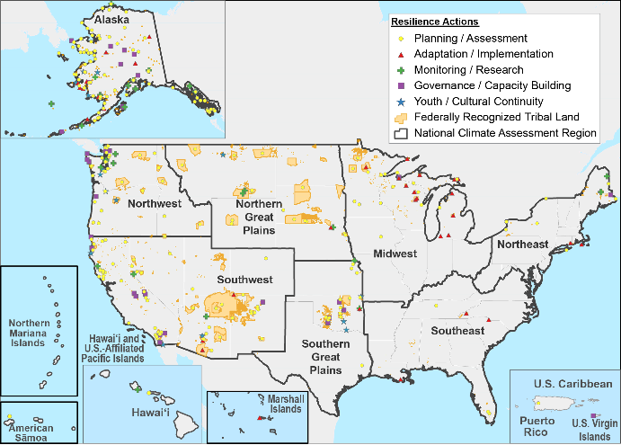
Fig. 15.1: Indigenous Peoples’ Climate Initiatives and Plans
Ch. 15 | Tribes and Indigenous Peoples
Many Indigenous peoples are taking steps to adapt to climate change impacts. Search the online version of this map by activity type, region, and sector to find more information and links to each project: https://biamaps.doi.gov/nca/. To provide feedback and add new projects for inclusion in the database, see: https://www.bia.gov/bia/ots/tribal-resilience-program/nca/. Thus far, tribal entities in the Northwest have the highest concentration of climate activities (Ch. 24: Northwest). For other case studies of tribal adaptation activities, see both the Institute for Tribal Environmental Professionals’ Tribal Profiles,¹ and Tribal Case Studies within the U.S. Climate Resilience Toolkit.^{2,3} Source: Bureau of Indian Affairs.
Notes:
1: ITEP, 2017: Tribes and Climate Change Program: Tribal Profiles. Northern Arizona University, Institute for Tribal Environmental Professionals (ITEP), Flagstaff, AZ. http://www7.nau.edu/Itep/Main/Tcc/Tribes/
2: U.S. Federal Government, 2017: U.S. Climate Resilience Toolkit: Tribal Nations [web site]. U.S. Global Change Research Program, Washington, DC https://toolkit.climate.gov/topics/tribal-nations
3: U.S. Federal Government, 2018: U.S. Climate Resilience Toolkit: Case Studies [web site]. U.S. Global Change Research Program, Washington, DC. https://toolkit.climate.gov/case-studies

Slide 6
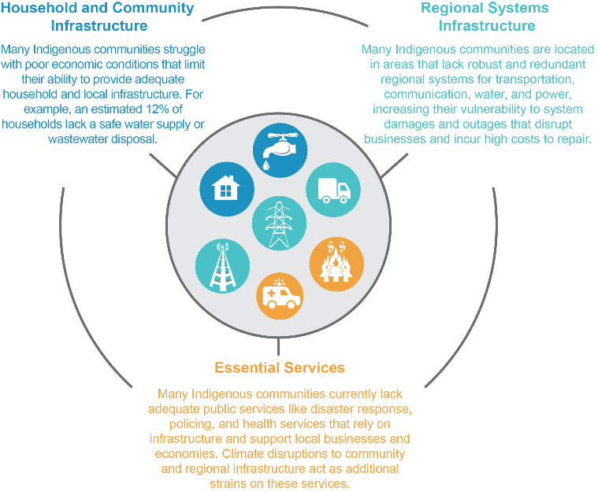
Fig. 15.2: Infrastructure and Economic Vulnerabilities
Ch. 15 | Tribes and Indigenous Peoples
Communities’ economic potential and livelihoods rely on infrastructure and the essential services it delivers, and many tribes and Indigenous communities already face acute infrastructure challenges that make them highly vulnerable to climate impacts.²² Indigenous peoples along the coasts and in the islands, the Southwest, and Alaska have experienced the most extensive infrastructure-related impacts thus far (Ch. 8: Coastal; Ch. 20: U.S. Caribbean; Ch. 25: Southwest; Ch. 26: Alaska; Ch. 27: Hawai‘i & Pacific Islands). Source: USGCRP.
Notes:
22: Norton-Smith, K., K. Lynn, K. Chief, K. Cozzetto, J. Donatuto, M.H. Redsteer, L.E. Kruger, J. Maldonado, C. Viles, and K.P. Whyte, 2016: Climate change and indigenous peoples: A synthesis of current impacts and experiences. Gen. Tech. Rep. PNW-GTR-944. U.S. Department of Agriculture, Forest Service, Pacific Northwest Research Station, Portland, OR, 136 pp. https://www.fs.usda.gov/treesearch/pubs/53156

Slide 7
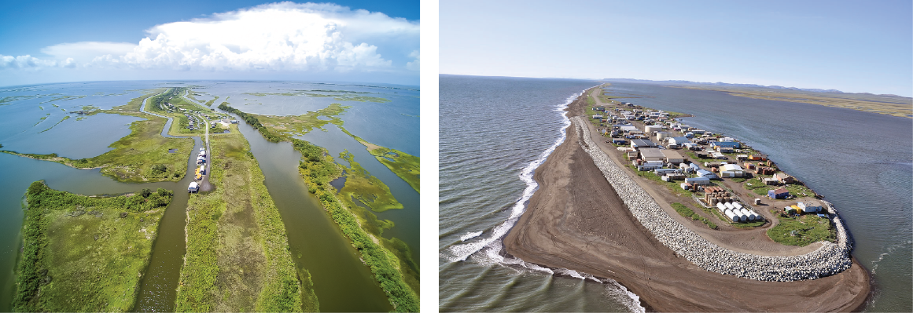
Fig. 15.3: Isle de Jean Charles, LA, and Kivalina, AK
Ch. 15 | Tribes and Indigenous Peoples
These photos show aerial views of (left) Isle de Jean Charles, Louisiana, and (right) Kivalina, Alaska. As projections of sea level rise and coastal inundation are realized, many impacted communities are confronting political, ecological, and existential questions about how to adapt. Photo credits: (left) Ronald Stine; (right) ShoreZone (CC BY 3.0).

Slide 8
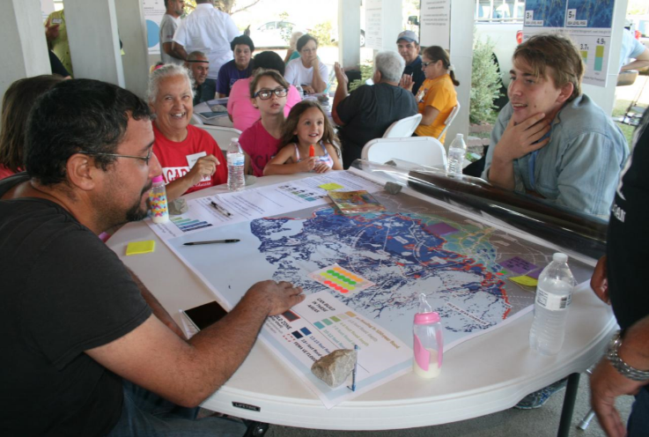
Fig. 15.4: Community Planning
Ch. 15 | Tribes and Indigenous Peoples
Some tribal communities at risk of displacement from climate change are actively planning whole-community relocation strategies. As part of the resettlement of the tribal community of Isle de Jean Charles, residents are working with the Lowlander Center (a local, nongovernmental organization), the State of Louisiana, and others to finalize a plan that reflects the physical, sociocultural, and economic needs of the community. Photo credit: Louisiana Office of Community Development.

Slide 9
Ch. 15 | Tribes and Indigenous Peoples
15
Chapter Author Team
Federal Coordinating Lead Author
Rachael Novak, U.S. Department of the Interior, Bureau of Indian Affairs
Chapter Lead
Lesley Jantarasami, Oregon Department of Energy
Chapter Authors
Roberto Delgado, National Institutes of Health
Elizabeth Marino, Oregon State University–Cascades
Shannon McNeeley, North Central Climate Adaptation Science Center and Colorado State University
Chris Narducci, U.S. Department of Housing and Urban Development
Julie Raymond-Yakoubian, Kawerak, Inc.
Loretta Singletary, University of Nevada, Reno
Kyle Powys Whyte, Michigan State University
Review Editor
Karen Cozzetto, Northern Arizona University

Slide 10
Ch. 15 | Tribes and Indigenous Peoples
15
Acknowledgments
USGCRP Coordinators
Susan Aragon-Long, Senior Scientist
Allyza Lustig, Program Coordinator

Slide 11
Jantarasami, L.C., R. Novak, R. Delgado, E. Marino, S. McNeeley, C. Narducci, J. Raymond-Yakoubian, L. Singletary, and K. Powys Whyte, 2018: Tribes and Indigenous Peoples. In Impacts, Risks, and Adaptation in the United States: Fourth National Climate Assessment, Volume II [Reidmiller, D.R., C.W. Avery, D.R. Easterling, K.E. Kunkel, K.L.M. Lewis, T.K. Maycock, and B.C. Stewart (eds.)]. U.S. Global Change Research Program, Washington, DC, USA. doi: 10.7930/NCA4.2018.CH15
https://nca2018.globalchange.gov/chapter/tribes

