Slide 1
Chapter 20 | U.S. Caribbean

Slide 2
Ch. 20 | U.S. Caribbean
20
Key Message #1
Freshwater
Freshwater is critical to life throughout the Caribbean. Increasing global carbon emissions are projected to reduce average rainfall in this region by the end of the century, constraining freshwater availability, while extreme rainfall events, which can increase freshwater flooding impacts, are expected to increase in intensity. Saltwater intrusion associated with sea level rise will reduce the quantity and quality of freshwater in coastal aquifers. Increasing variability in rainfall events and increasing temperatures will likely alter the distribution of ecological life zones and exacerbate existing problems in water management, planning, and infrastructure capacity.

Slide 3
Ch. 20 | U.S. Caribbean
20
Key Message #2
Marine Resources
Marine ecological systems provide key ecosystem services such as commercial and recreational fisheries and coastal protection. These systems are threatened by changes in ocean surface temperature, ocean acidification, sea level rise, and changes in the frequency and intensity of storm events. Degradation of coral and other marine habitats can result in changes in the distribution of species that use these habitats and the loss of live coral cover, sponges, and other key species. These changes will likely disrupt valuable ecosystem services, producing subsequent effects on Caribbean island economies.

Slide 4
Ch. 20 | U.S. Caribbean
20
Key Message #3
Coastal Systems
Coasts are a central feature of Caribbean island communities. Coastal zones dominate island economies and are home to critical infrastructure, public and private property, cultural heritage, and natural ecological systems. Sea level rise, combined with stronger wave action and higher storm surges, will worsen coastal flooding and increase coastal erosion, likely leading to diminished beach area, loss of storm surge barriers, decreased tourism, and negative effects on livelihoods and well-being. Adaptive planning and nature-based strategies, combined with active community participation and traditional knowledge, are beginning to be deployed to reduce the risks of a changing climate.

Slide 5
Ch. 20 | U.S. Caribbean
20
Key Message #4
Rising Temperatures
Natural and social systems adapt to the temperatures under which they evolve and operate. Changes to average and extreme temperatures have direct and indirect effects on organisms and strong interactions with hydrological cycles, resulting in a variety of impacts. Continued increases in average temperatures will likely lead to decreases in agricultural productivity, changes in habitats and wildlife distributions, and risks to human health, especially in vulnerable populations. As maximum and minimum temperatures increase, there are likely to be fewer cool nights and more frequent hot days, which will likely affect the quality of life in the U.S. Caribbean.

Slide 6
Ch. 20 | U.S. Caribbean
20
Key Message #5
Disaster Risk Response to Extreme Events
Extreme events pose significant risks to life, property, and economy in the Caribbean, and some extreme events, such as flooding and droughts, are projected to increase in frequency and intensity. Increasing hurricane intensity and associated rainfall rates will likely affect human health and well-being, economic development, conservation, and agricultural productivity. Increased resilience will depend on collaboration and integrated planning, preparation, and responses across the region.

Slide 7
Ch. 20 | U.S. Caribbean
20
Key Message #6
Increasing Adaptive Capacity Through Regional Collaboration
Shared knowledge, collaborative research and monitoring, and sustainable institutional adaptive capacity can help support and speed up disaster recovery, reduce loss of life, enhance food security, and improve economic opportunity in the U.S. Caribbean. Increased regional cooperation and stronger partnerships in the Caribbean can expand the region’s collective ability to achieve effective actions that build climate change resilience, reduce vulnerability to extreme events, and assist in recovery efforts.

Slide 8
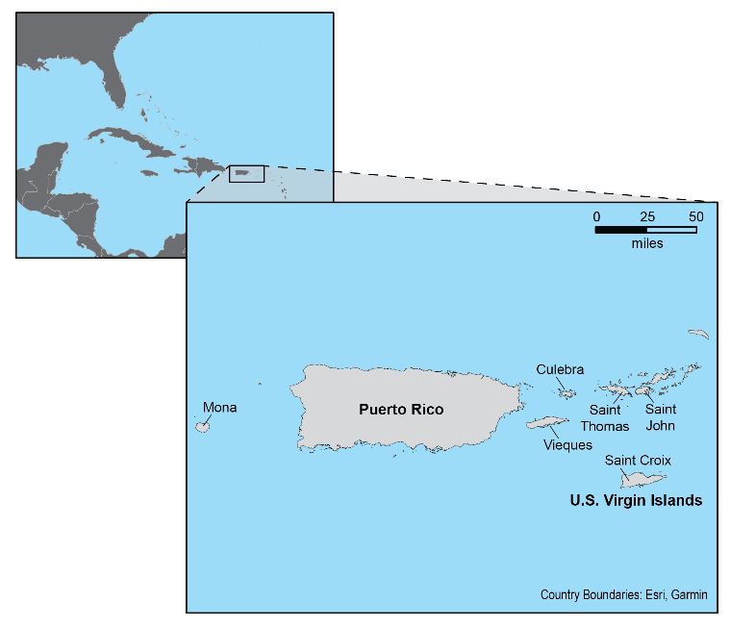
Fig. 20.1: U.S. Caribbean Region
Ch. 20 | U.S. Caribbean
The U.S. Caribbean includes the Commonwealth of Puerto Rico and the territory of the U.S. Virgin Islands. The region includes seven inhabited islands and nearly 800 smaller islands and cays.

Slide 9
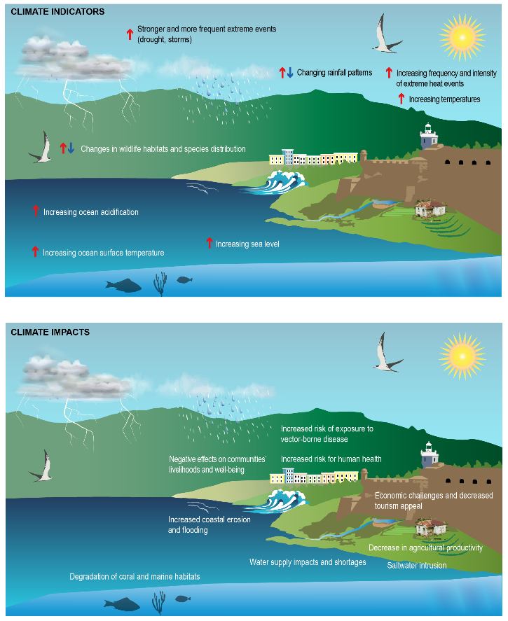
Fig. 20.2: Climate Indicators and Impacts
Ch. 20 | U.S. Caribbean
(top) Key indicators for monitoring climate variability and change in the U.S. Caribbean include sea level rise, ocean temperature and acidity, air temperature, rainfall patterns, frequency of extreme events, and changes in wildlife habitats. (bottom) Changes in these climate indicators result in environmental and social impacts to natural ecosystems, infrastructure, and society, including degradation of coral and marine habitats, increased coastal flooding and erosion, decrease in agricultural productivity, water supply shortages, negative effects on communities’ livelihoods and on human health, as well as economic challenges and decreased tourism appeal. Source: Puerto Rico Department of Natural and Environmental Resources.

Slide 10
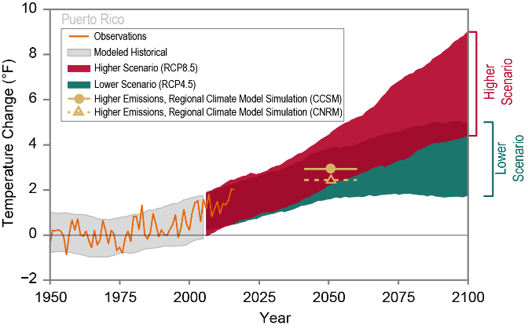
Fig. 20.3: Observed and Projected Temperature Change for Puerto Rico
Ch. 20 | U.S. Caribbean
Observed and projected temperature changes are shown as compared to the 1951–1980 average. Observed data are for 1950–2017, and the range of model simulations for the historical period is for 1950–2005. The range of projected temperature changes from global climate models is shown for 2006–2100 under a lower (RCP4.5) and a higher (RCP8.5) scenario (see the Scenario Products section of App. 3). Projections from two regional climate models are shown for 2036–2065, and they align with those from global models for the same period.^{29,30} Sources: NOAA NCEI, CICS-NC, and USGS.
Notes:
29: Wootten, A., J.H. Bowden, R. Boyles, and A. Terando, 2016: The sensitivity of WRF downscaled precipitation in Puerto Rico to cumulus parameterization and interior grid nudging. Journal of Applied Meteorology and Climatology, 55 (10), 2263-2281. http://dx.doi.org/10.1175/jamc-d-16-0121.1
30: Bowden, J., A. Wootten, A. Terando, and R. Boyles. 2018: Weather Research and Forecasting (WRF): Puerto Rico and US Virgin Islands Dynamical Downscaled Climate Change Projections. U.S. Geological Survey. http://dx.doi.org/10.5066/F7GB23BW

Slide 11
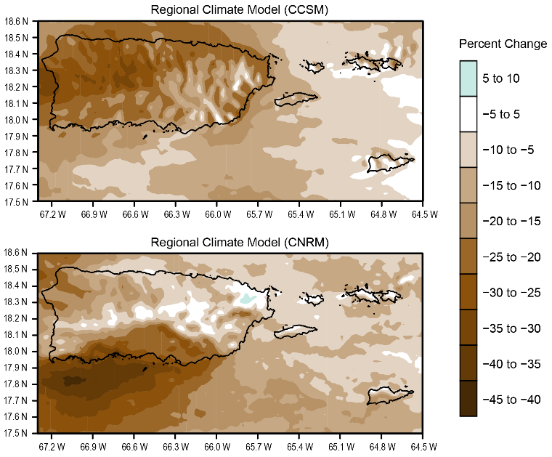
Fig. 20.4: Projected Precipitation Change for Puerto Rico
Ch. 20 | U.S. Caribbean
This figure shows the projected percent change in annual precipitation over the U.S. Caribbean region for the period 2040–2060 compared to 1985–2005 based on the results of two regional climate model simulations.^{29,30} These simulations downscale two global models for the higher scenario (RCP8.5)²⁶ and show that within-island changes are projected to exceed a 10% reduction in annual rainfall. Uncertainty remains as to the location of the largest reductions within the islands. Projections of precipitation change for the U.S. Virgin Islands are particularly uncertain because of model limitations related to resolving these smaller islands. Source: Bowden et al. 2018.³⁰
Notes:
26: USGCRP, 2017: Climate Science Special Report: Fourth National Climate Assessment, Volume I. Wuebbles, D.J., D.W. Fahey, K.A. Hibbard, D.J. Dokken, B.C. Stewart, and T.K. Maycock, Eds. U.S. Global Change Research Program, Washington, DC, 470 pp. http://dx.doi.org/10.7930/J0J964J6
29: Wootten, A., J.H. Bowden, R. Boyles, and A. Terando, 2016: The sensitivity of WRF downscaled precipitation in Puerto Rico to cumulus parameterization and interior grid nudging. Journal of Applied Meteorology and Climatology, 55 (10), 2263-2281. http://dx.doi.org/10.1175/jamc-d-16-0121.1
30: Bowden, J., A. Wootten, A. Terando, and R. Boyles. 2018: Weather Research and Forecasting (WRF): Puerto Rico and US Virgin Islands Dynamical Downscaled Climate Change Projections. U.S. Geological Survey. http://dx.doi.org/10.5066/F7GB23BW

Slide 12
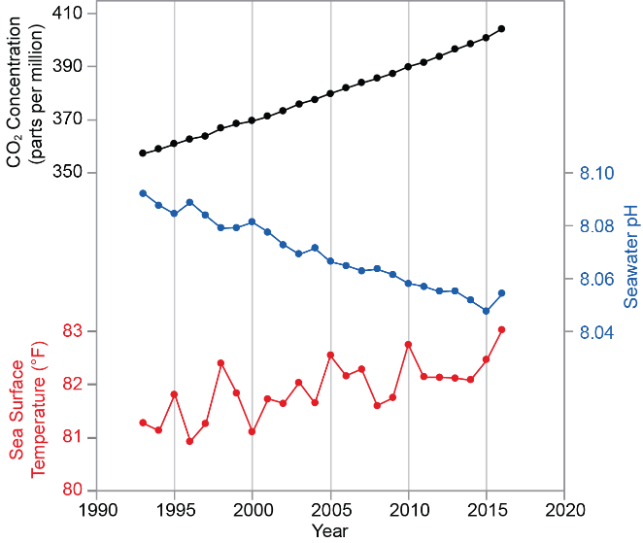
Fig. 20.5: Ocean Chemistry and Temperature
Ch. 20 | U.S. Caribbean
This figure represents an annual time series from 1993 to 2016 of atmospheric carbon dioxide (CO₂; black line), sea surface temperature (red line), and seawater pH (blue line) for the Caribbean region. The Caribbean ocean is subject to changes in surface pH and temperature due to the increase in atmospheric CO₂ concentrations. The oceans have the capacity to not only absorb heat from the air (leading to ocean warming) but also to absorb some of the CO₂ in the atmosphere, causing more acidic (lower pH) oceans. Continued ocean acidification and warming have potentially detrimental consequences for marine life and dependent coastal communities in the Caribbean islands. Source: University of Puerto Rico.

Slide 13
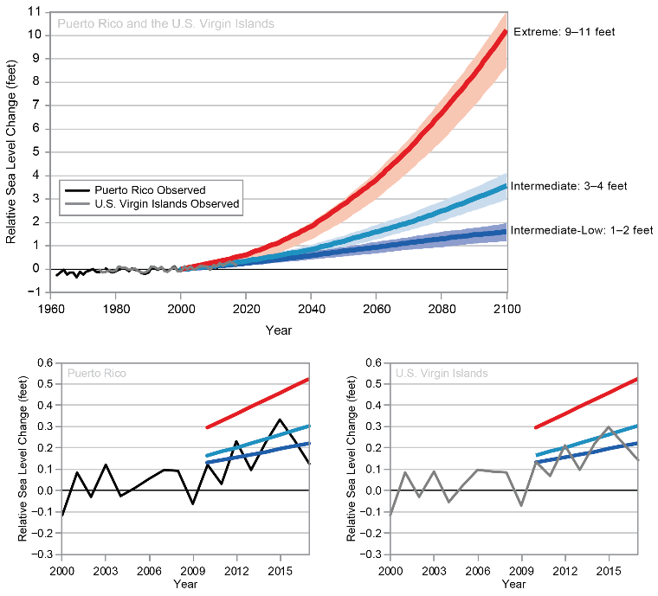
Fig. 20.6: Observed and Projected Sea Level Rise
Ch. 20 | U.S. Caribbean
(top) Observed sea level rise trends in Puerto Rico and the U.S. Virgin Islands reflect an increase in sea level of about 0.08 inches (2.0 mm) per year for the period 1962–2017 for Puerto Rico and for 1975–2017 for the U.S. Virgin Islands. The bottom panels show a closer look at more recent trends from 2000 to 2017 that measure a rise in sea level of about 0.24 inches (6.0 mm) per year. Projections of sea level rise are shown under three different scenarios of Intermediate-Low (1–2 feet), Intermediate (3–4 feet), and Extreme (9–11 feet) sea level rise. The scenarios depict the range of future sea level rise based on factors such as global greenhouse gas emissions and the loss of glaciers and ice sheets. Sources: NOAA NCEI and CICS-NC.

Slide 14
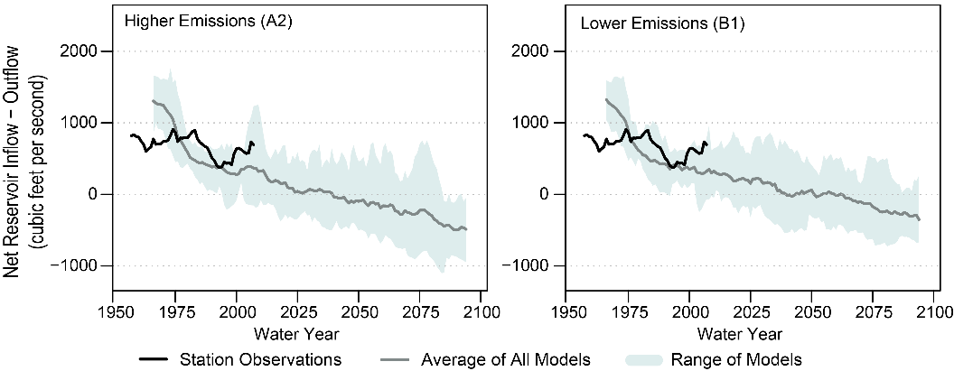
Fig. 20.7: Projected Change in Annual Streamflow
Ch. 20 | U.S. Caribbean
This figure shows ten-year moving averages of projected annual streamflow leaving Lago La Plata and Lago Loíza. Projections were developed using an estimation of water supply entering the reservoirs and an estimation of withdrawals. The former was developed using a range of global climate models (GCMs; shading indicates averages from all GCMs used in the study) and the mean of that range (gray line). The latter was developed using a conservative population growth rate. Annual streamflow is modeled under a higher emissions scenario (SRES A2; left panel) and a lower emissions scenario (SRES B1; right panel). The solid black line is the historical streamflow through 2012.⁴⁶ It is important to note these are the best estimates available for projected streamflow and use the older generation of GCMs, which project more drying for the region.²⁸ Source: adapted from Van Beusekom et al. 2016.⁴⁶
Notes:
28: Hayhoe, K., 2013: Quantifying Key Drivers of Climate Variability and Change for Puerto Rico and the Caribbean. Texas Tech University, [Lubbock, TX], various pp. http://www.thinkamap.com/share/IndividualGISdata/PDFs/KatherineHayhoe_CaribbeanFinalReport.pdf
46: Van Beusekom, A.E., W.A. Gould, A.J. Terando, and J.A. Collazo, 2016: Climate change and water resources in a tropical island system: Propagation of uncertainty from statistically downscaled climate models to hydrologic models. International Journal of Climatology, 36 (9), 3370-3383. http://dx.doi.org/10.1002/joc.4560

Slide 15
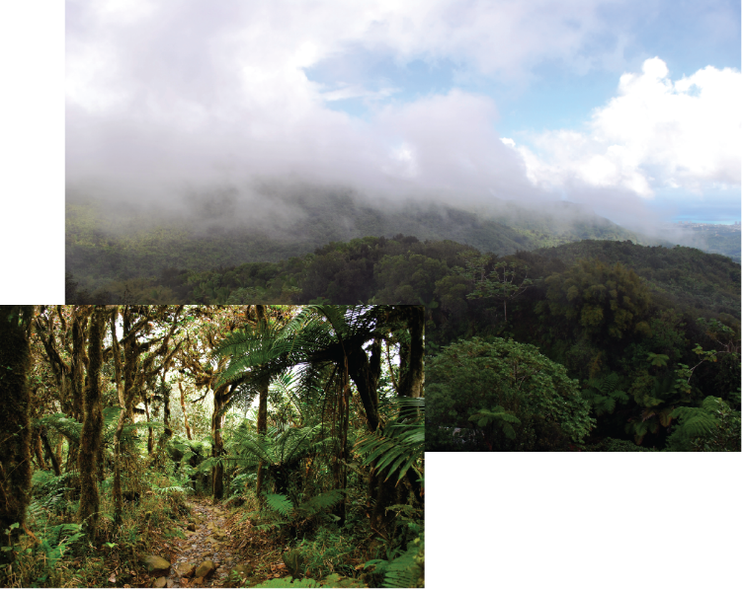
Fig. 20.8: Cloud Forests Are Vulnerable to Climate Change
Ch. 20 | U.S. Caribbean
Tropical montane cloud forests in the Luquillo Mountains of Puerto Rico are characterized by the frequent presence of clouds, reduced tree height, a high number of endemic and endangered species, and high water content of the soil due to reduced sunlight. Cloud forests around the world are vulnerable due to the warming and drying conditions that are expected with climate change.⁵² Cloud forests on low mountains are especially vulnerable, as drying and warming conditions can increase the elevation at which clouds form, thereby reducing or possibly eliminating the cloud cover shrouding the mountain peaks.^{53,54,55} Photo credit: Grizelle González, USDA Forest Service International Institute of Tropical Forestry.
Notes:
52: Dalling, J.W., K. Heineman, G. González, and R.Ostertag, 2016: Geographic, environmental and biotic sources of variation in the nutrient relations of tropical montane forests. Journal of Tropical Ecology, 32 (5), 368-383. http://dx.doi.org/10.1017/S0266467415000619
53: Foster, P., 2001: The potential negative impacts of global climate change on tropical montane cloud forests. Earth-Science Reviews, 55 (1), 73-106. http://dx.doi.org/10.1016/S0012-8252(01)00056-3
54: Lawton, R.O., U.S. Nair, R.A. Pielke, and R.M. Welch, 2001: Climatic impact of tropical lowland deforestation on nearby montane cloud forests. Science, 294 (5542), 584-587. http://dx.doi.org/10.1126/science.1062459
55: Ray, D.K., R.M. Welch, R.O. Lawton, and U.S. Nair, 2006: Dry season clouds and rainfall in northern Central America: Implications for the Mesoamerican Biological Corridor. Global and Planetary Change, 54 (1), 150-162. http://dx.doi.org/10.1016/j.gloplacha.2005.09.004

Slide 16
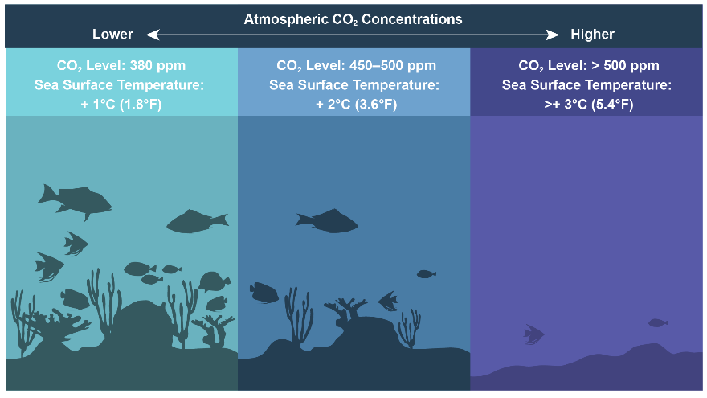
Fig. 20.9: Climate Change Effects on Coral Reefs
Ch. 20 | U.S. Caribbean
The diagram demonstrates how coral reef ecosystems in the U.S. Caribbean are likely to change in potentially warmer and more acidic waters caused by climate change, including elevated sea surface temperatures and elevated carbon dioxide (CO₂) levels. The severity of these impacts increases as CO₂ levels and sea surface temperatures rise. If conditions stabilized with concentrations of atmospheric CO₂ at 380 ppm (parts per million), coral would continue to be carbonate accreting, meaning reefs would still form and have corals. At 450–500 ppm, reef erosion could exceed calcification, meaning that reef structure is likely to erode and coral cover is likely to decline dramatically. Beyond 500 ppm, corals are not expected to survive.⁷⁷ Sources: NOAA and USFS.
Notes:
77: Hoegh-Guldberg, O., P.J. Mumby, A.J. Hooten, R.S. Steneck, P. Greenfield, E. Gomez, C.D. Harvell, P.F. Sale, A.J. Edwards, K. Caldeira, N. Knowlton, C.M. Eakin, R. Iglesias-Prieto, N. Muthiga, R.H. Bradbury, A. Dubi, and M.E. Hatziolos, 2007: Coral reefs under rapid climate change and ocean acidification. Science, 318 (5857), 1737-1742. http://dx.doi.org/10.1126/science.1152509

Slide 17
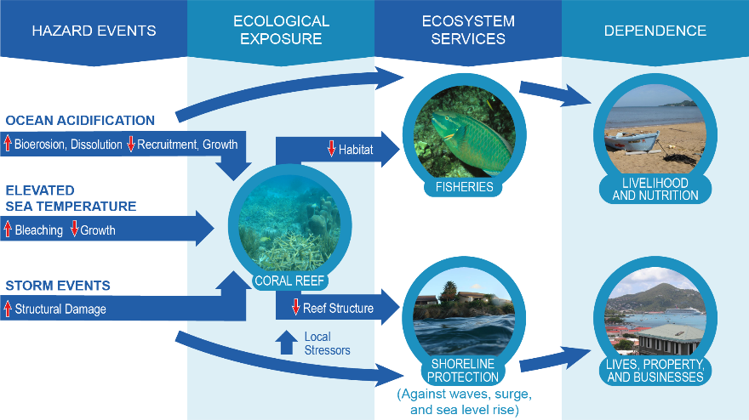
Fig. 20.10: Climate Change Impacts on Coral Reef Ecosystems and Societal Implications
Ch. 20 | U.S. Caribbean
The figure shows the connections between climate-related impacts (ocean acidification and warming as well as severe storms), responses of marine habitats and species to these impacts, and, ultimately, the effects to ecosystem services (such as fisheries and shoreline protection) and, in turn, the human community. Specifically, the figure depicts how degradation of coral reefs due to climate change is expected to affect fisheries and the economies that depend on them as habitat is lost. The figure also shows how reef degradation decreases shoreline protection for local communities, which affects the economy and human populations more generally. Source: adapted from Pendleton et al. 2016.⁷⁸
Notes:
78: Pendleton, L., A. Comte, C. Langdon, J.A. Ekstrom, S.R. Cooley, L. Suatoni, M.W. Beck, L.M. Brander, L. Burke, J.E. Cinner, C. Doherty, P.E.T. Edwards, D. Gledhill, L.-Q. Jiang, R.J. van Hooidonk, L. Teh, G.G. Waldbusser, and J. Ritter, 2016: Coral reefs and people in a high-CO2 world: Where can science make a difference to people? PLOS ONE, 11 (11), e0164699. http://dx.doi.org/10.1371/journal.pone.0164699

Slide 18
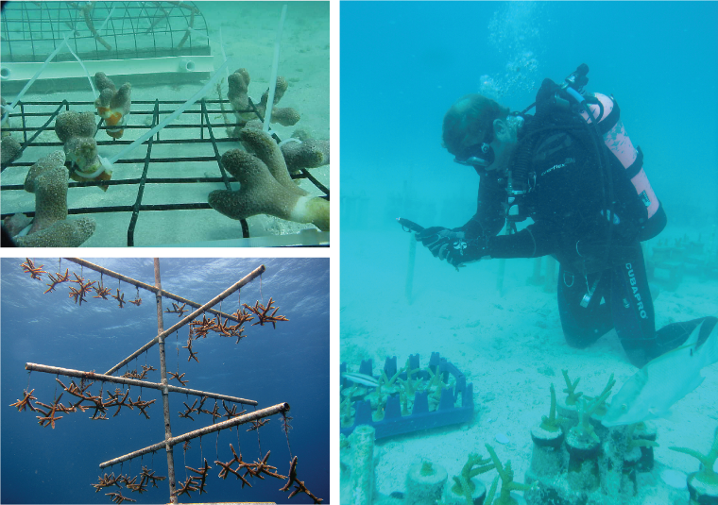
Fig. 20.11: Coral Farming Can Increase the Extent and Diversity of Coral Reefs
Ch. 20 | U.S. Caribbean
Examples of coral farming in the U.S. Caribbean and Florida demonstrate different types of structures used for growing fragments from branching corals. Coral farming is a strategy meant to improve the reef community and ecosystem function, including for fish species. The U.S Caribbean Islands, Florida, Hawai‘i, and the U.S.-Affiliated Pacific Islands face similar threats from coral bleaching and mortality due to warming ocean surface waters and ocean acidification. Degradation of coral reefs is expected to negatively affect fisheries and the economies that depend on them as habitat is lost in both regions. While coral farming may provide some targeted recovery, current knowledge and efforts are not nearly advanced enough to compensate for projected losses from bleaching and acidification. Photo credits: (top left) Carlos Pacheco, USFWS; (bottom left) NOAA; (right) Florida Fish and Wildlife (CC BY-ND 2.0).

Slide 19
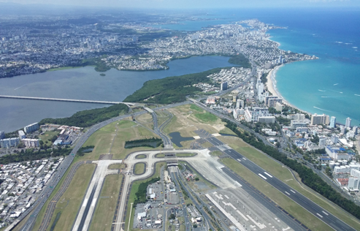
Fig. 20.12: Critical Infrastructure at Risk, San Juan Metro Area
Ch. 20 | U.S. Caribbean
Puerto Rico’s Luis Muñoz Marín (LMM) international airport is already at risk from extreme weather and climate-related events and is expected to become more vulnerable in the future as a result of continuing sea level rise. Photo credit: Ernesto Díaz, Puerto Rico Department of Natural and Environmental Resources.

Slide 20
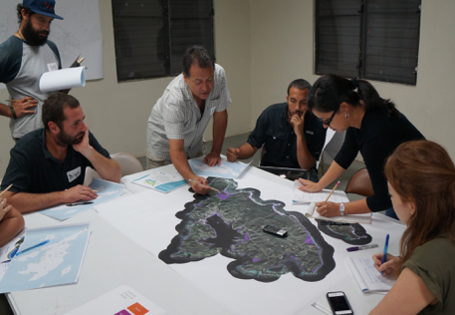
Fig. 20.13: Assessing Vulnerability with Communities
Ch. 20 | U.S. Caribbean
Culebra’s Mayor and community members worked on the participatory maps to identify risks, important natural resources, infrastructure, and important services to the community in Culebra. This exercise allowed them to gather information about issues in the territory that are important to the community but not commonly reflected in maps. Photo credit: Vanessa Marrero, Puerto Rico Department of Natural and Environmental Resources.

Slide 21
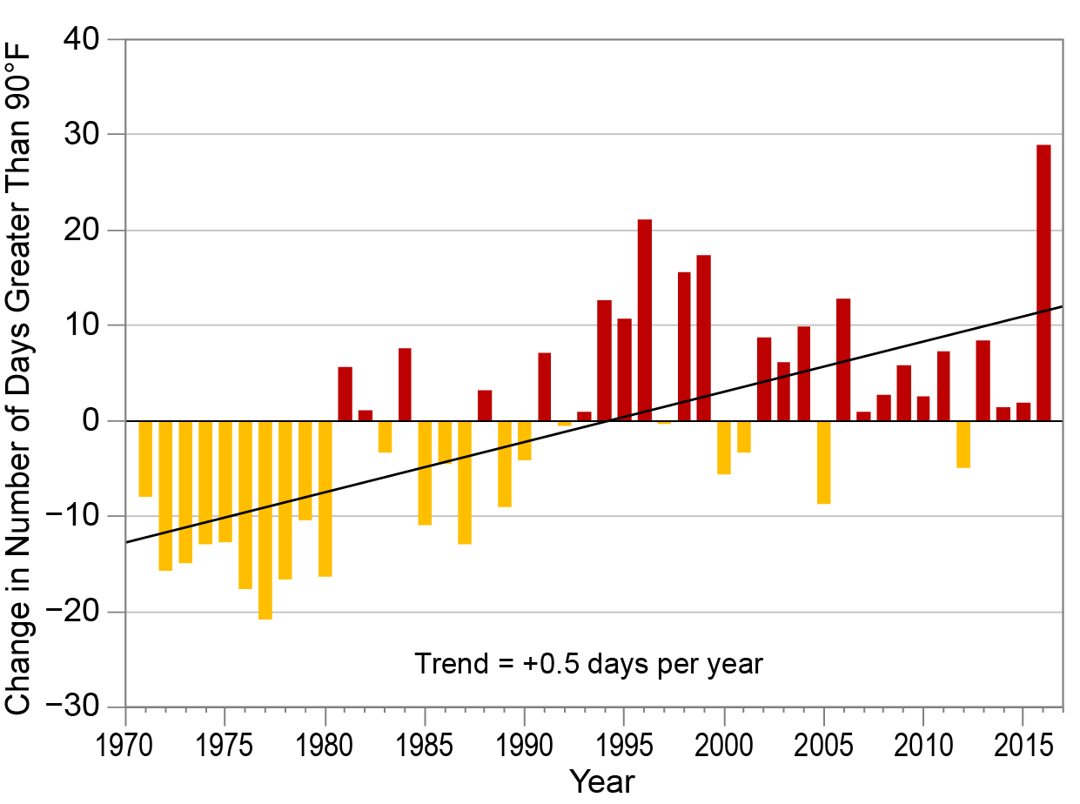
Fig. 20.14: Days Above 90°F in Puerto Rico
Ch. 20 | U.S. Caribbean
This figure illustrates the deviation from the long-term (1971–2016) average annual number of days exceeding 90°F, based on data from eight climate stations in Puerto Rico. Source: University of Puerto Rico.

Slide 22
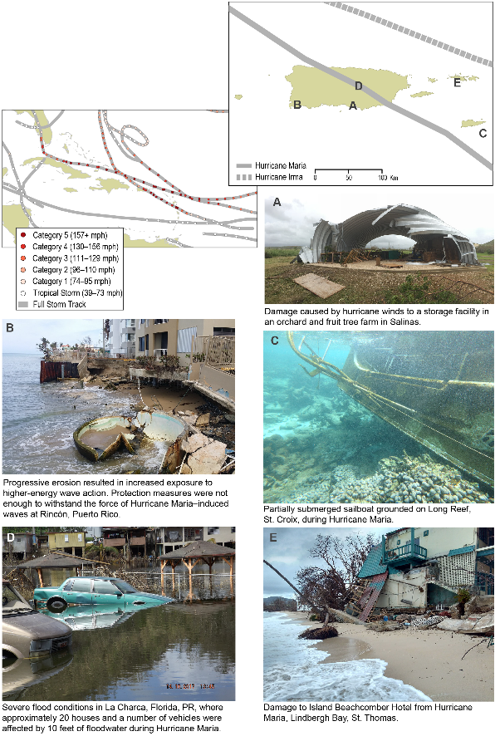
Fig. 20.15: Hurricane Impacts in 2017
Ch. 20 | U.S. Caribbean
In September 2017, the U.S. Caribbean region was impacted by two major hurricanes: Irma (Category 5) and Maria (Categories 4 and 5). This figure shows the hurricanes’ tracks across both the Caribbean and (inset) the U.S. Caribbean region, as well as (A–E) some of the impacts felt throughout the region. Sources: (tropical cyclone tracks) NOAA NCEI and ERT, Inc. Photo credits: (A) Ricardo Burgos; (B) Ernesto Díaz, Puerto Rico DNER; (C) Michael Doig, NOAA; (D) Joel Figuero; (E) Greg Guannel, The University of the Virgin Islands.

Slide 23
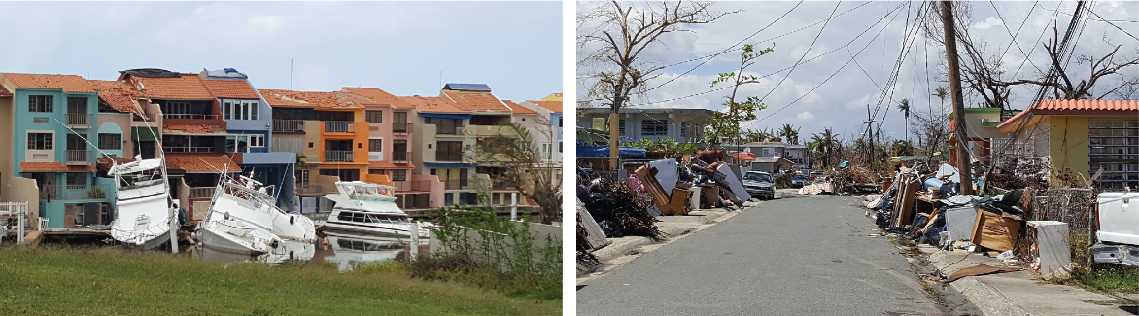
Fig. 20.16: Hurricane Maria Damage
Ch. 20 | U.S. Caribbean
Residential and vessel damages caused by Hurricane Maria in 2017, at (left) Palmas del Mar and (right) Punta Santiago, Humacao, Puerto Rico. Photo credits: (left) Ernesto Díaz, Puerto Rico DNER; (right) Vanessa Marrero, Puerto Rico DNER.

Slide 24
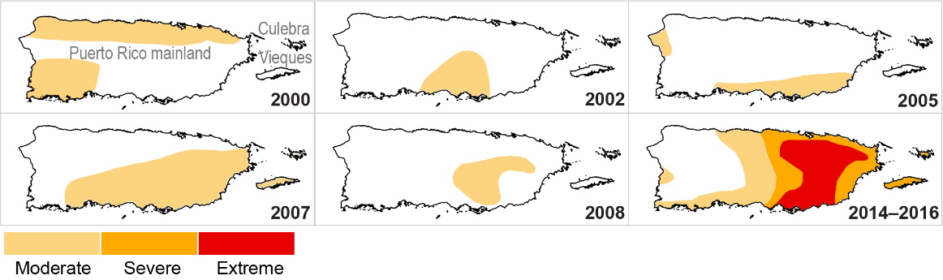
Fig. 20.17: Maximum Extent of Drought
Ch. 20 | U.S. Caribbean
These maps show the maximum extent of each registered drought between 2000 and 2016 by the U.S. Drought Monitor. While six drought events were registered, the most severe of these occurred between 2014 and 2016, with extreme conditions covering the eastern half of the main island of Puerto Rico. The five events prior to 2014 were registered as moderate drought and were short-lived in comparison. Source: U.S. Forest Service.

Slide 25
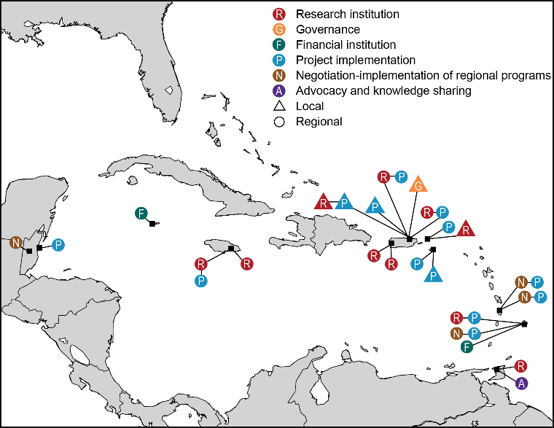
Fig. 20.18: Climate Risk Management Organizations
Ch. 20 | U.S. Caribbean
Some of the organizations working on climate risk assessment and management in the Caribbean are shown. Joint regional efforts to address climate challenges include the implementation of adaptation measures to reduce natural, social, and economic vulnerabilities, as well as actions to reduce greenhouse gas emissions. See the online version of this figure at http://nca2018.globalchange.gov/chapter/20#fig-20-18 for more details. Sources: NOAA and the USDA Caribbean Climate Hub.

Slide 26
Ch. 20 | U.S. Caribbean
20
Chapter Author Team
Federal Coordinating Lead Author
William A. Gould, USDA Forest Service International Institute of Tropical Forestry
Chapter Lead
Ernesto L. Díaz, Department of Natural and Environmental Resources, Coastal Zone Management Program
Chapter Authors
Nora L. Álvarez-Berríos, USDA Forest Service International Institute of Tropical Forestry
Felix Aponte-González, Aponte, Aponte & Asociados
Wayne Archibald, Archibald Energy Group
Jared Heath Bowden, Department of Applied Ecology, North Carolina State University
Lisamarie Carrubba, NOAA Fisheries, Office of Protected Resources
Wanda Crespo, Estudios Técnicos, Inc.
Stephen Joshua Fain, USDA Forest Service International Institute of Tropical Forestry
Grizelle González, USDA Forest Service International Institute of Tropical Forestry

Slide 27
Ch. 20 | U.S. Caribbean
20
Chapter Author Team
Chapter Authors (cont.)
Annmarie Goulbourne, Environmental Solutions Limited
Eric Harmsen, Department of Agriculture and Biosystems Engineering, University of Puerto Rico
Azad Henareh Khalyani, Natural Resource Ecology Laboratory, Colorado State University
Eva Holupchinski, USDA Forest Service International Institute of Tropical Forestry
James P. Kossin, National Oceanic and Atmospheric Administration
Amanda J. Leinberger, Center for Climate Adaptation Science and Solutions, University of Arizona
Vanessa I. Marrero-Santiago, Department of Natural and Environmental Resources, Coastal Zone Management Program
Odalys Martínez-Sánchez, NOAA National Weather Service
Kathleen McGinley, USDA Forest Service International Institute of Tropical Forestry

Slide 28
Ch. 20 | U.S. Caribbean
20
Chapter Author Team
Chapter Authors (cont.)
Melissa Meléndez Oyola, University of New Hampshire
Pablo Méndez-Lázaro, University of Puerto Rico
Julio Morell, University of Puerto Rico
Isabel K. Parés-Ramos, USDA Forest Service International Institute of Tropical Forestry
Roger Pulwarty, National Oceanic and Atmospheric Administration
William V. Sweet, NOAA National Ocean Service
Adam Terando, U.S. Geological Survey, Southeast Climate Adaptation Science Center
Sigfredo Torres-González, U.S. Geological Survey (Retired)
Review Editor
Jess K. Zimmerman, University of Puerto Rico

Slide 29
Ch. 20 | U.S. Caribbean
20
Acknowledgments
Technical Contributors
Mariano Argüelles, Puerto Rico Department of Agriculture
Gabriela Bernal-Vega, University of Puerto Rico
Roberto Moyano, Estudios Técnicos, Inc.
Pedro Nieves, USVI Coastal Zone Management
Aurelio Mercado-Irizarry, University of Puerto Rico
Dominique Davíd-Chavez, Colorado State University
USGCRP Coordinators
Allyza Lustig, Program Coordinator
Apurva Dave, International Coordinator and Senior Analyst
Christopher W. Avery, Senior Manager

Slide 30
Gould, W.A., E.L. Díaz, (co-leads), N.L. Álvarez-Berríos, F. Aponte-González, W. Archibald, J.H. Bowden, L. Carrubba, W. Crespo, S.J. Fain, G. González, A. Goulbourne, E. Harmsen, E. Holupchinski, A.H. Khalyani, J. Kossin, A.J. Leinberger, V.I. Marrero-Santiago, O. Martínez-Sánchez, K. McGinley, P. Méndez-Lázaro, J. Morell, M.M. Oyola, I.K. Parés-Ramos, R. Pulwarty, W.V. Sweet, A. Terando, and S. Torres-González, 2018: U.S. Caribbean. In Impacts, Risks, and Adaptation in the United States: Fourth National Climate Assessment, Volume II [Reidmiller, D.R., C.W. Avery, D.R. Easterling, K.E. Kunkel, K.L.M. Lewis, T.K. Maycock, and B.C. Stewart (eds.)]. U.S. Global Change Research Program, Washington, DC, USA. doi: 10.7930/NCA4.2018.CH20
https://nca2018.globalchange.gov/chapter/caribbean

