Slide 1
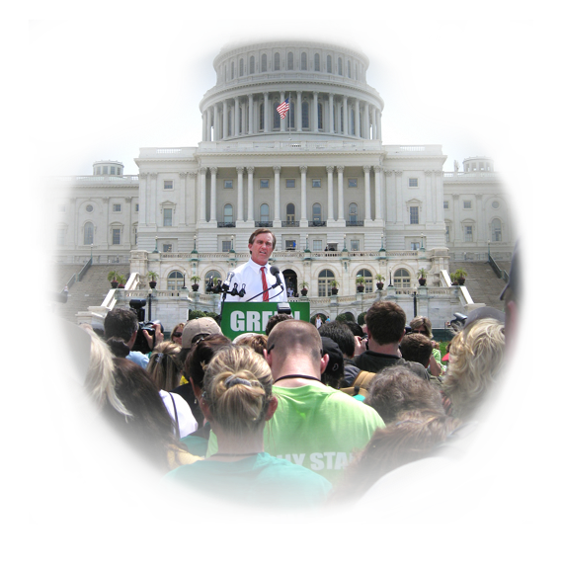
ADVOCACY: STRATEGIES FOR SUCCESS
CHILDREN’S HEALTH DEFENSE
childrenshealthdefense.org

Slide 2
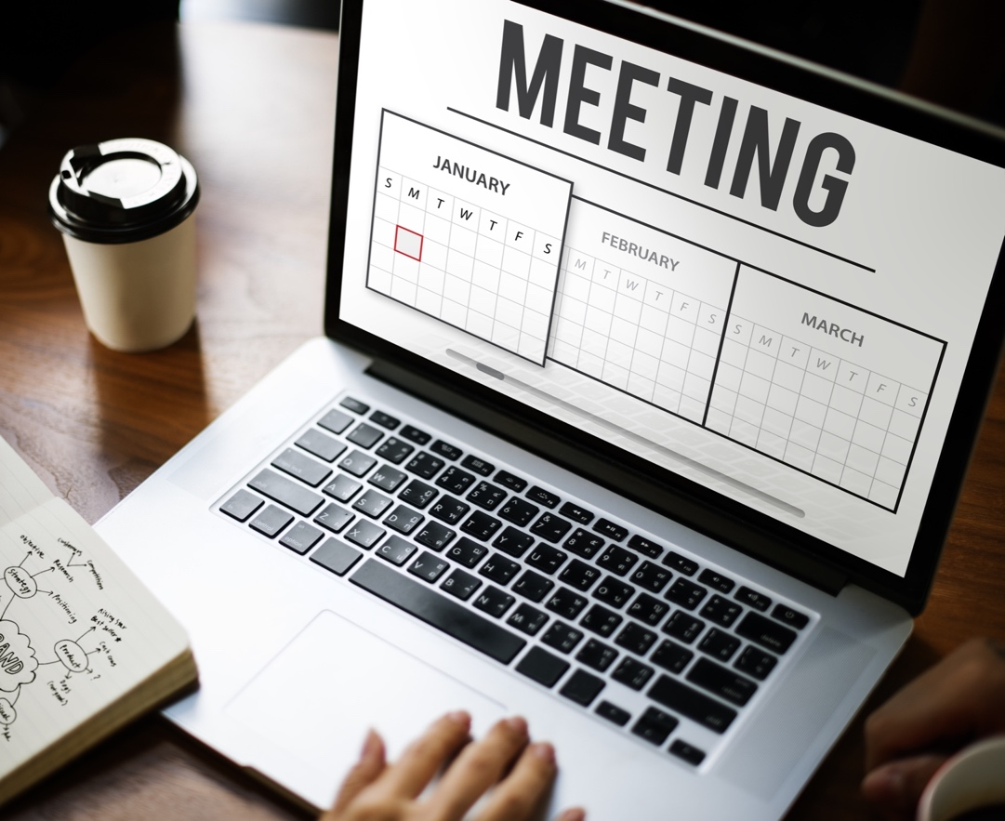
SCHEDULING A SUCCESSFUL MEETING
WHO
Represents you in your state and district? www.congress.gov
DECIDE
How many meetings you can accomplish during your visit.
FOCUS
On members who will be most receptive to your requests initially.

Slide 3
BEFORE YOU MAKE THE CALL
RESEARCH
Do a little community research.
CONNECT
Do you have any personal connections to your member?
NETWORK
Do you have any family or friends who know or work for your member?

Slide 4
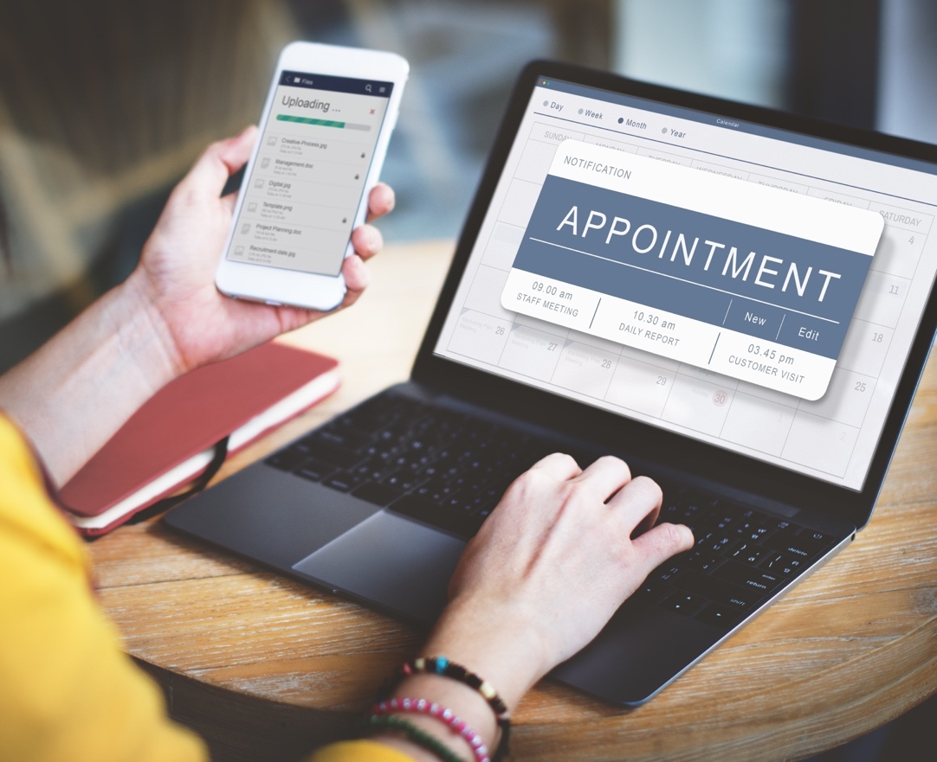
MAKING THE APPOINTMENT
ASK
to speak with the Health Legislative Assistant.
ASK
for a meeting with your member.
IF
The member is not available, meet with the Legislative Assistant.
REMEMBER
to be sure to THANK them for their time!

Slide 5
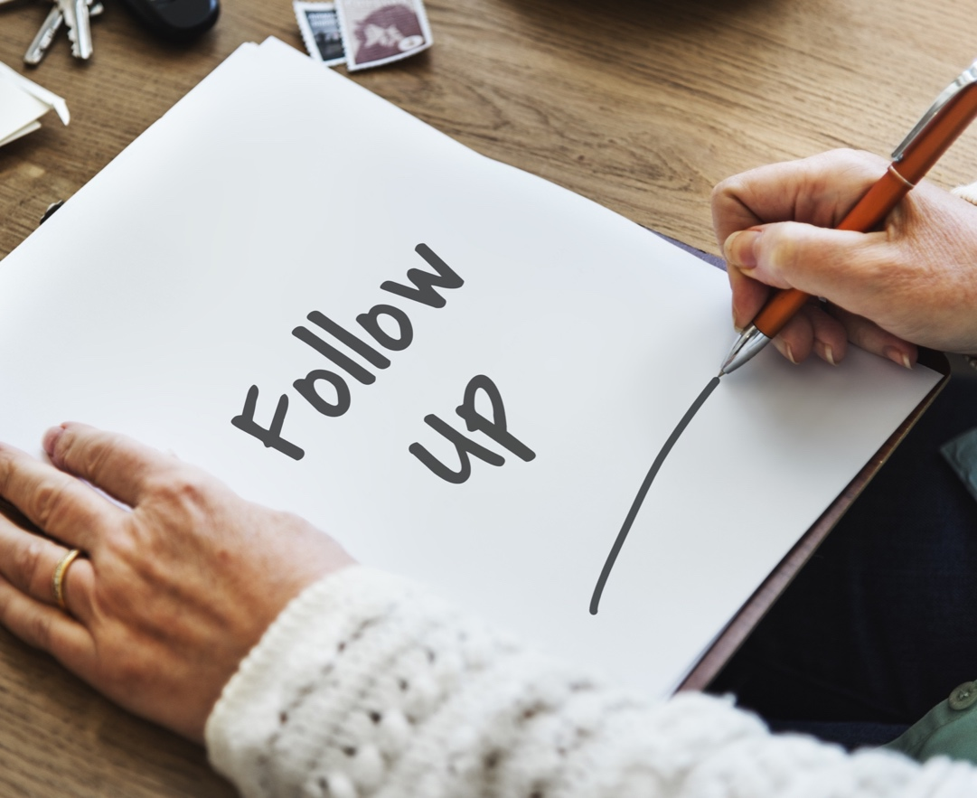
FOLLOW UP
SEND
A follow-up letter confirming your meeting.
INCLUDE
Information about your group and the reason for the meeting and a brief agenda as to what will be discussed.
CLOSE
with a sincere thank you for making the visit possible.

Slide 6
PREPARING FOR THE MEETING
WHAT
Are their views and what issues matter to them the most?
HOW
have they voted in the past?
GO
to www.vote-smart.org/index.htm
REMEMBER
All politics is local. Be sure to include how this issue impacts your state and their constituents.

Slide 7
ORGANIZING YOUR GROUP
INTIMATE
Keep it small, no more than 5 people.
FOCUS
Develop talking points to keep the meeting focused.
LEAD
Decide on the groups spokesperson to lead the discussion and keep the meeting on track.

Slide 8
ORGANIZING YOUR PRESENTATION
MESSAGE
Develop your message around your “ask”.
AGENDA Create an agenda for the meeting.
TIMING
Most meetings are 30 minutes, so keep your presentation to 20 minutes.
WRAP-UP
Be sure to leave time for questions and informal discussion.

Slide 9
WHAT TO BRING
MARKETING MATERIALS
Brochures, fact sheets, articles and handouts organized in a folder for both the LA and member.
BUSINESS CARDS + PAPER Be sure to have a note pad and business cards available.
CAMERA
A camera is a must! Ask to take a picture with your representative.

Slide 10
BEFORE THE MEETING
BE SEEN
Secure media coverage for your visit.
GET NOTED Send out a local press release.
CONFIRM
Call the day before to confirm and get directions.
PUNCTUALITY Arrive early and be gracious.

Slide 11
ATTENDING THE MEETING
INTRODUCTIONS
Introduce yourself, team and your member.
SHARE Share personal story.
TALKING POINTS
Present talking points and be prepared to answer questions.
FOLLOW-UP Ask how to best follow-up on the issue.

Slide 12
AFTER THE MEETING
SUMMARIZE
Send a thank-you letter summarizing the meeting and next steps.
CULTIVATE Maintain your relationship with the member or LA.
STAY IN TOUCH Add them to your mailing list and keep them current on your issue.
COMMIT Try to attend local events for your member to show your commitment.

Slide 13
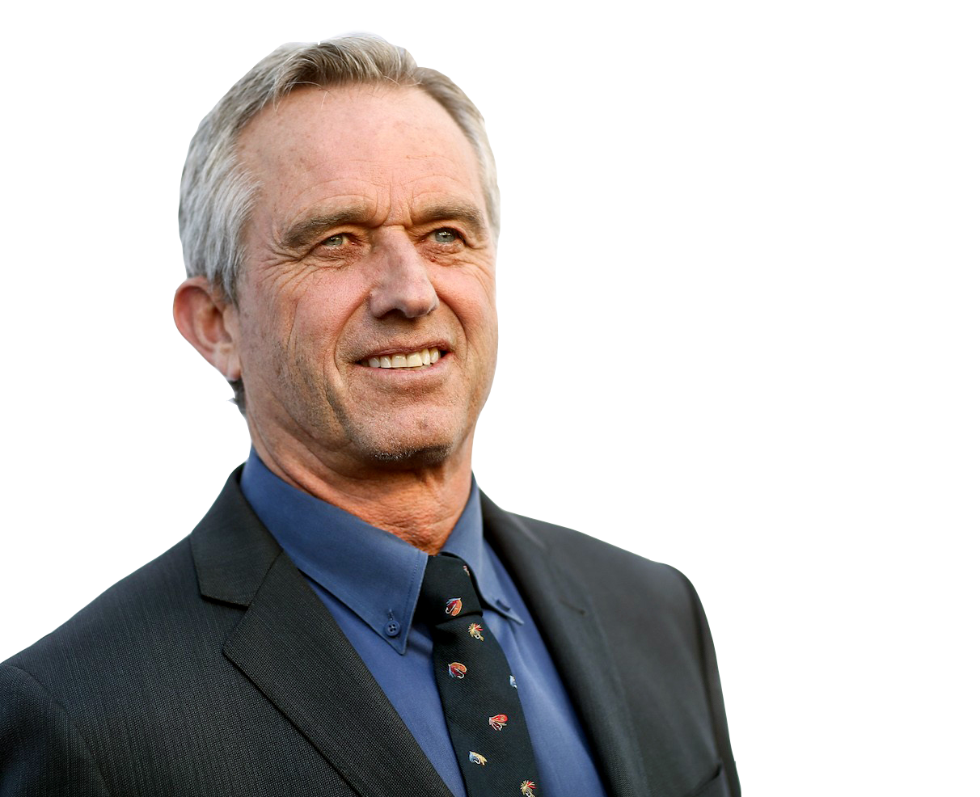
THANK YOU, KEEP IN TOUCH, JOIN THE MOVEMENT
“We want robust and transparent science, independent and honest regulators, safe vaccines and healthy children.”
Robert F. Kennedy, Jr.
Children’s Health Defense 1227 North Peachtree Pkwy, Suite 202 Peachtree City, GA 30290 PH 202-810-1826 http://childrenshealthdefense.org/ Team@childrenshealthdefense.org

